Slide 1
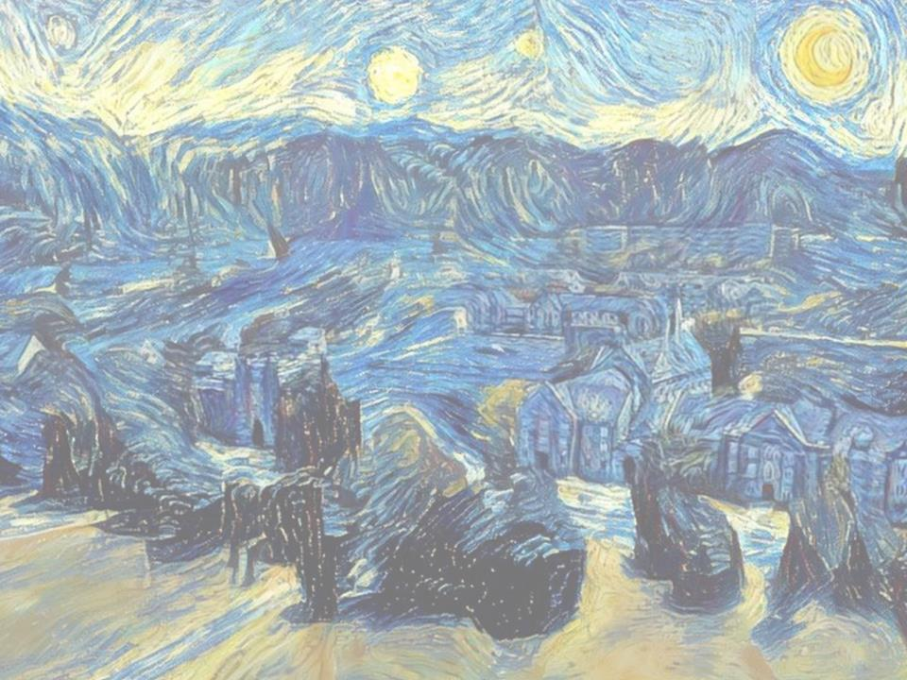
DigSite
#3
What Happened
to the River?

Slide 2
Joshua
3:1-17

Slide 3

Hide it in your
Joshua 1:9

Slide 4
Have I not commanded you?
Be strong and courageous.
Do not be afraid;
do not be discouraged,
for the LORD your God
will be with you
wherever you go.
Joshua 1:9

Slide 5
Hide it in your
Acts 10:34-35

Slide 6
Then Peter began to speak:
I know realize
how true it is that God does not show favoritism
but accepts from every nation
the one who fears him
and does what is right
Acts 10:34-35

Slide 7
Hide it in your
Joshua 3:5

Slide 8
Joshua told the people
"Consecrate yourselves,
for tomorrow
the LORD will do amazing things
among you."
Joshua 3:5
DS#3

Slide 9
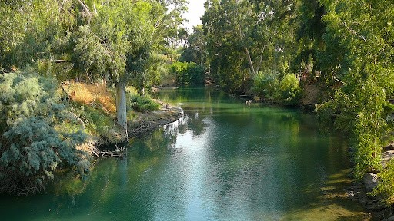
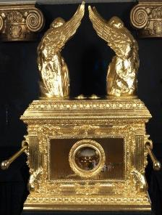
Joshua
3:1-17
Early in the morning Joshua and all the Israelites set out from Shittim and went to the Jordan, where they camped before crossing over.

Slide 10
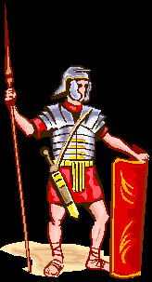
After three days the officers went throughout the camp, giving orders to the people:
When you see the ark of the covenant of the LORD your God, and the Levitical priests carrying it, you are to move out from your positions and follow it.

Slide 11
Then you will know which way to go, since you have never been this way before.

Slide 12

2000 cubits
which is about
3000 feet or 900 meters
But keep a distance of about two thousand cubits between you and the ark; do not go near it.

Slide 13
Joshua told the people
"Consecrate yourselves,
for tomorrow
the LORD will do amazing things
among you."
Joshua 3:5
DS#3

Slide 14
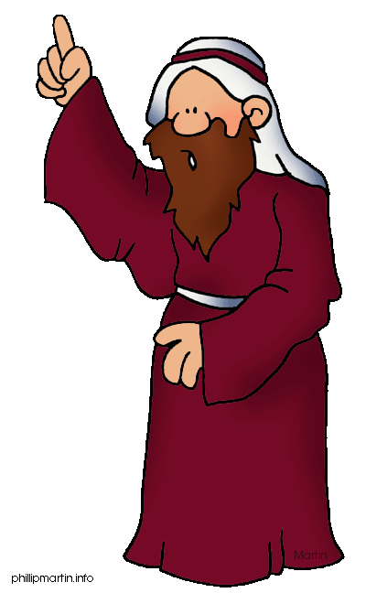
Joshua said to the priests,
Take up the ark of the covenant and pass on ahead of the people.

Slide 15
So they took it up and went ahead of them.

Slide 16
And the LORD said to Joshua,
"Today I will begin to exalt you in the eyes of all Israel,

Slide 17
And the LORD said to Joshua,
"Today I will begin to exalt you in the eyes of all Israel,
so they may know that I am with you
as I was with Moses.

Slide 18
Come here and listen to the words of the LORD your God.
Joshua said to the Israelites,

Slide 19
This is how you will know that the living God is among you and that he will certainly drive out before you the Canaanites, Hittites, Hivites, Perizzites, Girgashites, Amorites and Jebusites.

Slide 20
See,
the ark of the covenant
of the Lord of all the earth will go into the Jordan ahead of you.

Slide 21

Now then, choose 12 men from the tribes of Israel, one from each tribe.
Reuben
Simeon
Levi
Judah
Issachar
Zebulun
Benjamin
Dan
Naphtali
Gad
Asher
Joseph (E&M)
Jacob’s
(Israel’s)
sons
Notes:
21

Slide 22
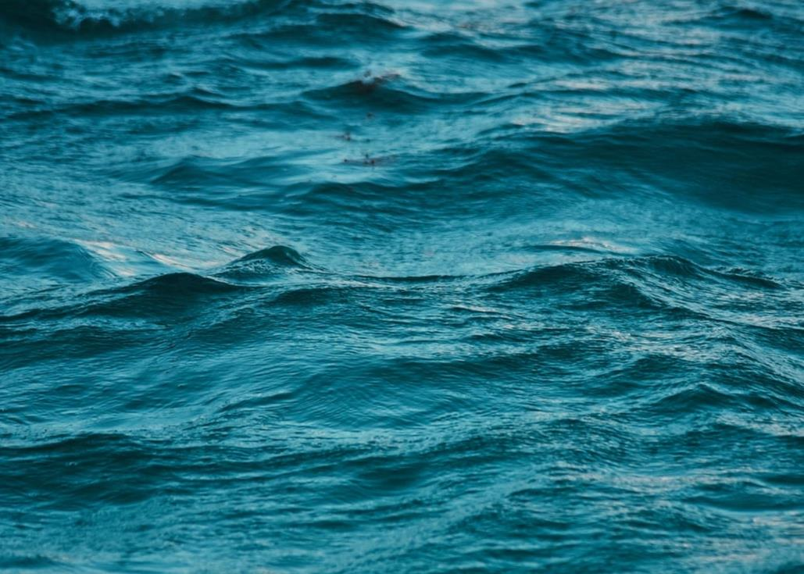
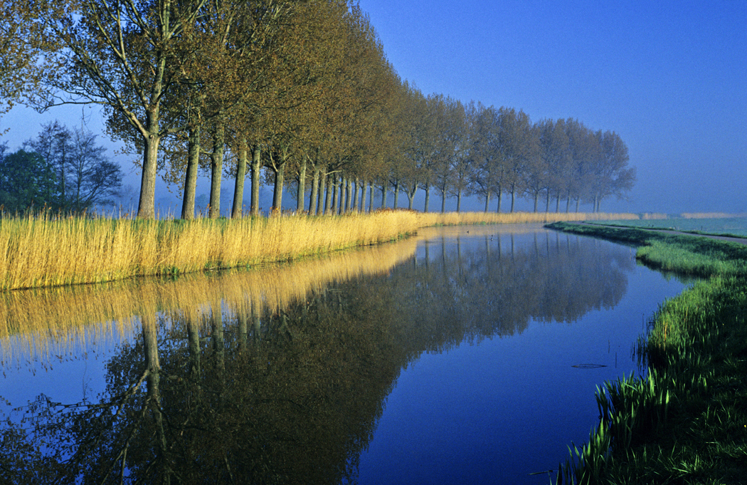
And as soon as the priests who carry the ark of the LORD - the Lord of all the earth - set foot in the Jordan, its waters flowing downstream will be cut off and stand up in a heap.

Slide 23
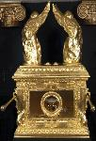
So when the people broke camp to cross the Jordan, the priests carrying the ark of the covenant went ahead of them.
2000 cubits

Slide 24
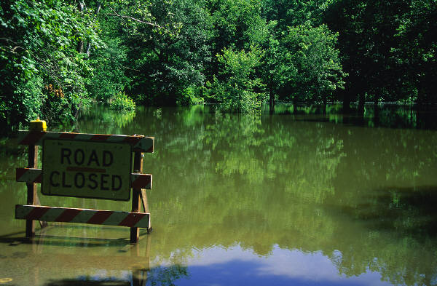
Now the Jordan is at flood stage all during harvest.

Slide 25
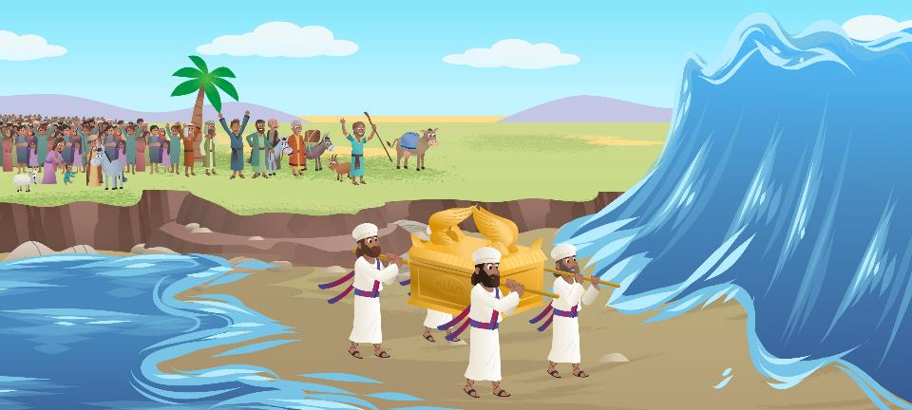
Yet as soon as the priests who carried the ark reached the Jordan and their feet touched the water's edge, the water from upstream stopped flowing.

Slide 26
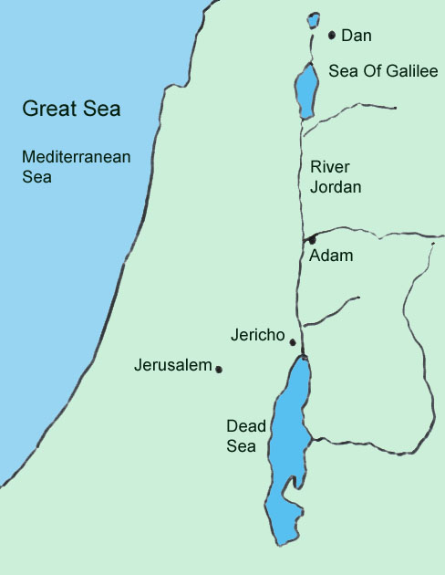
It piled up in a heap a great distance away, at a town called Adam* in the vicinity of Zarethan,

Slide 27
while the water flowing down to the Sea of the Arabah
(that is the Dead Sea*)
was completely cut off.

Slide 28
So the people crossed over opposite Jericho.

Slide 29

The priests who carried the ark of the covenant of the LORD stopped in the middle of the Jordan and stood on dry ground,

Slide 30
while all Israel passed by until the whole nation had completed the crossing on dry ground.

Slide 31
To set apart
FAITH WORDS
Consecrate
Sanctify
#3

Slide 32
People from the tribe of Levi who helped the priests with their duties
People
Levites
#3

Slide 33
Descendants of the Levite Aaron whom God chose to be the worship leaders of Israel and serve in the Tabernacle
People
Priests
#3

Slide 34
A town about 15-20 miles upriver from where the Israelites crossed the Jordan
Places
Adam
in the vicinity of Zarethan
#3

Slide 35
The Dead Sea
Places
Sea of Arabah
#3

Slide 36
Every year at early summer harvest it was flooded from the spring rain, making it deeper, wider and with a strong current.
Terms
Flood Stage
of the Jordan
#3

Slide 37
A distance of about 18 inches
Terms
Cubit
#3

Slide 38
In ancient Israel, priests often carried the ark of the covenant into battle. They marched ahead of the warriors as a symbol of God leading Israel into battle.
Did you know?
#3

