Slide 1
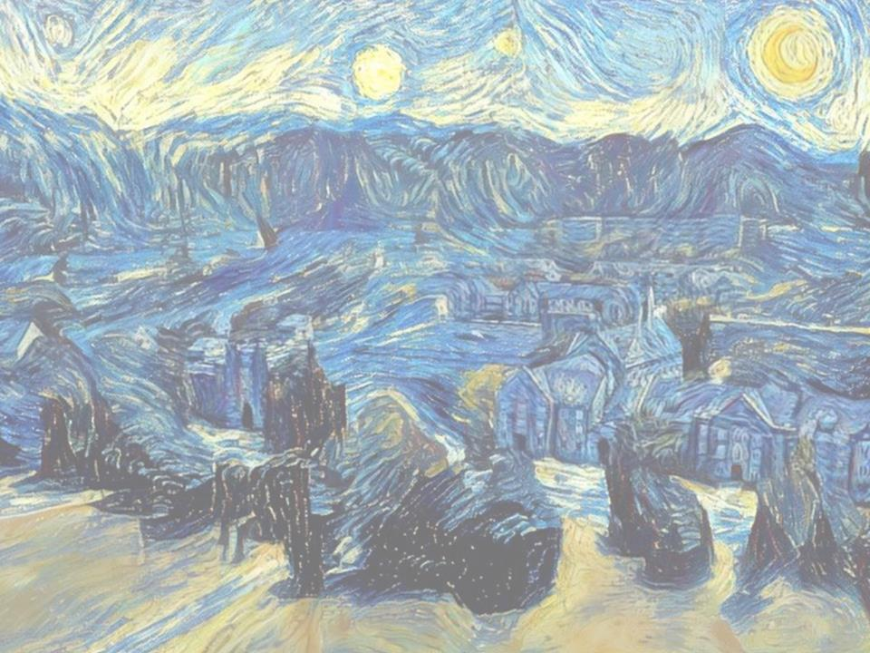
DigSite
#2
Don’t Be Afraid

Slide 2
Joshua 2:1-24
DigSite # 2

Slide 3

Hide it in your
Have I not commanded you?
Be strong and courageous.
Do not be afraid;
do not be discouraged,
for the LORD your God
will be with you
wherever you go.
Joshua 1:9

Slide 4
Hide it in your
Then Peter began to speak:
I know realize
how true it is that God does not show favoritism
but accepts from every nation
the one who fears him
and does what is right
Acts 10:34-35

Slide 5
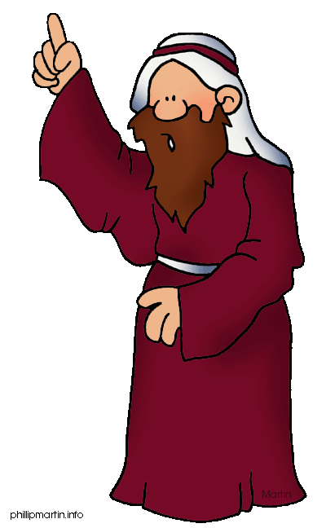
Then Joshua son of Nun secretly
sent two spies from Shittim.
SPY 1
SPY 2

Slide 6
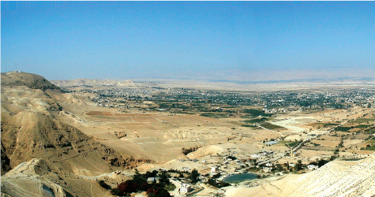

Go, look over the land, especially Jericho.
SPY 1
SPY 2

Slide 7
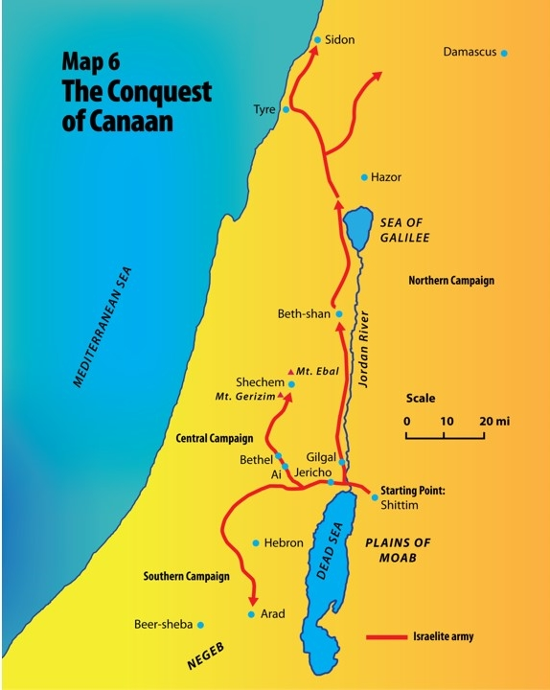

Slide 9
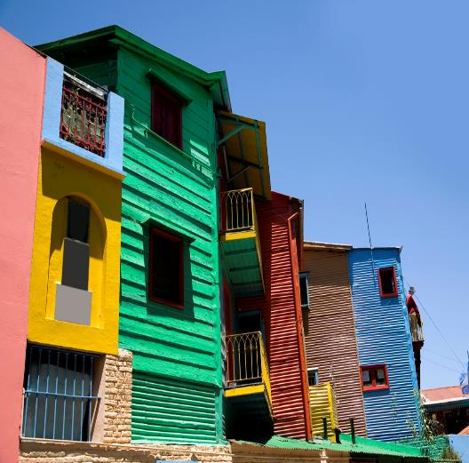
So they went and entered the house of a prostitute named Rahab and stayed there.

Slide 10
The king of Jericho was told,
Look! Some of the Israelites have
come here tonight to spy out the land.

Slide 11

So the king of Jericho sent this message to Rahab:
Bring out the men who came to you
and entered your house, because they
have come to spy out the whole land.

Slide 12
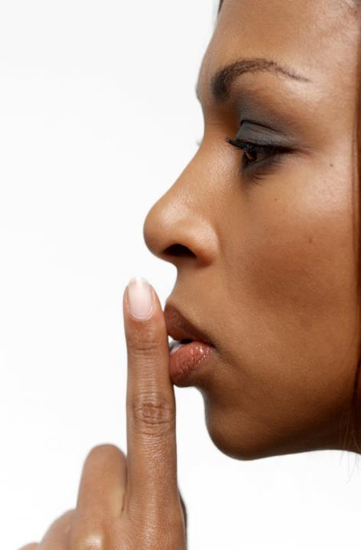
But the woman
had taken the two men
and hidden them.

Slide 13

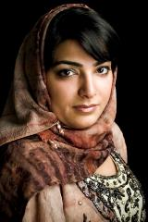
She said,
Yes, the men came to me, but I did not know where they had come from.

Slide 14
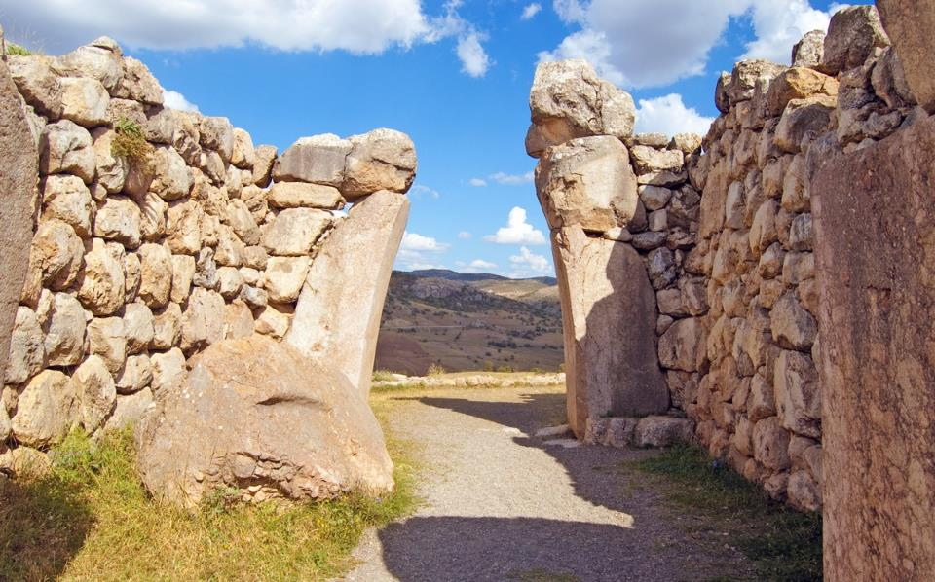
At dusk, when it was time to close the city gate, they left.

Slide 15
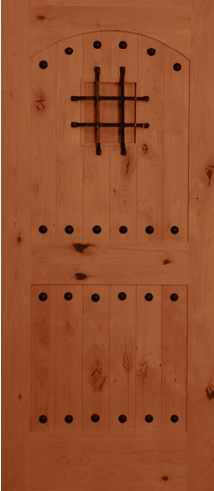
I don't know which way they went.

Slide 16
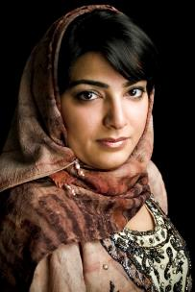
Go after them quickly.
You may catch up with them.

Slide 17

(But she had taken them up to the roof

Slide 18
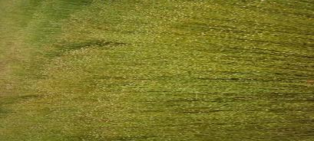
And hidden them under the stalks of flax she had laid out on the roof.)

Slide 19

Did You Know?
Flax is a tall plant used to make cloth and paper and is healthy to eat…but don’t eat your clothes!!!

Slide 20
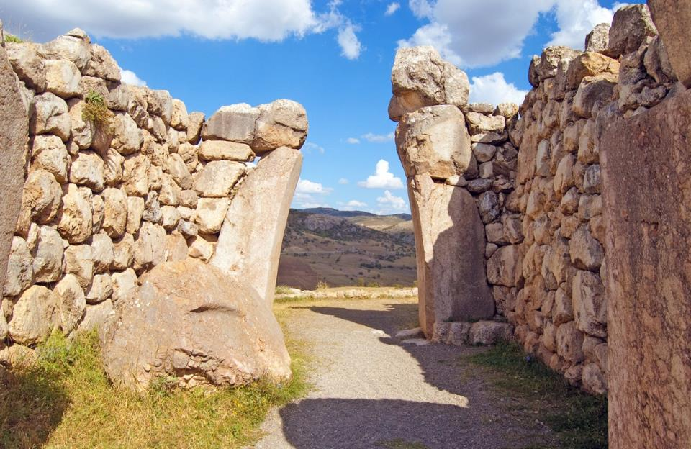
So the men set out in pursuit of the spies on the road that leads to the fords of the Jordan,

Slide 21
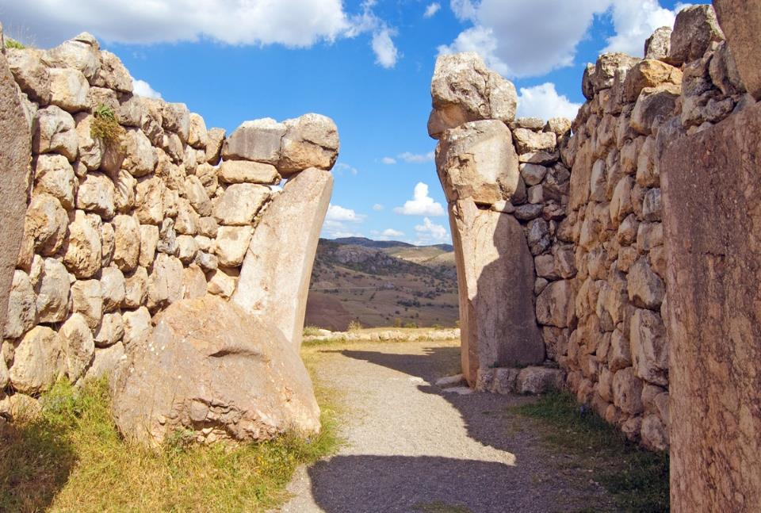
and as soon as the pursuers had gone out, the gate was shut.

Slide 22
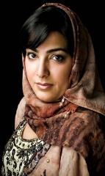
Before the spies lay down for the night, she went up on the roof and said to them,

Slide 23

I know that the LORD has given you this land and that a great fear of you has fallen on us,

Slide 24
so that all who live in this country are melting in fear because of you.

Slide 25

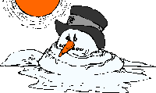

Slide 26
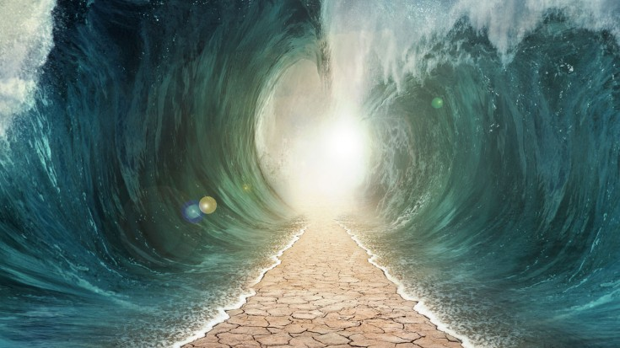
We have heard how the
LORD dried up the water of the Red Sea for you when you came out of Egypt,

Slide 27
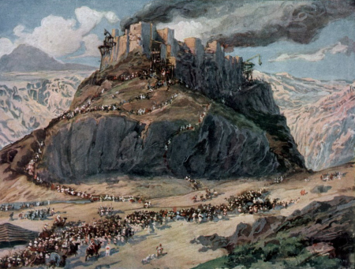
and what you did to Sihon and Og, the two kings of the Amorites east of the Jordan, whom you completely destroyed.

Slide 28


When we heard of it, our hearts melted and everyone's courage failed because of you,

Slide 29
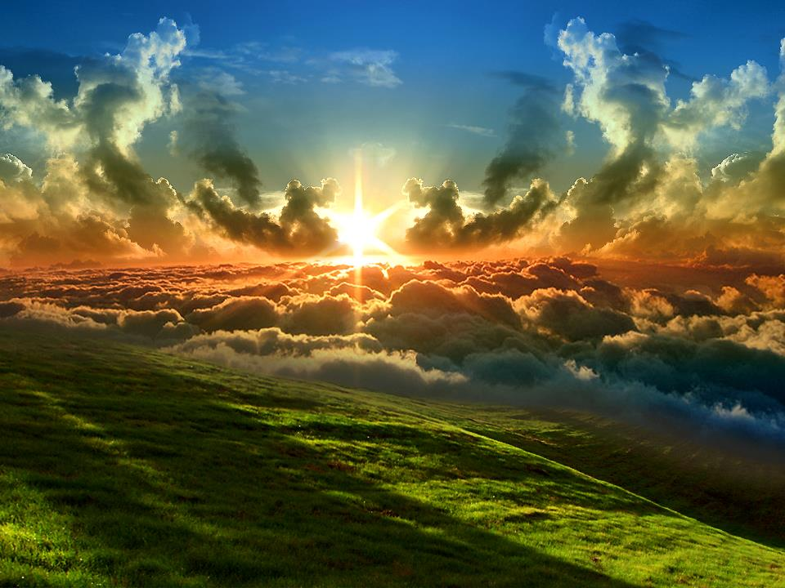
for the LORD your God is God in
heaven above and on the earth below.

Slide 30
Now then, please swear to me by the LORD that you will show kindness to my family, because I have shown kindness to you.

Slide 31

Give me a sure sign that you will spare the lives of my father and mother, my brothers and sisters, and all who belong to them, and that you will save us from death.

Slide 32

Give me a sure sign that you will spare the lives of my father and mother, my brothers and sisters, and all who belong to them, and that you will save us from death.

Slide 33


“Our lives for your lives!"
the men assured her.

Slide 34
If you don't tell what we are doing, we will treat you kindly and faithfully when the LORD gives us the land.

Slide 35




So she let them down by a rope through the window, for the house she lived in was part of the city wall.

Slide 36
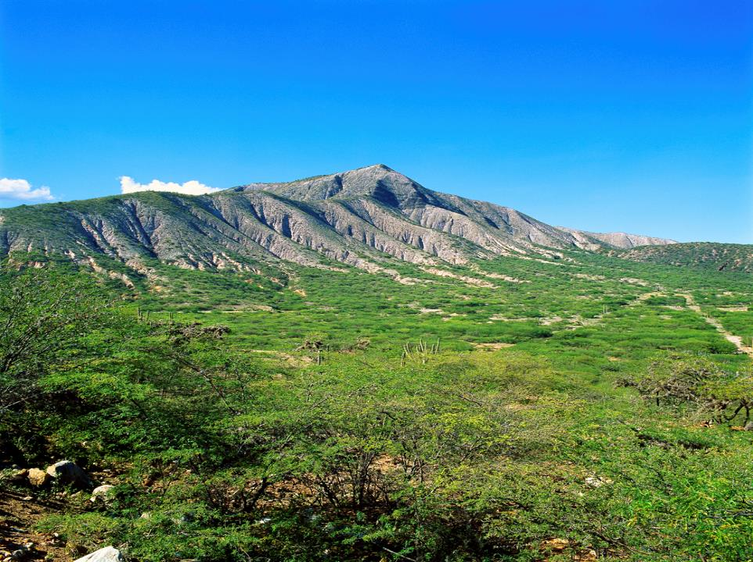
She said to them,
Go to the hills so the pursuers will not find you. Hide yourselves there three days until they return, and then go on your way.

Slide 37

Now the men
had said to her,
This oath you made us swear
will not be binding on us unless, when we enter the land, you have tied this scarlet cord* in the window through which you let us down,

Slide 38

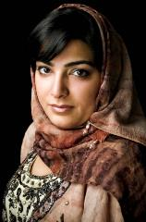
and unless you have brought your father and mother, your brothers and all your family into your house.

Slide 39

If any of them go outside your house into the street,* their blood will be on their own heads; we will not be responsible.
As for those who are in the house with you, their blood will be on our head if a hand is laid on them.

Slide 40
But if you tell what we are doing, we will be released from the oath you made us swear.

Slide 41
Agreed.
Let it be as you say.

Slide 42
So she sent them away, and they departed.

Slide 43


And she
tied the
scarlet cord
in the
window.

Slide 44
When they left, they went into the hills and
stayed there three days, until the pursuers had searched all along the road and returned without finding them.

Slide 45
When they left, they went into the hills and
stayed there three days, until the pursuers had searched all along the road and returned without finding them.

Slide 46
Then the two men started back. They went down out of the hills, forded the river and came to Joshua son of Nun and told him everything that had happened to them.

Slide 47
They said to Joshua,
The LORD has surely given the whole land
into our hands; all the people are melting in fear because of us.

