Slide 1
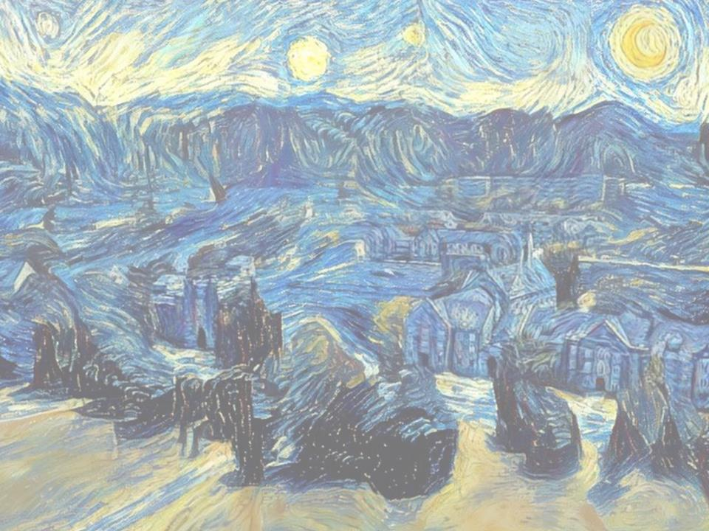
DigSite
#1
Don’t Be Afraid

Slide 2
Joshua 1:1-18
DigSite # 1

Slide 3
Lesson #1

Slide 4
What does it mean to forsake?
To reject or turn away from
????????????????
????????????????
If your friend had to stay in the gym and you left her to play in the sanctuary, would that be forsaking?

Slide 5
What does it mean to forsake?
To reject or turn away from
????????????????
If your friend had to stay in the gym and you left her to play in the sanctuary, would that be forsaking?

Slide 6
What does it mean to forsake?
To reject or turn away from
If your friend had to stay in the gym and you left her to play in the sanctuary, would that be forsaking?

Slide 7
Forsake?
To reject or turn away from
If your sister wanted to play with you and the big kids and you sent her back to Mom, would that be forsaking?

Slide 8
Forsake?
To reject or turn away from
If God asked you to play with the new boy who came to children’s church, and you ignored him, would that be forsaking?

Slide 9
Forsake?
To reject or turn away from
If God asked you to obey your parents every day, and you did, would that be forsaking?

Slide 10
Able to stand against fear, danger or difficulty; brave
COURAGEOUS

Slide 11
Which one of these people is courageous?
1. A boy who comes to quizzing even though he is afraid
2. A girl who doesn’t obey her mom because she wants to do something else
3. A child who goes to church with his friends just like every Sunday

Slide 12
Which one of these people is courageous?
1. A boy who comes to quizzing even though he is afraid
2. A girl who doesn’t obey her mom because she wants to do something else
3. A child who goes to church with his friends just like every Sunday

Slide 13
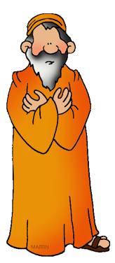
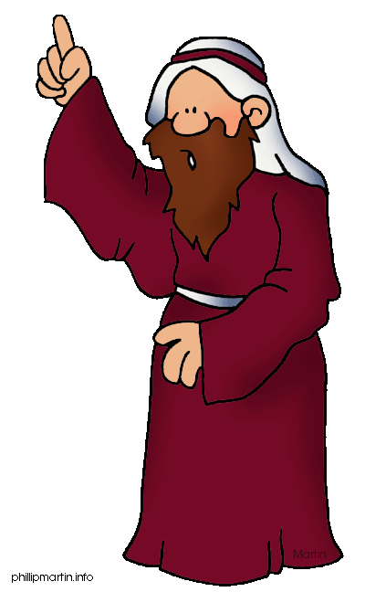
After the death of Moses the servant of the LORD, the LORD said to Joshua son of Nun, Moses' aide:
Joshua

Slide 14
After the death of Moses the servant of the LORD, the LORD said to Joshua son of Nun, Moses' aide:
Joshua

Slide 15
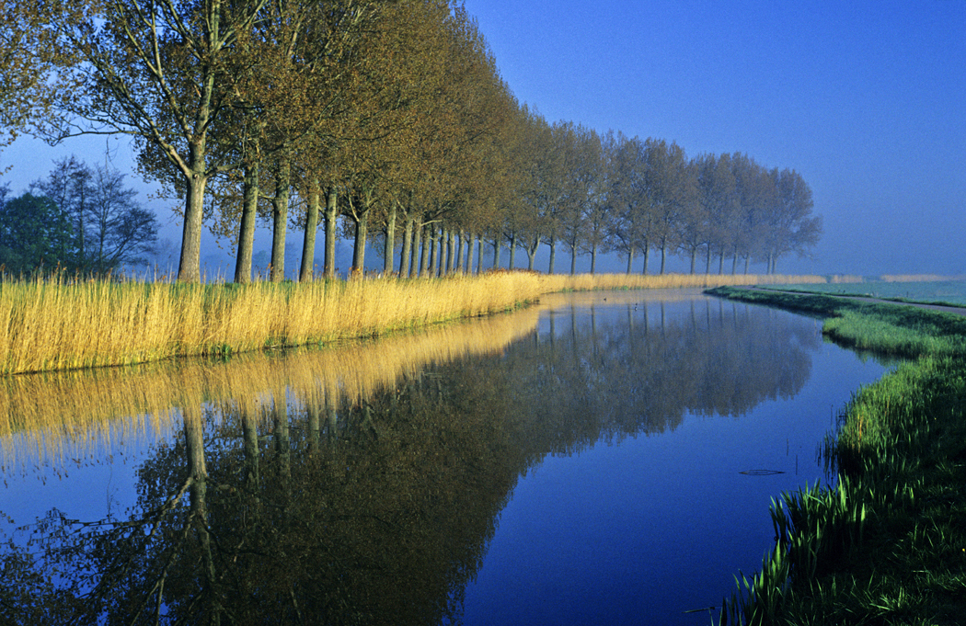
Moses my servant is dead. Now then,
you and all these people, get ready to cross the
Jordan River into the land I am about
to give to them—to the Israelites.

Slide 16
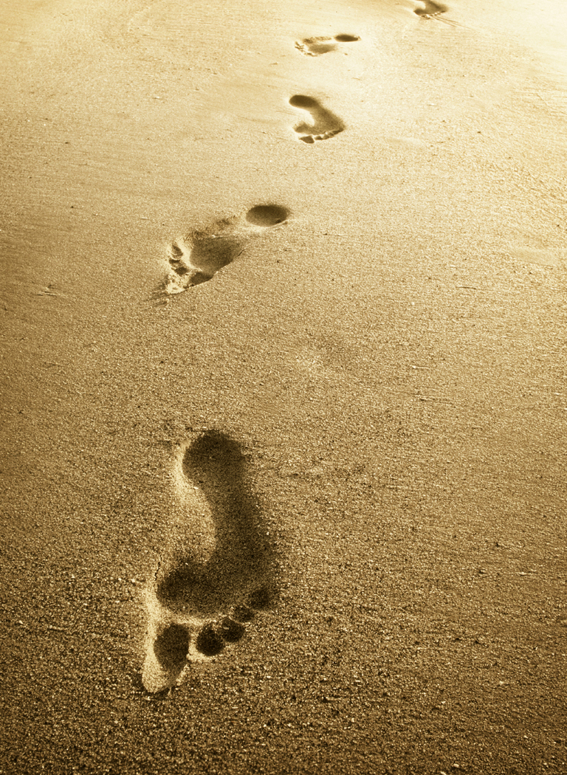
I will give you every place
where you set your foot,
as I promised Moses.

Slide 17
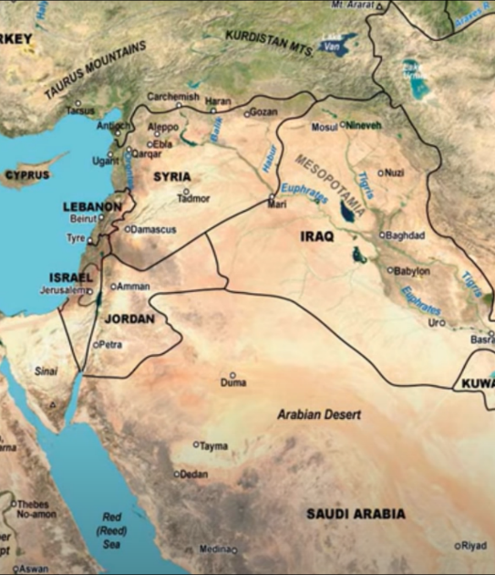
Your territory will extend from the desert to Lebanon, and from the great river, the Euphrates - all the Hittite country - to the Mediterranean Sea in the west.
EGYPT

Slide 18
Your territory will extend from the desert to Lebanon, and from the great river, the Euphrates - all the Hittite country - to the Mediterranean Sea in the west.
EGYPT

Slide 19
Your territory will extend from the desert to Lebanon, and from the great river, the Euphrates - all the Hittite country -to the Mediterranean Sea in the west.
EGYPT

Slide 20
No one will be able to stand against you all the days of your life.

Slide 21
As I was with Moses, so I will be with you; I will never leave you nor forsake you.

Slide 22
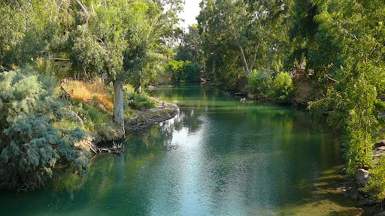
Be strong and courageous, because you will lead these people to inherit the land I swore to their ancestors to give them.

Slide 23
Be strong and very courageous. Be careful to obey all the law my servant Moses gave you; do not turn from it to the *right or to the *left,
that you may be successful wherever you go.

Slide 24
Be strong and very courageous. Be careful to obey all the law my servant Moses gave you; do not turn from it to the *right or to the *left,
that you may be successful wherever you go.

Slide 25
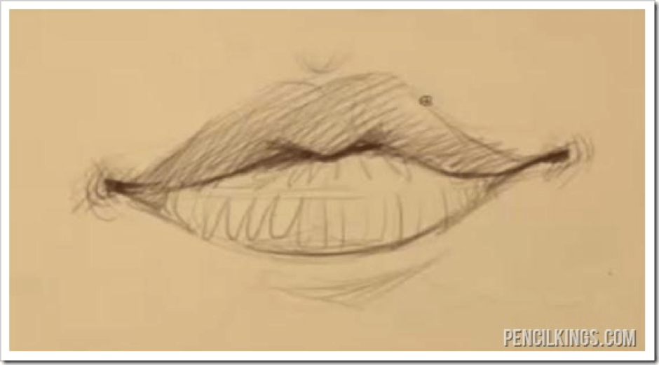
Keep this Book of the Law always on your lips;

Slide 26


meditate on it day and night, so that you may be careful to do everything written in it.

Slide 27

Then you will be prosperous and successful.

Slide 28
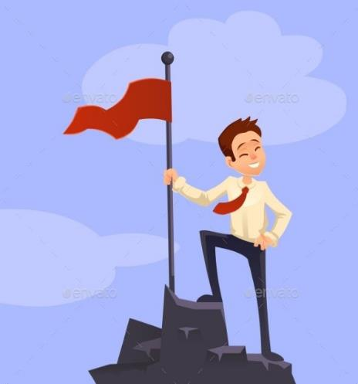
Then you will be prosperous and successful.

Slide 29
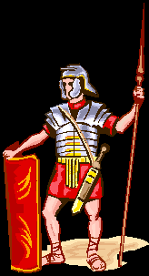
So Joshua ordered the officers of the people:
Go through the camp and tell the people, “Get your provisions ready.”*

Slide 30
So Joshua ordered the officers of the people:
Go through the camp and tell the people, “Get your provisions ready.”*

Slide 31
Have I not commanded you?
Be strong and courageous.
Do not be afraid;
do not be discouraged,
for the LORD your God
will be with you
wherever you go.
Joshua 1:9
DS#1

Slide 32
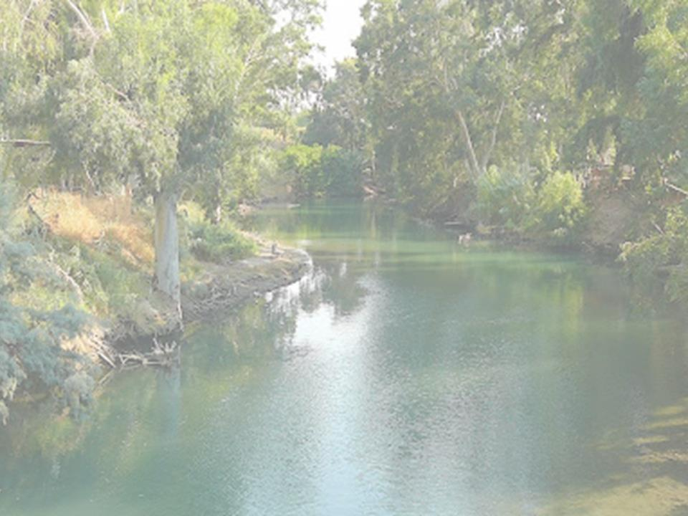
3 days
from now you will
cross the Jordan
here

Slide 33
to go in and
take possession of the
land the LORD your God
is giving YOU
for your own.

Slide 34
But to the
the
the
Reubenites,
Gadites, and
half-tribe of Manasseh,
Joshua said,
"Remember the command that Moses the servant of the LORD gave you after he said:

Slide 35
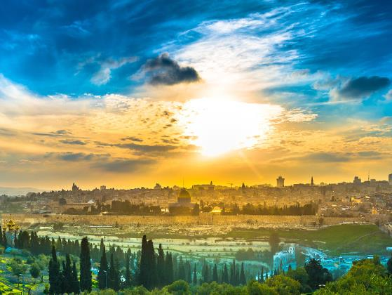
The LORD your God will give you rest by giving you this land.

Slide 36
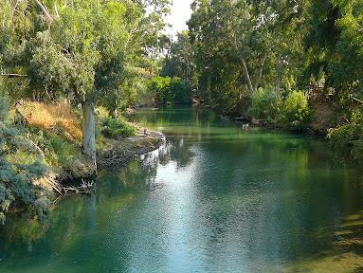
Your wives, your children and your livestock may stay in the land that Moses gave you east of the Jordan,

Slide 37
but all your fighting men,
ready for battle, must cross over ahead of your fellow Israelites.

Slide 38
You are to help them until the LORD gives them rest, as he has done for you, and until they too have taken possession of the land the LORD your God is giving them.

Slide 39
After that, you may go back and
occupy your own land,

Slide 40
which Moses the servant
of the LORD gave you east
of the Jordan toward the
sunrise.

Slide 41
Then they answered Joshua,
Just as we fully obeyed Moses, so we will obey you.

Slide 42
Then they answered Joshua,
Whatever you have commanded us we will do

Slide 43
Then they answered Joshua,
and wherever you send us we will go.

Slide 44
Only may the LORD your God be with you as he was with Moses.

Slide 45
Whoever rebels against your word and does not obey it, whatever you may command them, will be put to DEATH.

Slide 46
Only be strong and courageous!

Slide 47
When we are afraid, what will God do?
Never leave us or forsake us

Slide 48
What must we do?
Trust in Him

Slide 49
Questions

Slide 50
Who is Moses’ aide?
Joshua
Caleb
Noah
Reuben

Slide 51
Who is Moses’ aide?
Joshua
Caleb
Noah
Reuben

Slide 52
What body of water are the Israelites to cross?
Red Sea
Canaan River
Jordan River
Dead Sea

Slide 53
What body of water are the Israelites to cross?
Red Sea
Canaan River
Jordan River
Dead Sea

Slide 54
What did the Israelites have to do to be successful?
Obey the law
March quickly
Load their guns

Slide 55
What did the Israelites have to do to be successful?
Obey the law
March quickly
Load their guns

Slide 56
When are the Israelites to meditate on the law?
On Sunday
Day and night
When they fight
When they are bored

Slide 57
When are the Israelites to meditate on the law?
On Sunday
Day and night
When they fight
When they are bored

Slide 58
Which tribes were to live east of the Jordan River?
Hittites
Reubenites
Gadites
½ tribe of Manasseh

Slide 59
Which tribes were to live east of the Jordan River?
Hittites
Reubenites
Gadites
½ tribe of Manasseh

