Slide 1
Exodus Dig Site 20
Exodus 40:1-38

Slide 2
Exodus 34:10a
“Then the Lord said: ‘I am making a covenant with you. Before all your people I will do wonders never before done in any nation in all the world.’”

Slide 3
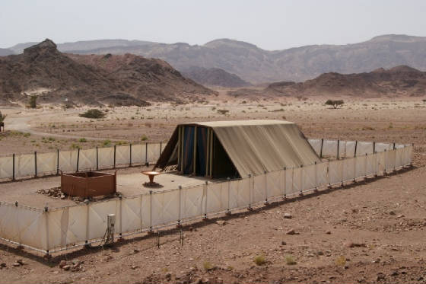
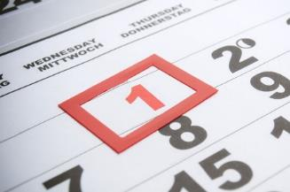
Then the Lord said to Moses: “Set up the tabernacle, the tent of meeting, on the first day of the first month.

Slide 4
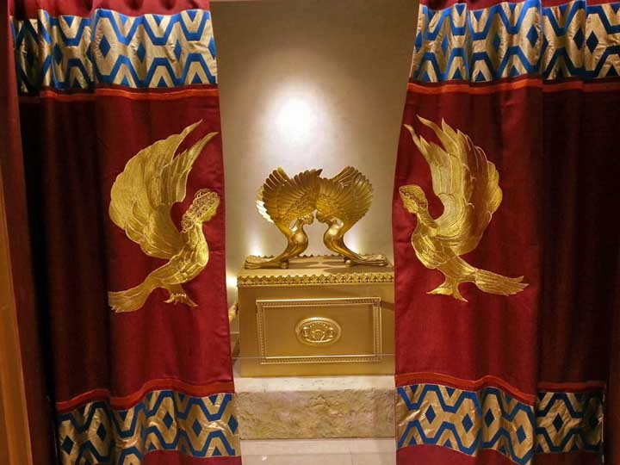
Place the ark of the covenant law in it and shield the ark with the curtain.

Slide 5
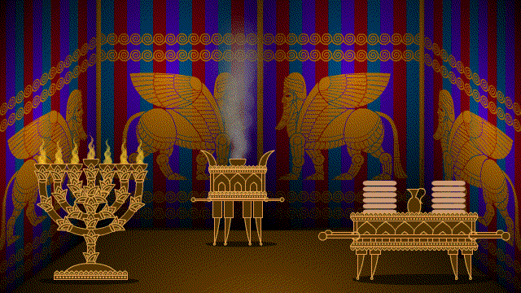
Bring in the table and set out what belongs on it. Then bring in the lampstand and set up its lamps.

Slide 6
Place the gold altar of incense in front of the ark of the covenant law and put the curtain at the entrance to the tabernacle.

Slide 7
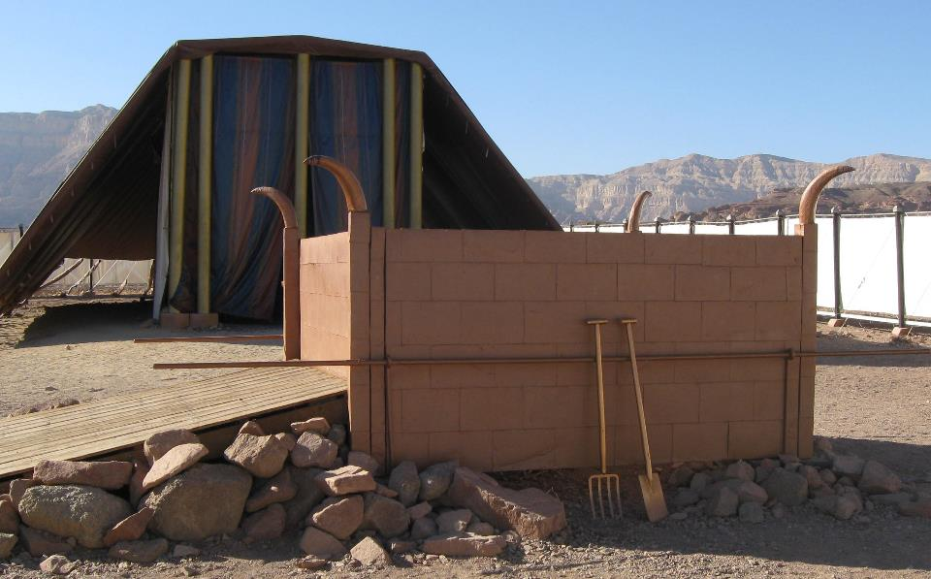
Place the altar of burnt offering in front of the entrance to the tabernacle, the tent of meeting;

Slide 8
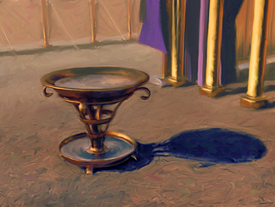
place the basin between the tent of meeting and the altar and put water in it.

Slide 9
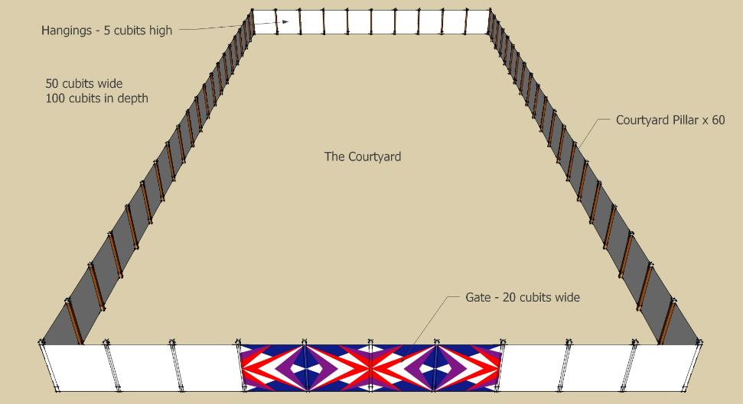
Set up the courtyard around it and put the curtain at the entrance to the courtyard.

Slide 10
Take the anointing oil and anoint the tabernacle and everything in it; consecrate it and all its furnishings, and it will be holy.

Slide 11
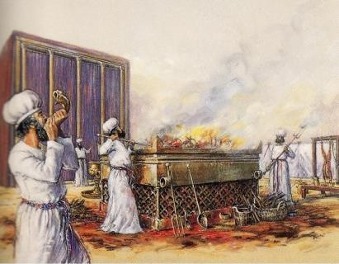
Then anoint the altar of burnt offering and all its utensils; consecrate the altar, and it will be most holy.

Slide 12
Anoint the basin and its stand and consecrate them.

Slide 13
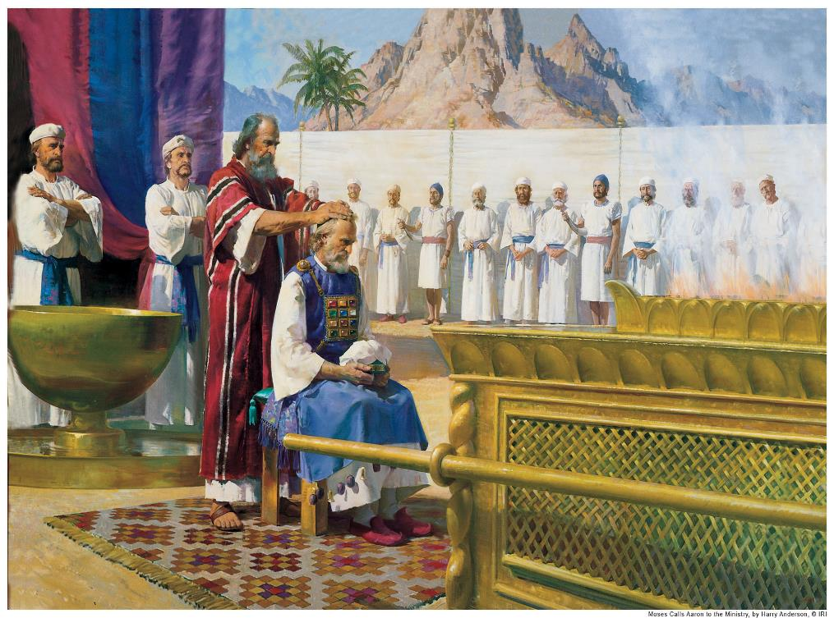
“Bring Aaron and his sons to the entrance to the tent of meeting and wash them with water. Then dress Aaron in the sacred garments, anoint him and consecrate him so he may serve me as priest.

Slide 14
Bring his sons and dress them in tunics. Anoint them just as you anointed their father, so they may serve me as priests. Their anointing will be to a priesthood that will continue throughout their generations.

Slide 15
Moses did everything just as the Lord commanded him.

Slide 16
So the tabernacle was set up on the first day of the first month in the second year.

Slide 17
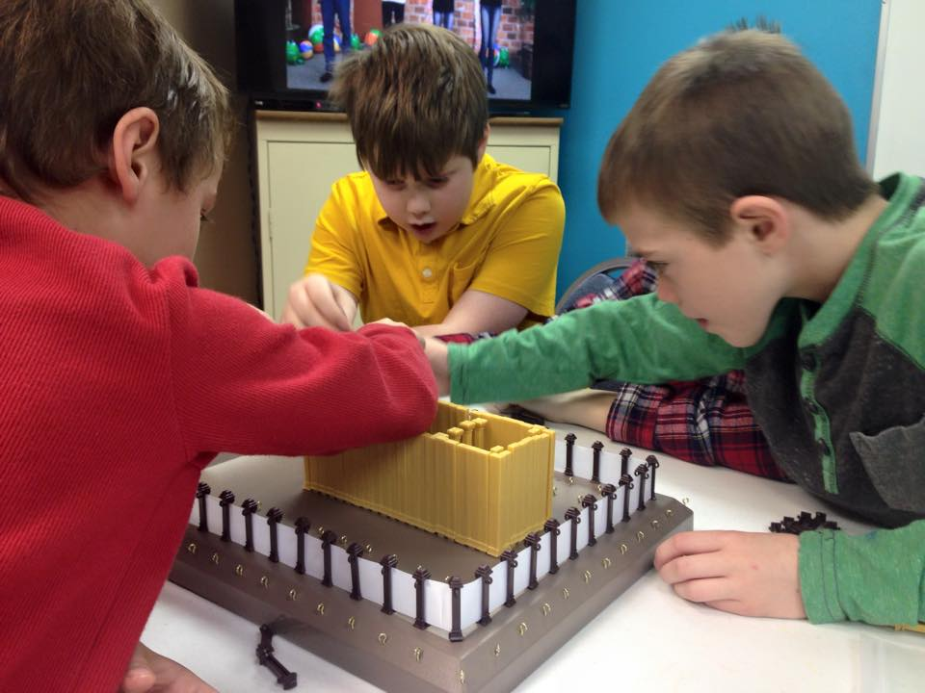
When Moses set up the tabernacle, he put the bases in place, erected the frames, inserted the crossbars and set up the posts.

Slide 18
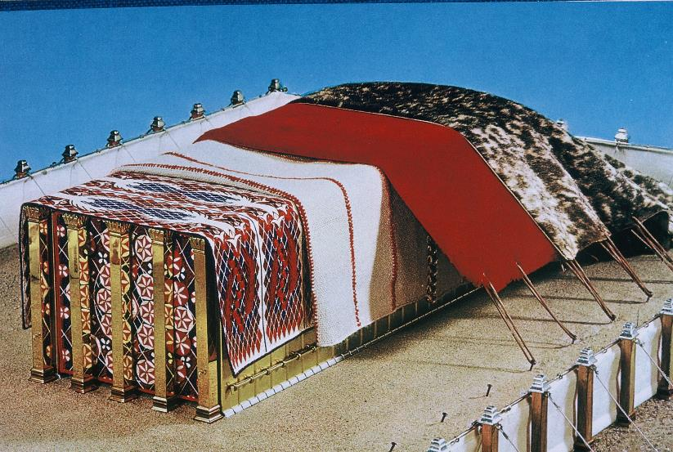
Then he spread the tent over the tabernacle and put the covering over the tent, as the Lord commanded him.

Slide 19
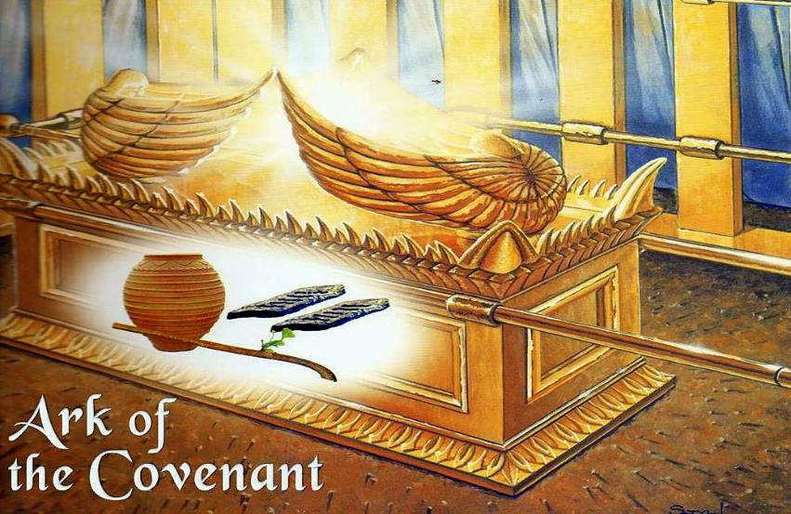
He took the tablets of the covenant law and placed them in the ark, attached the poles to the ark and put the atonement cover over it.

Slide 20
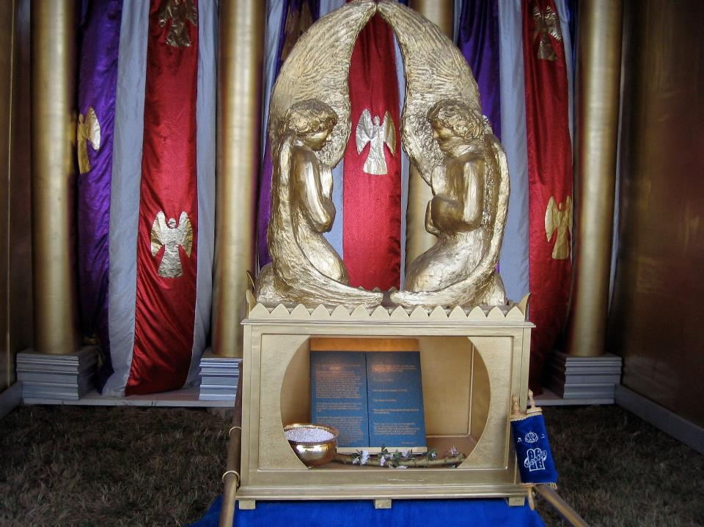
Then he brought the ark into the tabernacle and hung the shielding curtain and shielded the ark of the covenant law, as the Lord commanded him.

Slide 21
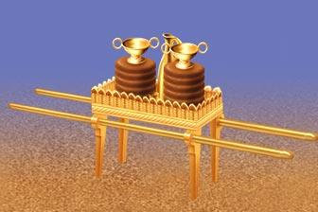
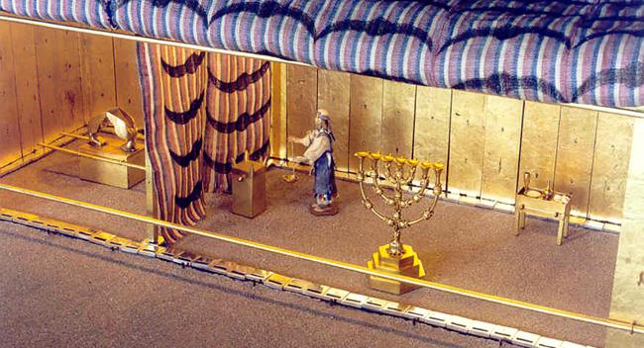
Moses placed the table in the tent of meeting on the north side of the tabernacle outside the curtain and set out the bread on it before the Lord, as the Lord commanded him.

Slide 22
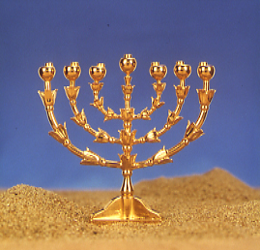
He placed the lampstand in the tent of meeting opposite the table on the south side of the tabernacle and set up the lamps before the Lord, as the Lord commanded him.

Slide 23
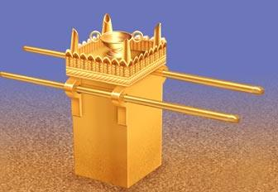
Moses placed the gold altar in the tent of meeting in front of the curtain and burned fragrant incense on it, as the Lord commanded him.

Slide 24
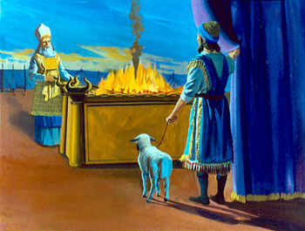
Then he put up the curtain at the entrance to the tabernacle. He set the altar of burnt offering near the entrance to the tabernacle, the tent of meeting, and offered on it burnt offerings and grain offerings, as the Lord commanded him.

Slide 25
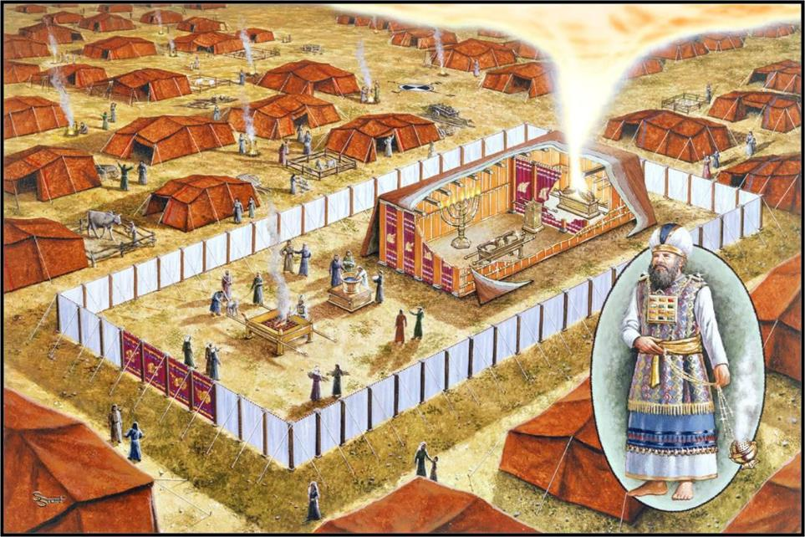
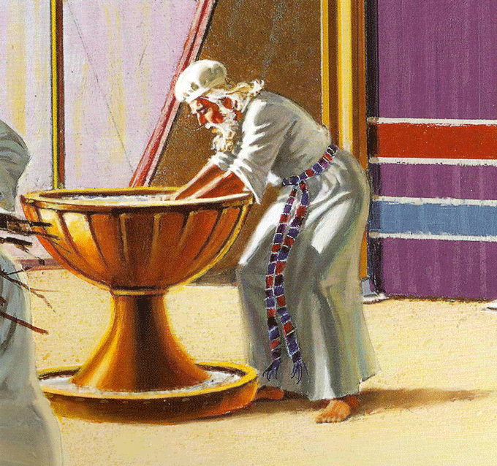
He placed the basin between the tent of meeting and the altar and put water in it for washing, and Moses and Aaron and his sons used it to wash their hands and feet.*

Slide 26
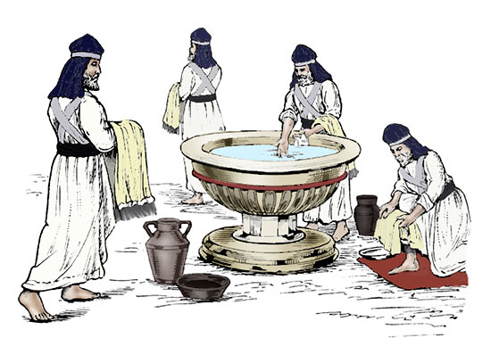
They washed whenever they entered the tent of meeting or approached the altar, as the Lord commanded Moses.

Slide 27
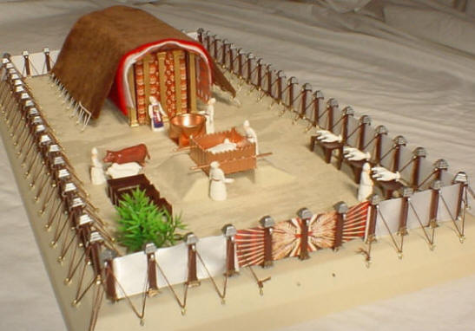
Then Moses set up the courtyard around the tabernacle and altar and put up the curtain at the entrance to the courtyard. And so Moses finished the work.

Slide 28
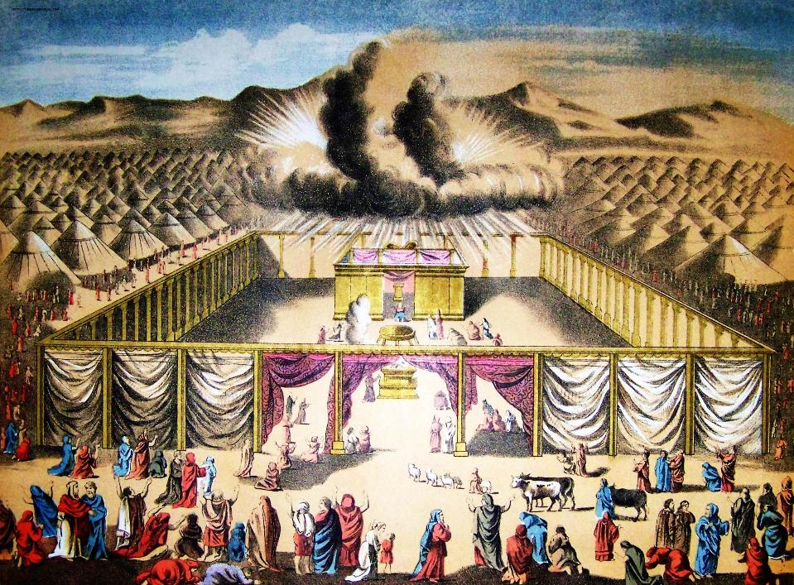
Then the cloud covered the tent of meeting, and the glory of the Lord filled the tabernacle.

Slide 29
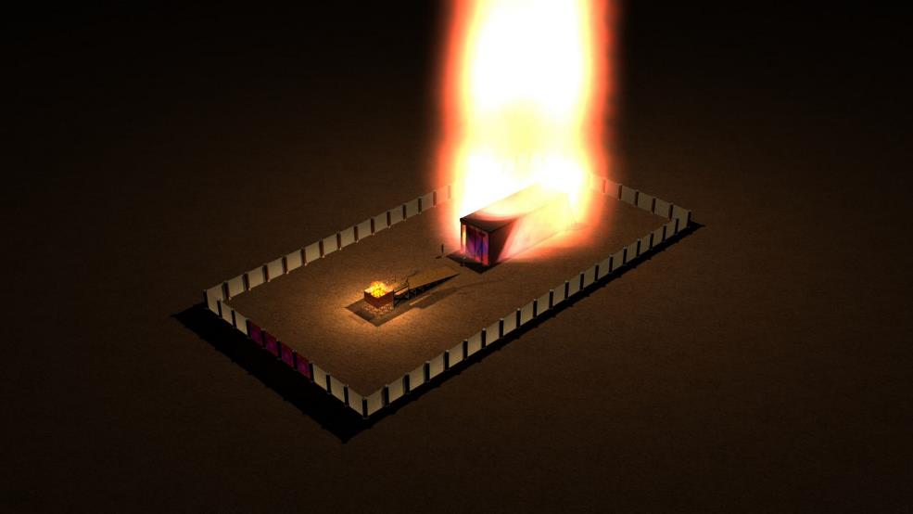
Moses could not enter the tent of meeting because the cloud had settled on it, and the glory of the Lord filled the tabernacle.

Slide 30
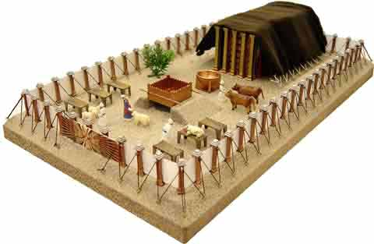
In all the travels of the Israelites, whenever the cloud lifted from above the tabernacle, they would set out;
Time to go!

Slide 31
but if the cloud did not lift, they did not set out—until the day it lifted.
We’re staying another day!

Slide 32
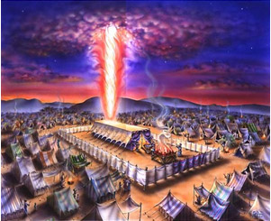
So the cloud of the Lord was over the tabernacle by day, and fire was in the cloud by night, in the sight of all the Israelites during all their travels.

