Slide 1

Dig Site #14
R-E-S-P-E-C-T!

Slide 2
Memory Verse
You shall have no other gods before me. You shall not make for yourself an image in the form of anything in heaven above or on the earth beneath or in the waters below.
Exodus 20:3-4
Lesson #14

Slide 3
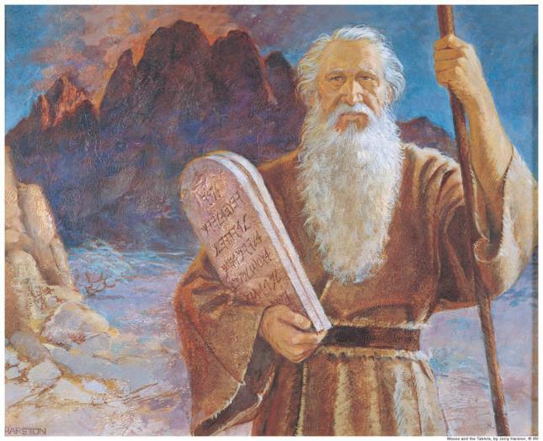
Exodus 20:1-21
R-E-S-P-E-C-T

Slide 4
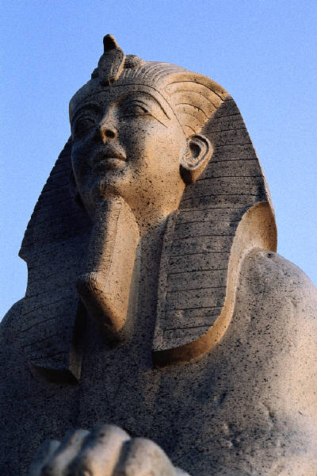
And God spoke all these words:
I am the LORD your God, who brought you out of Egypt, out of the land of slavery.

Slide 5
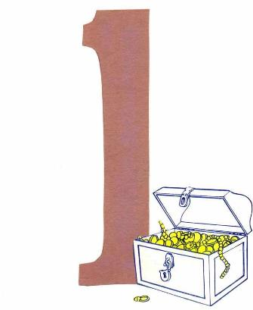
“You shall have no other gods before me.

Slide 6
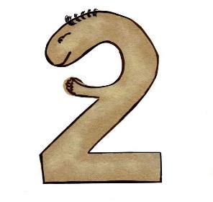
You shall not make for yourself an image in the form of anything in heaven above or on the earth beneath or in the waters below.

Slide 7
You shall not bow down
to them
or worship them;
for I, the LORD your God,
am a jealous God,
punishing the children
for the sin of the parents
to the 3rd and 4th
generation of those
who hate me,

Slide 8
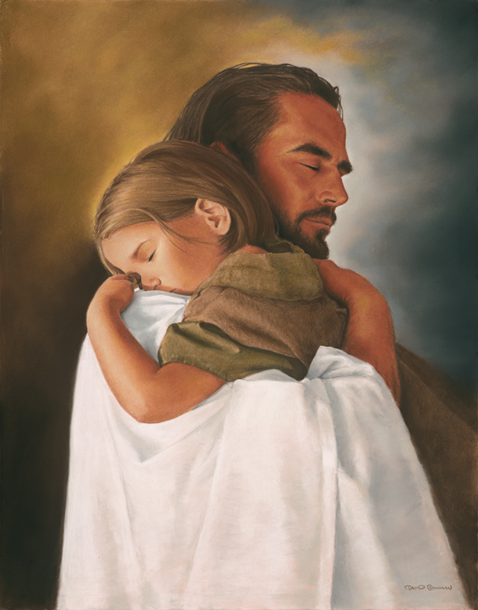
But showing love
to a thousand generations
of those who love
me and keep my commandments.

Slide 9
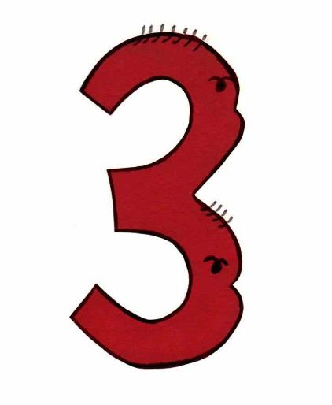
You shall not misuse the name of the LORD your God, for the LORD will not hold anyone guiltless who misuses his name.
#*&$##*#!
@*&$#@#!

Slide 10
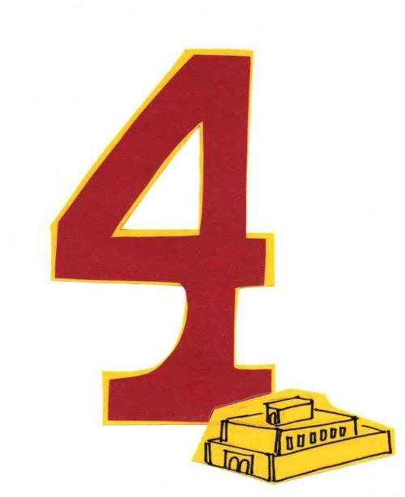
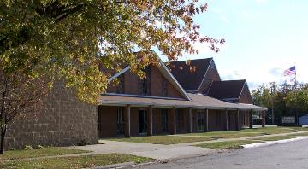
Remember the Sabbath day by keeping it holy. Six days you shall labor and do all your work, but the 7th day is a sabbath to the LORD your God.
1
2
4
3
3
2
4
1

Slide 11
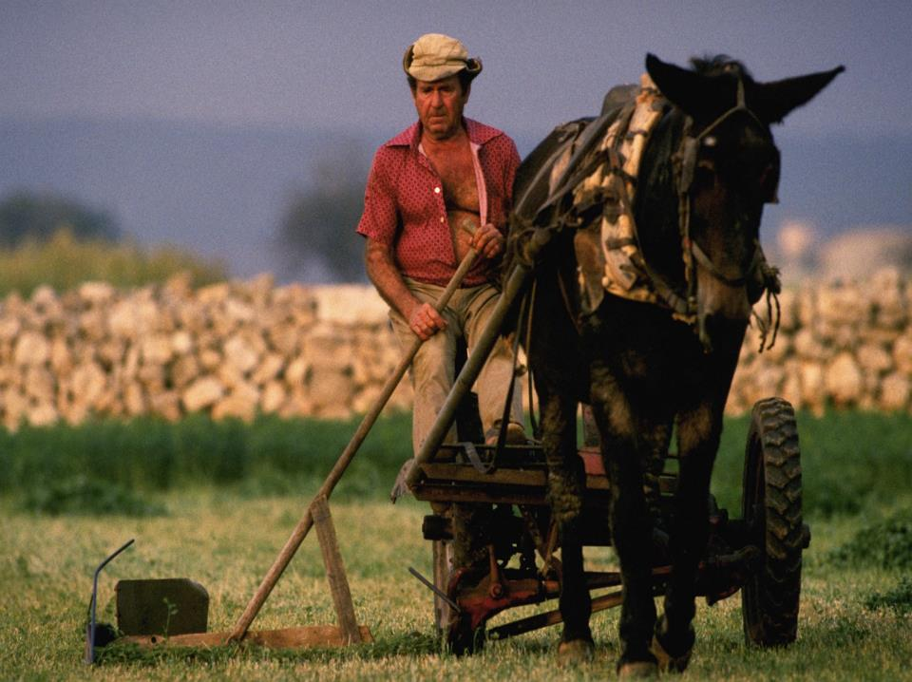
On it you shall not do any work, neither you, nor your son or daughter, nor your male or female servant, nor your animals, nor the foreigner residing in your town.

Slide 12

For in 6 days the LORD made the heavens and the earth, the sea, and all that is in them, but he rested on the 7th day.
6 = work
7 = rest
Therefore the LORD blessed the Sabbath day and made it holy.

Slide 13
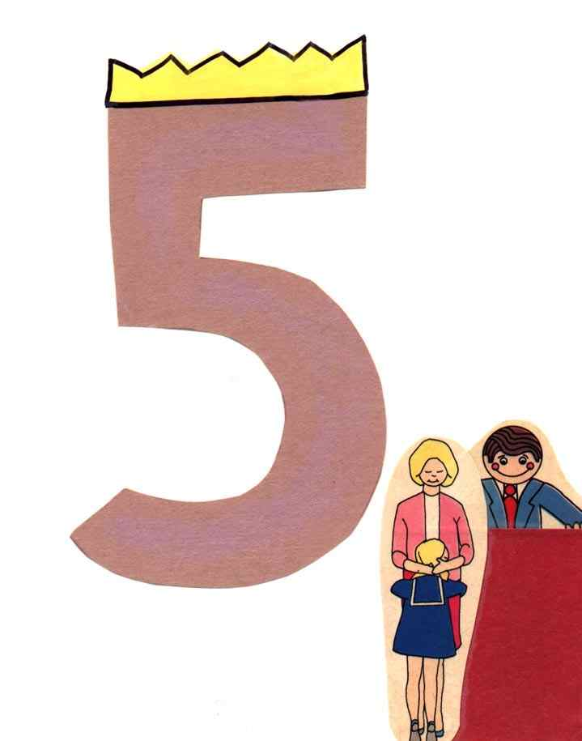
Honor your father and your mother, so that you may live long in the land the LORD your God is giving you.
3
2
4
1
5

Slide 14
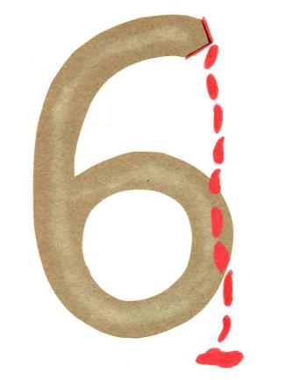
You shall not murder.

Slide 15
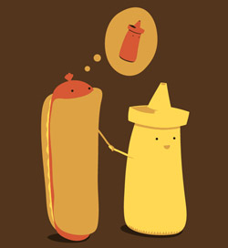
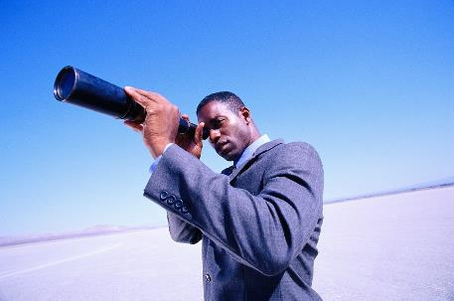
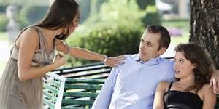
7
You shall not commit adultery.
7

Slide 16
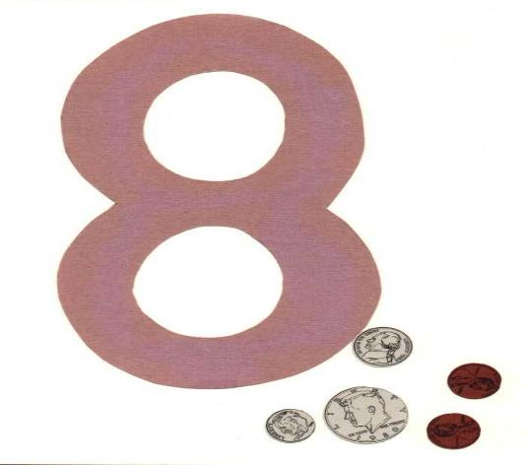


You shall not steal.

Slide 17


You shall not give false testimony against your neighbor.
I don’t like her!
She always steals from me and I heard she even killed someone!

Slide 18
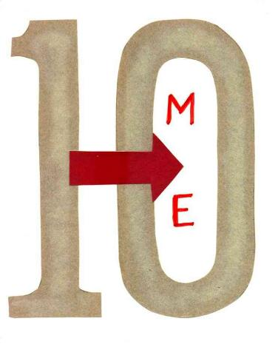
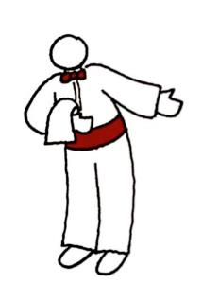
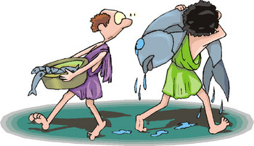
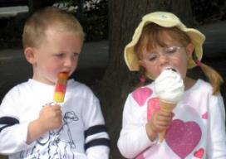
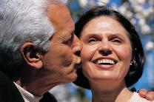
You shall not covet your neighbor's house. You shall not covet your neighbor's wife, or his male or female servant, his ox or donkey, or anything that belongs to your neighbor.

Slide 19

When the people saw the thunder and lightning and heard the trumpet and saw the mountain in smoke, they trembled with fear.

Slide 20
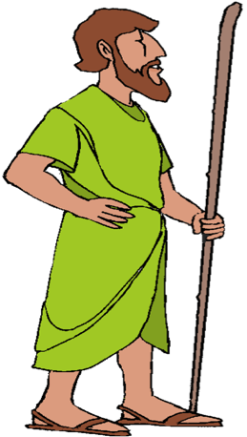
They stayed at a distance and said to Moses,
Speak to us yourself and we will listen. But do not have God speak to us or we will die.

Slide 21
Moses said to the people,
Do not be afraid. God has come to test you, so that the fear of God will be with you to keep you from sinning.

Slide 22
The people remained at a distance, while Moses approached the thick darkness where God was.

