Slide 1
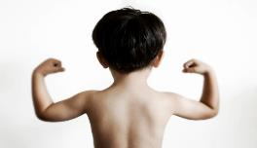
Memory Verse
The Lord will fight for you;
You need only to be still.
Exodus 14:14
Lesson #11

Slide 2

Lesson #11
Exodus 13:17 – 14:31

Slide 3
When Pharaoh let the people go, God did not lead them on the road through the Philistine country,
though that was shorter.
NO!
Philistine Country

Slide 4
If they face war,
they might change their minds
and return to Egypt.
For God said,
Egypt

Slide 5
So God led the people around by the desert road toward the Red Sea.
The Israelites went up out of Egypt ready for battle.

Slide 6
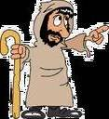

Moses took the bones of Joseph with him because Joseph had made the Israelites swear an oath.
He had said,
God will surely come to your aid, and then you must carry my bones up with you from this place.

Slide 7
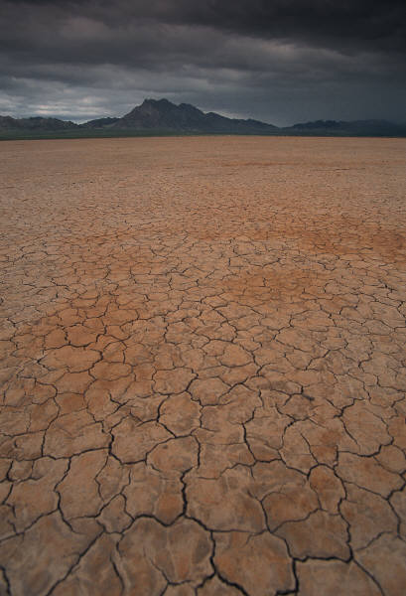

After leaving Succoth they camped at Etham on the edge of the desert.
Etham
Succoth

Slide 8
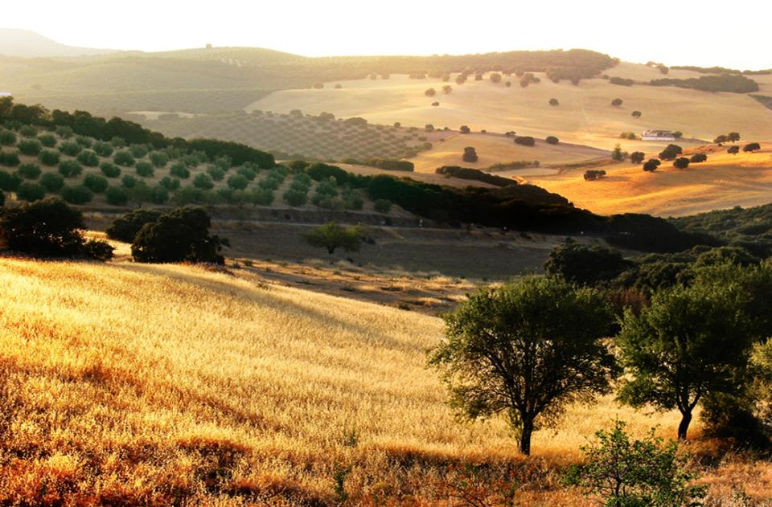

By day the LORD went ahead of them in a pillar of cloud to guide them on their way

Slide 9

and by night in a pillar of fire to give them light, so that they could travel by day or night.

Slide 10
Neither the pillar of cloud by day nor the pillar of fire by night left its place in front of the people.

Slide 11
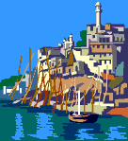
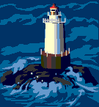
MIGDOL
Then the LORD said to Moses,
"Tell the Israelites to turn back and encamp near Pi Hahiroth, between Migdol and the sea.
They are to encamp by the sea, directly opposite Baal Zephon.”
the sea
Pi Hahiroth
Baal Zephon

Slide 12

Pharaoh will think
The Israelites are wandering around the land in confusion, hemmed in by the desert.

Slide 13

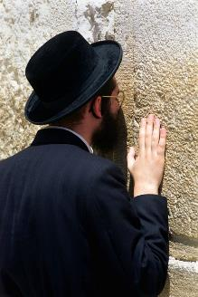
Glory
to God
in the
Highest!
And I will harden Pharaoh's heart, and he will pursue them. But I will gain glory for myself through Pharaoh and all his army, and the Egyptians will know that I am the LORD.
So the Israelites did this.

Slide 14
When the king of Egypt was told that the people had fled, Pharaoh and his officials changed their minds about them and said,
What have we done?
We have let the Israelites go and have lost their services!

Slide 15
So he had his chariot made ready and took his army with him. He took 600 of the best chariots, along with all the other chariots of Egypt, with officers over all of them.
100
200
300
400
500
600

Slide 16
The LORD hardened the heart of Pharaoh king of Egypt, so that he pursued the Israelites, who were marching out boldly.

Slide 17
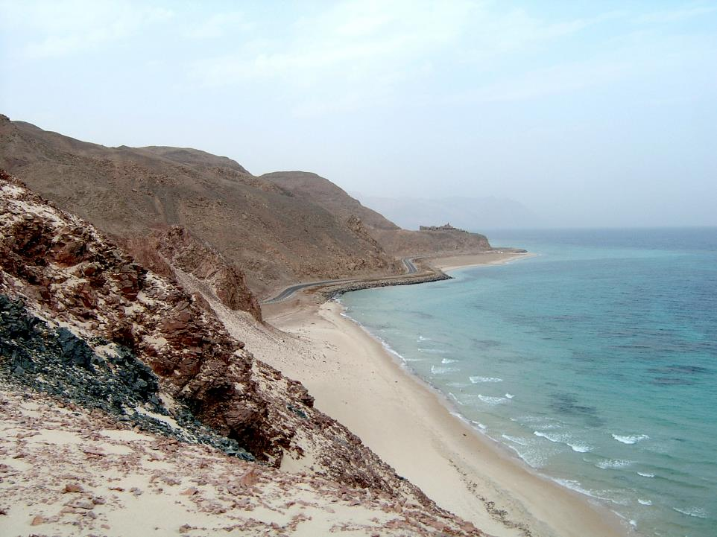
The Egyptians—all Pharaoh's horses and chariots, horsemen and troops—pursued the Israelites and overtook them as they camped by the sea near Pi Hahiroth, opposite Baal Zephon.

Slide 18
As Pharaoh approached, the Israelites looked up, and there were the Egyptians, marching after them. They were terrified and cried out to the LORD.
Lord,
help Us!!!!
Lord,
help Us!!!!
Lord,
help Us!!!!

Slide 19
They said to Moses,
Was it because there were no graves in Egypt that you brought us to the desert to die? What have you done to us by bringing us out of Egypt?

Slide 20
Didn't we say to you in Egypt, 'Leave us alone;
let us serve the Egyptians'?

Slide 21
It would have been better for us to serve the Egyptians than to die in the desert!

Slide 22
Moses answered the people,
Do not be afraid. Stand firm and you will see the deliverance the LORD will bring you today. The Egyptians you see today you will never see again.

Slide 23
The LORD will fight for you; you need only to be still.

Slide 24

Then the LORD said to Moses, "Why are you crying out to me?
Tell the Israelites to move on.”

Slide 25
Raise your staff and stretch out your hand over the sea to divide the water so that the Israelites can go through the sea on dry ground.

Slide 26
I will harden the hearts of the Egyptians so that they will go in after them. And I will gain glory through Pharaoh and all his army, through his chariots and his horsemen.

Slide 27
The Egyptians will know that I am the LORD when I gain glory through Pharaoh, his chariots and his horsemen.

Slide 28
Then the angel of God, who had been traveling in front of Israel's army, withdrew and went behind them. The pillar of cloud also moved from in front and stood behind them coming between the armies of Egypt and Israel.

Slide 29
Throughout the night the cloud brought darkness to the one side and light to the other side; so neither went near the other all night long.

Slide 30
Then Moses stretched out his hand over the sea, and all that night the LORD drove the sea back with a strong east wind and turned it into dry land.

Slide 31
The waters were divided and the Israelites went through the sea on dry ground, with a wall of water on their right and on their left.

Slide 32
The Egyptians pursued them, and all Pharaoh's horses and chariots and horsemen followed them into the sea.

Slide 33
During the last watch of the night the LORD looked down from the pillar of fire and cloud at the Egyptian army and threw it into confusion.

Slide 34
He jammed the wheels of their chariots so that they had difficulty driving.
And the Egyptians said,
Let's get away from the Israelites! The LORD is fighting for them against Egypt.

Slide 35
Then the LORD said to Moses,
Stretch out your hand over the sea so that the waters may flow back over the Egyptians and their chariots and horsemen.

Slide 36
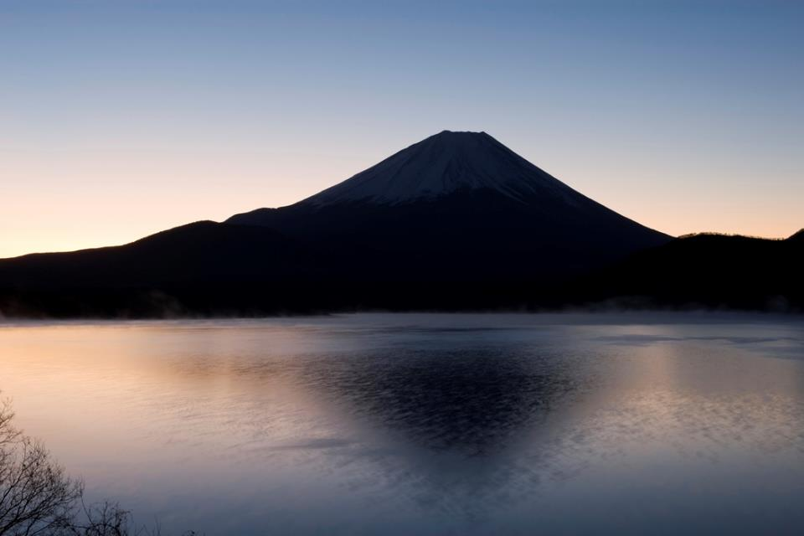

Moses stretched out his hand over the sea, and at daybreak the sea went back to its place. The Egyptians were fleeing toward it, and the LORD swept them into the sea.

Slide 37
The water flowed back and covered the chariots and horsemen—the entire army of Pharaoh that had followed the Israelites into the sea.
Not one of them survived.

Slide 38
But the Israelites went through the sea on dry ground, with a wall of water on their right and on their left.

Slide 39
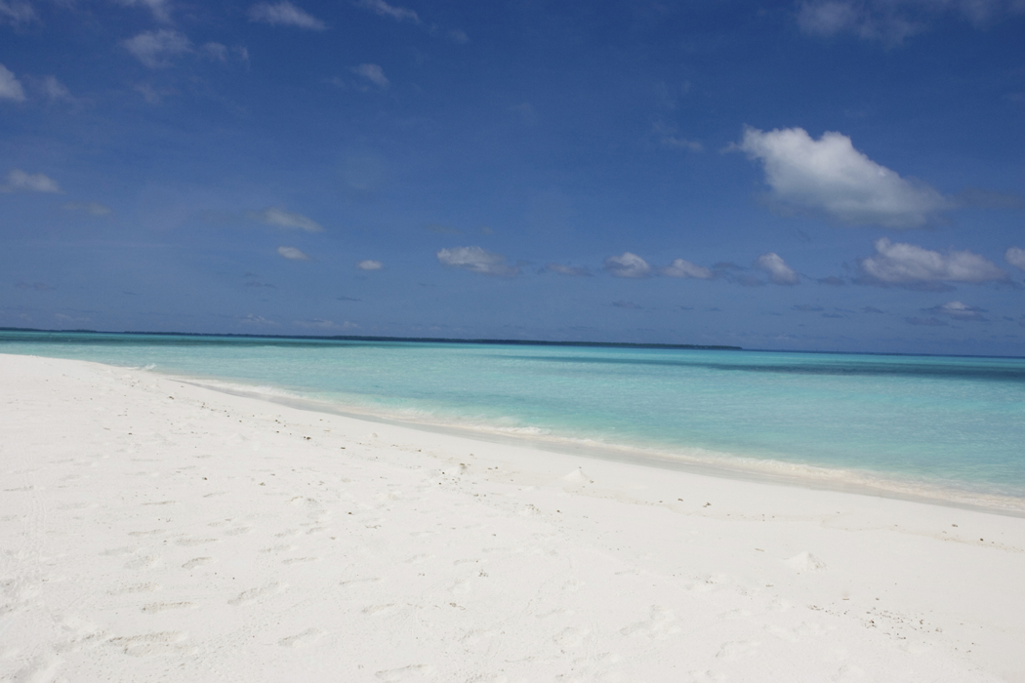
That day the LORD saved Israel from the hands of the Egyptians, and Israel saw the Egyptians lying dead on the shore.

Slide 40
And when the Israelites saw the mighty hand of the LORD displayed against the Egyptians, the people feared the LORD and put their trust in him and in Moses his servant.

