Slide 1
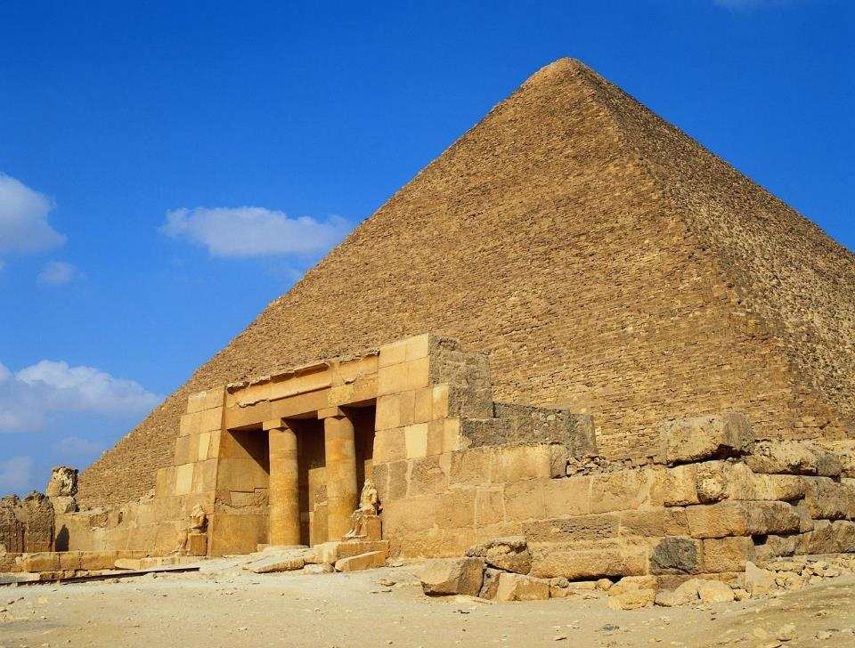
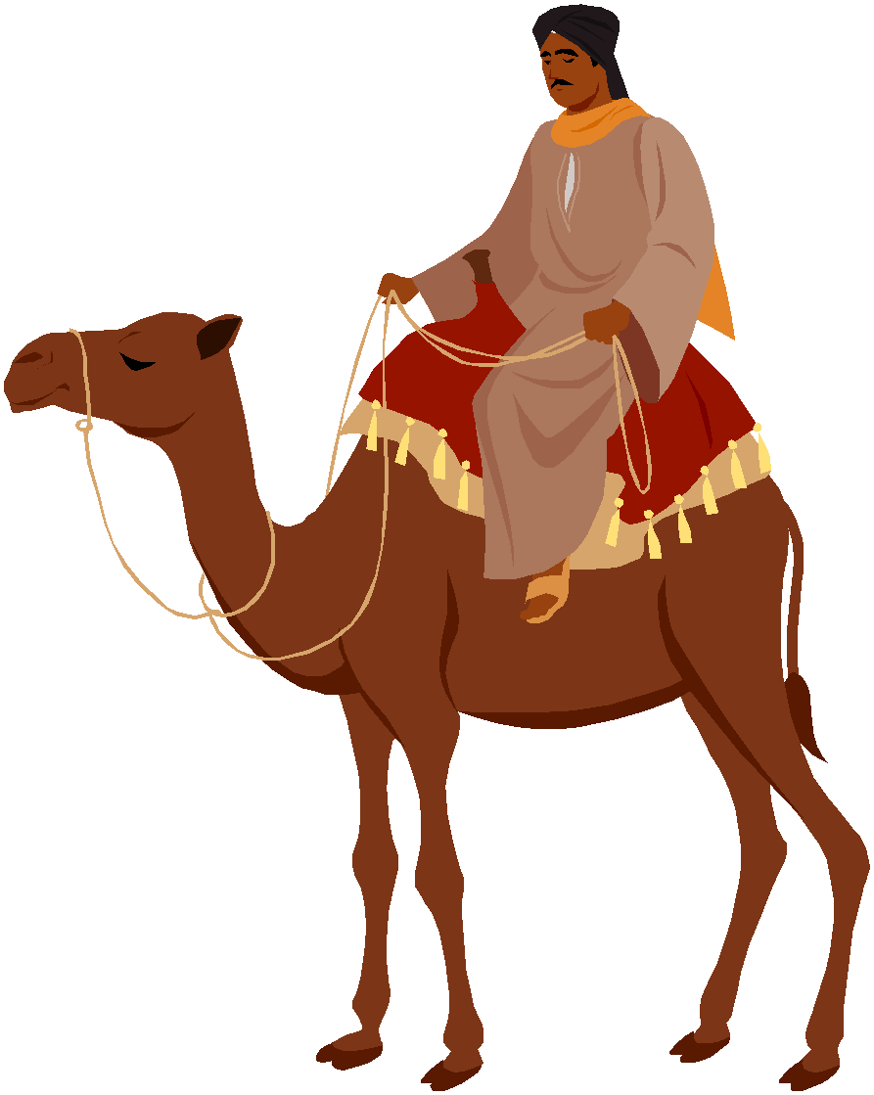
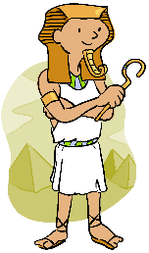
Dig Site 18
Genesis 43:1-15, 23b-32;
44:1-18, 33-34

Slide 2
FACE
TO
FACE

Slide 3
forgiving each other,
Ephesians 4:32
Be kind and compassionate to one another,
Memory Verse
just as in Christ God forgave you.
DS#18

Slide 4
BACK
TO EGYPT

Slide 5
Now the famine was still severe in the land.

Slide 6
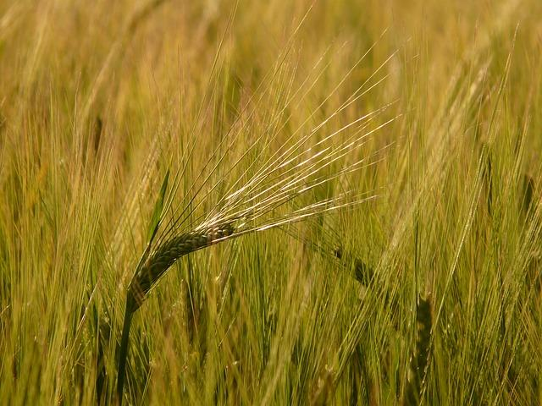
So when they had eaten all the grain they had brought from Egypt, their father said to them,

Slide 7
Go back and buy us a little more food.

Slide 8
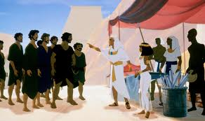
But Judah said to him

Slide 9
The man warned us solemnly, ‘You will not see my face again unless your brother is with you.’

Slide 10
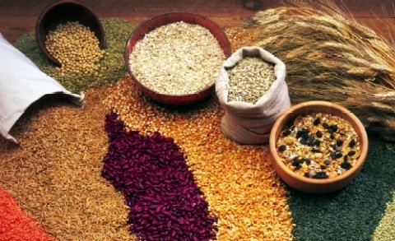
If you will send our brother along with us, we will go down and buy food for you.

Slide 11
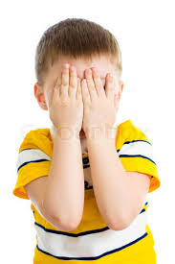
But if you will not send him, we will not go down, because the man said to us,

Slide 12
‘You will not see my face again unless your brother is with you.’

Slide 13
Israel asked,
Why did you bring this trouble on me by telling the man you had another brother?

Slide 14
They replied,
The man questioned us closely about ourselves and our family. ‘Is your father still living?’ he asked us. ‘Do you have another brother?’

Slide 15
We simply answered his questions. How were we to know he would say, ‘Bring your brother down here’?

Slide 16
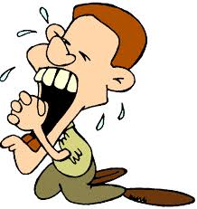
Then Judah said to Israel his father,
Send the boy along with me and we will go at once, so that we and you and our children may live and not die.

Slide 17
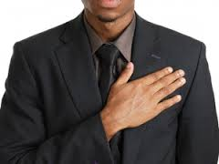
I myself will guarantee his safety; you can hold me personally responsible for him.

Slide 18
If I do not bring him back to you and set him here before you, I will bear the blame before you all my life.

Slide 19
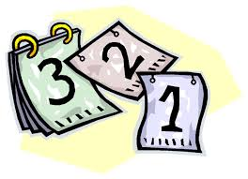
As it is, if we had not delayed, we could have gone and returned twice.

Slide 20
As it is, if we had not delayed, we could have gone and returned twice.

Slide 21
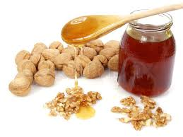
Then their father Israel said to them,
If it must be, then do this: Put some of the best products of the land in your bags and take them down to the man as a gift

Slide 22
Then their father Israel said to them,
—a little balm and a little honey, some spices and myrrh, some pistachio nuts and almonds.

Slide 23
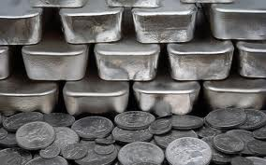
Take double the amount of silver with you, for you must return the silver that was put back into the mouths of your sacks. Perhaps it was a mistake.

Slide 24
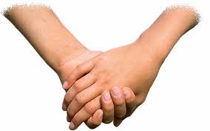
Take your brother also and go back to the man at once.

Slide 25
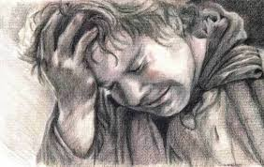
And may God Almighty (El-Shaddai) grant you mercy before the man so that he will let your other brother and Benjamin come back with you.

Slide 26
As for me, if I am bereaved, I am bereaved.

Slide 27
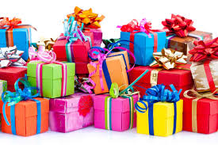
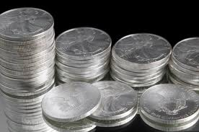
So the men took the gifts and double the amount of silver, and Benjamin also. They hurried down to Egypt and presented themselves to Joseph.

Slide 28
AT
JOSEPH’S
HOUSE

Slide 29
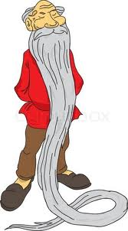
He asked them how they were, and then he said,
How is your aged father you told me about? Is he still living?

Slide 30
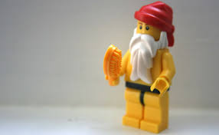
They replied,
Your servant our father is still alive and well.

Slide 31
And they bowed down, prostrating themselves before him.

Slide 32
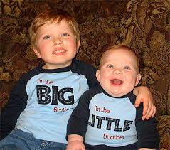
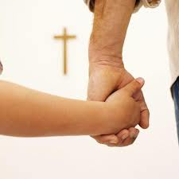
As he looked about and saw his brother Benjamin, his own mother’s son, he asked,
Is this your youngest brother, the one you told me about?

Slide 33
And he said,
God be gracious to you, my son.

Slide 34
Deeply moved at the sight of his brother, Joseph hurried out and looked for a place to weep.

Slide 35
Then he brought Simeon out to them.

Slide 36
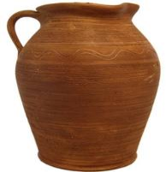
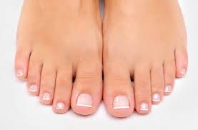
The steward took the men into Joseph’s house, gave them water to wash their feet

Slide 37
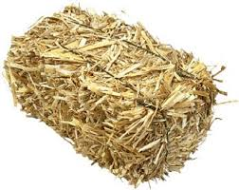
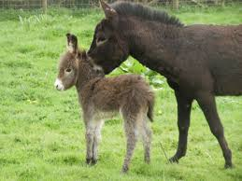
provided fodder for their donkeys.

Slide 38
They prepared their gifts for Joseph’s arrival at noon, because they had heard that they were to eat there.

Slide 39
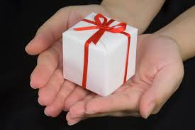
When Joseph came home, they presented to him the gifts they had brought into the house,

Slide 40
and they bowed down before him to the ground.

Slide 41
He went into his private room and wept there.

Slide 42
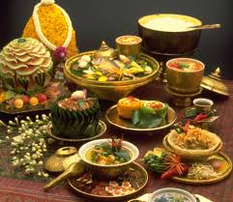
After he had washed his face, he came out and, controlling himself, said,
Serve the food.

Slide 43
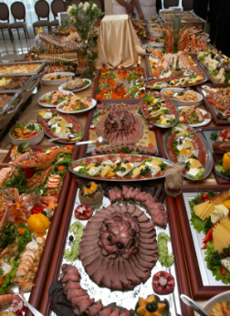
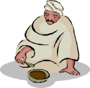
They served him by himself, the brothers by themselves, and the Egyptians who ate with him by themselves, because Egyptians could not eat with Hebrews, for that is detestable to Egyptians.

Slide 44
Now Joseph gave these instructions to the steward of his house: “Fill the men’s sacks with as much food as they can carry, and put each man’s silver in the mouth of his sack.

Slide 45
Then put my cup, the silver one, in the mouth of the youngest one’s sack, along with the silver for his grain.” And he did as Joseph said.

Slide 46
As morning dawned, the men were sent on their way with their donkeys. They had not gone far from the city when Joseph said to his steward,

Slide 47
Go after those men at once, and when you catch up with them, say to them,

Slide 48
‘Why have you repaid good with evil? Isn’t this the cup my master drinks from and also uses for divination? This is a wicked thing you have done.

Slide 49
When he caught up with them, he repeated these words to them. But they said to him,

Slide 50
When he caught up with them, he repeated these words to them. But they said to him,*
Why does my lord say such things? Far be it from your servants to do anything like that! We even brought back to you from the land of Canaan the silver we found inside the mouths of our sacks.

Slide 51
So why would we steal silver or gold from your master’s house?
If any of your servants is found to have it, he will die; and the rest of us will become my lord’s slaves.”

Slide 52
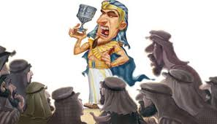
Very well, then, he said
let it be as you say.
Whoever is found to have it will become my slave; the rest of you will be free from blame.”

Slide 53
Each of them quickly lowered his sack to the ground and opened it. Then the steward proceeded to search, beginning with the oldest and ending with the youngest.

Slide 54
And the cup was found in Benjamin’s sack.

Slide 55
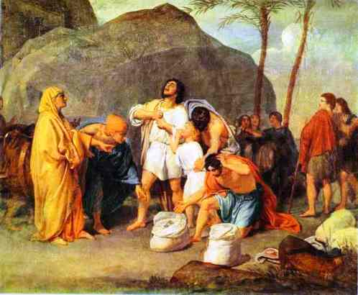
Each of them quickly lowered his sack to the ground and opened it. Then the steward proceeded to search, beginning with the oldest and ending with the youngest. And the cup was found in Benjamin’s sack.*

Slide 56
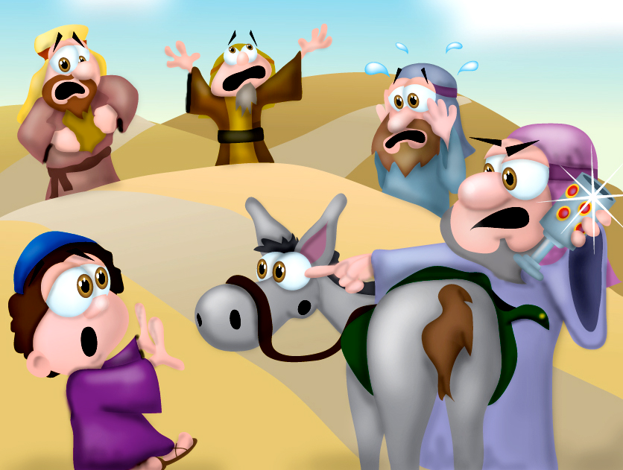
At this, they tore their clothes. Then they all loaded their donkeys and returned to the city.

Slide 57
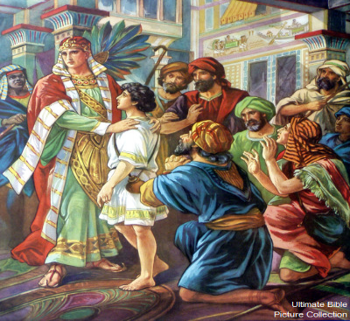
Joseph was still in the house when Judah and his brothers came in, and they threw themselves to the ground before him. Joseph said to them,

Slide 58
What is this you have done?
Don’t you know that a man like me can find things out by divination?

Slide 59
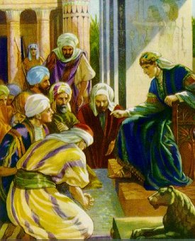
Judah replied.
What can we say to my lord?

Slide 60
What can we say? How can we prove our innocence? God has uncovered your servants’ guilt. We are now my lord’s slaves—we ourselves and the one who was found to have the cup.

Slide 61
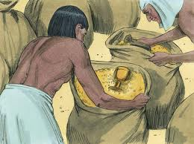
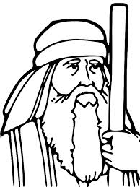
But Joseph said,
Far be it from me to do such a thing! Only the man who was found to have the cup will become my slave. The rest of you, go back to your father in peace.

Slide 62
Then Judah went up to him and said: “Pardon your servant, my lord, let me speak a word to my lord.

Slide 63
Do not be angry with your servant, though you are equal to Pharaoh himself.

Slide 64
“Now then, please let your servant remain here as my lord’s slave in place of the boy, and let the boy return with his brothers.

Slide 65
How can I go back to my father if the boy is not with me? No! Do not let me see the misery that would come on my father.”

