Slide 1
Dig Site 5 Genesis 7:17 – 8:22
The Waters Rose

Slide 2
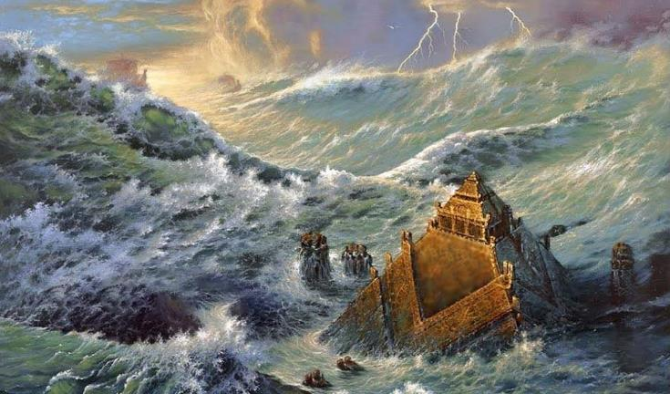
For forty days the flood kept coming on the earth,

Slide 3
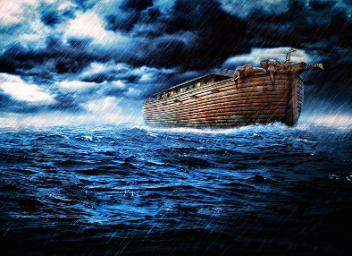
and as the waters increased they lifted the ark high above the earth.

Slide 4
The waters rose and increased greatly on the earth, and the ark floated on the surface of the water.

Slide 5
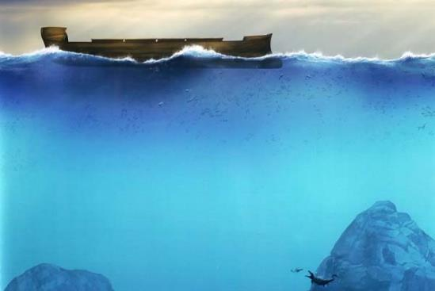
They rose greatly on the earth, and all the high mountains under the entire heavens were covered. The waters rose and covered the mountains to a depth of more than fifteen cubits (23 feet).

Slide 6
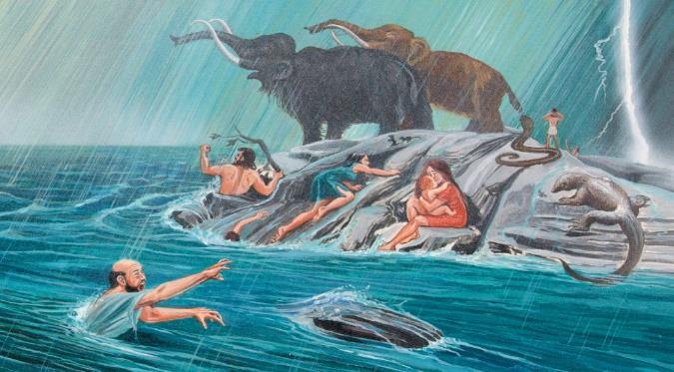
Every living thing that moved on land perished—birds, livestock, wild animals, all the creatures that swarm over the earth, and all mankind. Everything on dry land that had the breath of life in its nostrils died.

Slide 7
Every living thing on the face of the earth was wiped out; people and animals and the creatures that move along the ground and the birds were wiped from the earth.

Slide 8
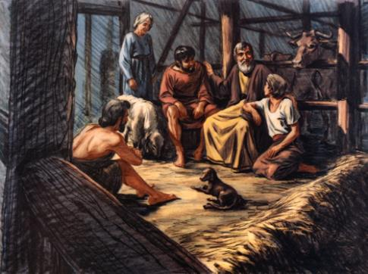
Only Noah was left, and those with him in the ark.

Slide 9
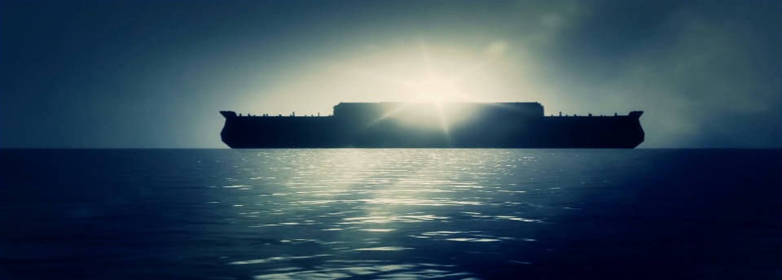
The waters flooded the earth for a hundred and fifty days.

Slide 10
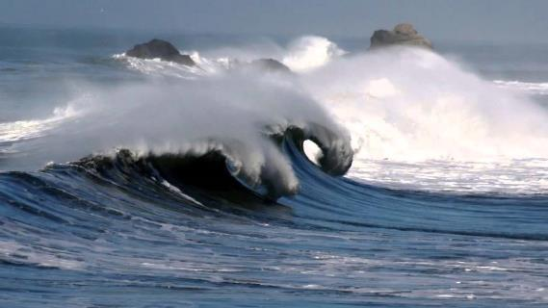
But God remembered Noah and all the wild animals and the livestock that were with him in the ark, and he sent a wind over the earth, and the waters receded.

Slide 11
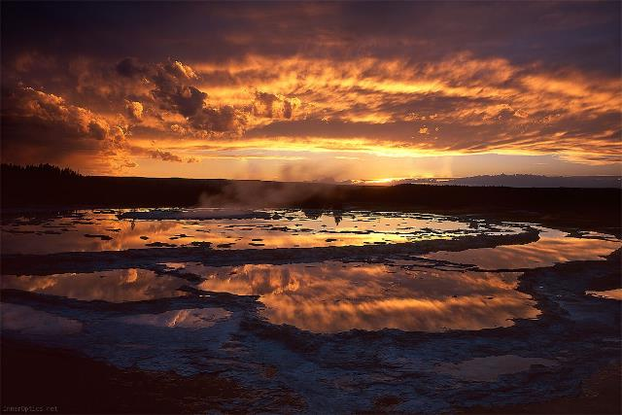
Now the springs of the deep and the floodgates of the heavens had been closed, and the rain had stopped falling from the sky.

Slide 12
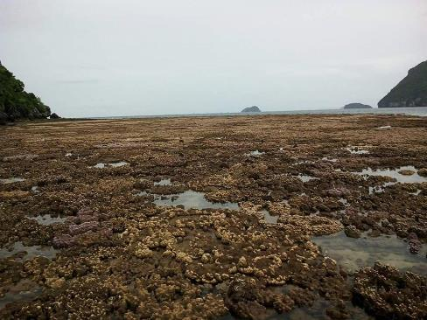
The water receded steadily from the earth.

Slide 13
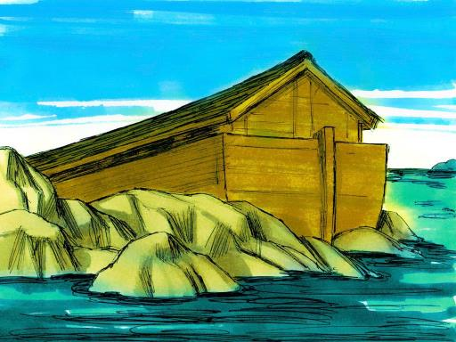
At the end of the 150 days the water had gone down, and on the 17th day of the 7th month the ark came to rest on the mountains of Ararat.

Slide 14
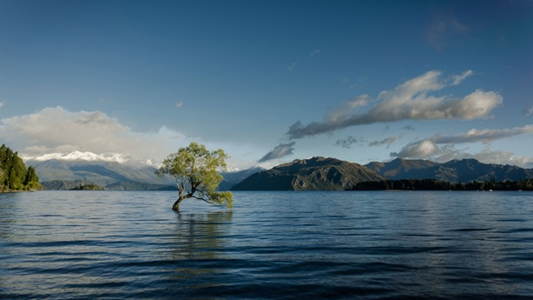
The waters continued to recede until the 10th month, and on the 1st day of the 10th month the tops of the mountains became visible.

Slide 15
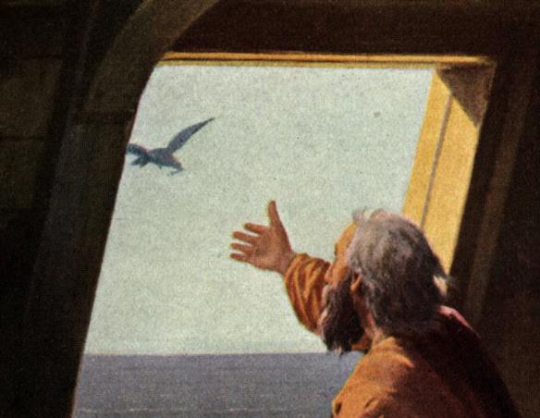
After forty days Noah opened a window he had made in the ark and sent out a raven,

Slide 16
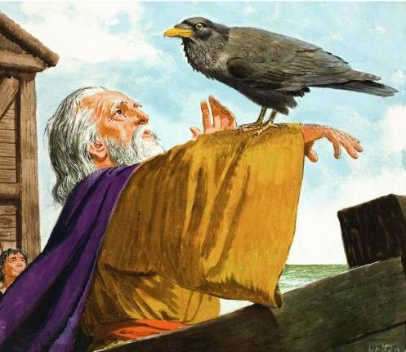
and it kept flying back and forth until the water had dried up from the earth.

Slide 17
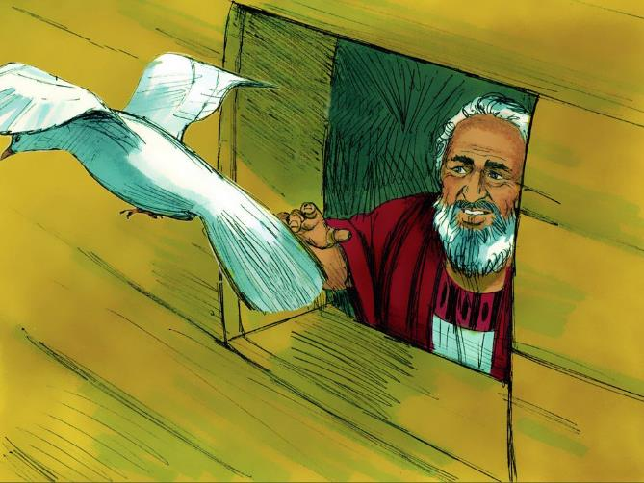
Then he sent out a dove to see if the water had receded from the surface of the ground.

Slide 18
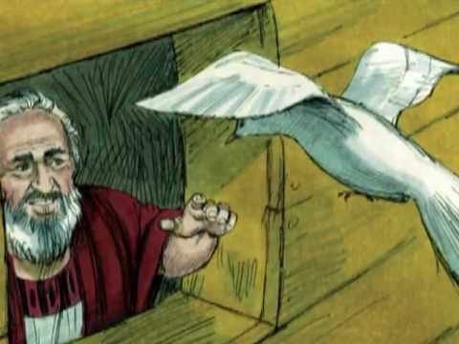
But the dove could find nowhere to perch because there was water over all the surface of the earth; so it returned to Noah in the ark. He reached out his hand and took the dove and brought it back to himself in the ark.

Slide 19
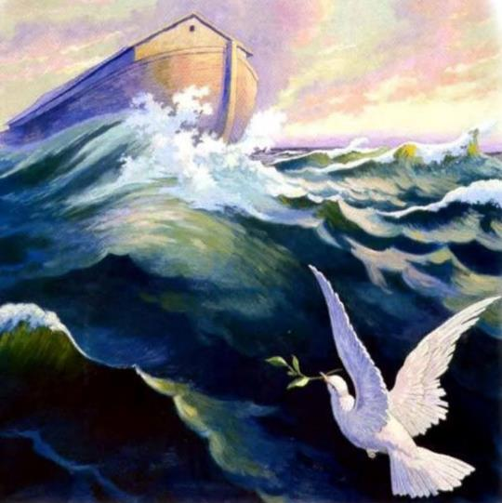
He waited seven more days and again sent out the dove from the ark.

Slide 20
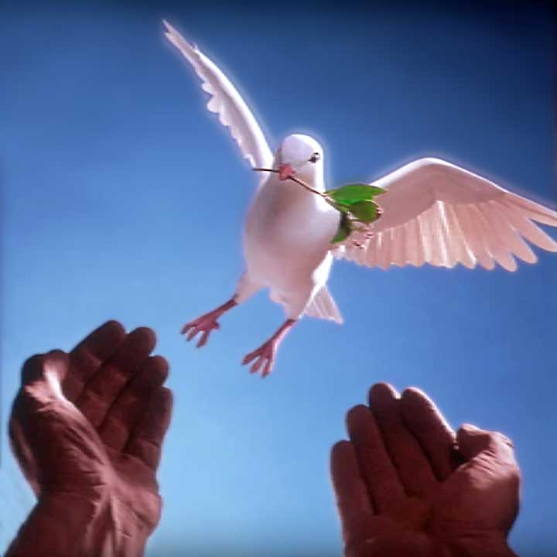
When the dove returned to him in the evening, there in its beak was a freshly plucked olive leaf! Then Noah knew that the water had receded from the earth.

Slide 21
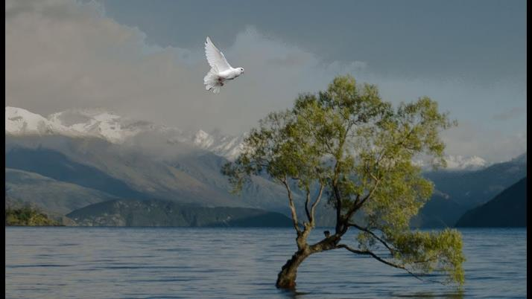
He waited seven more days and sent the dove out again, but this time it did not return to him.

Slide 22
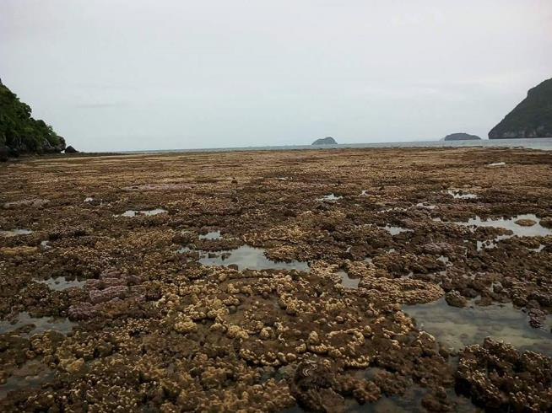
By the first day of the first month of Noah’s 601st, the water had dried up from the earth.

Slide 23
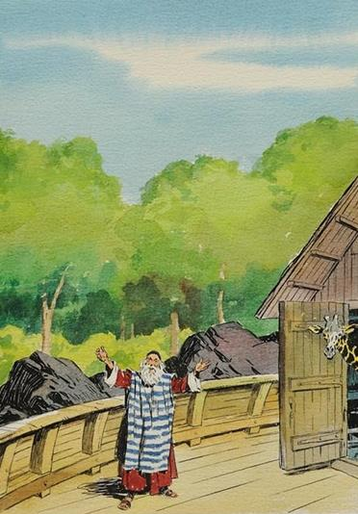
Noah then removed the covering from the ark and saw that the surface of the ground was dry.

Slide 24
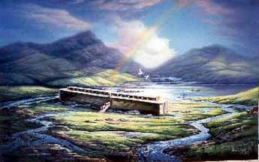
By the 27th day of the 2nd month the earth was completely dry.

Slide 25
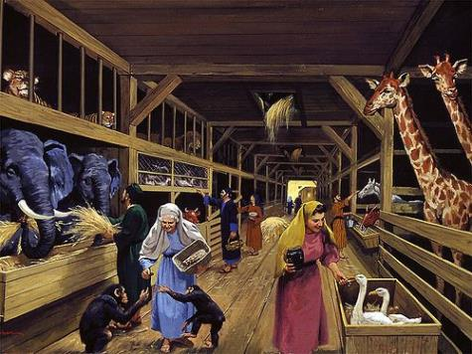
Then God said to Noah, “Come out of the ark, you and your wife and your sons and their wives. Bring out every kind of living creature that is with you—the birds, the animals, and all the creatures that move along the ground—so they can multiply on the earth and be fruitful and increase in number on it.”

Slide 26
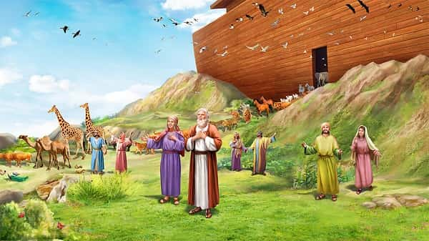
So Noah came out, together with his sons and his wife and his sons’ wives. All the animals and all the creatures that move along the ground and all the birds—everything that moves on land—came out of the ark, one kind after another.

Slide 27
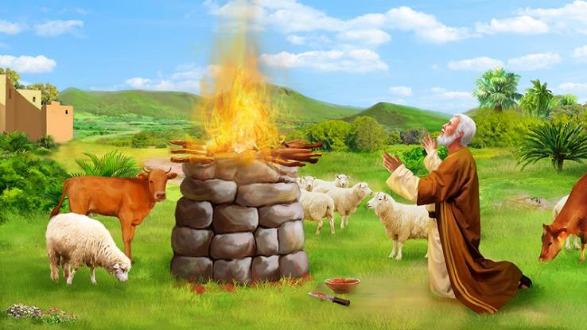
Then Noah built an altar to the Lord and, taking some of all the clean animals and clean birds, he sacrificed burnt offerings on it.

Slide 28
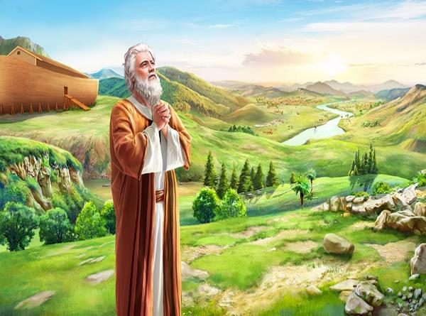
The Lord smelled the pleasing aroma and said in his heart:
“Never again will I curse the ground because of humans, even though every inclination of the human heart is evil from childhood. And never again will I destroy all living creatures, as I have done.

Slide 29
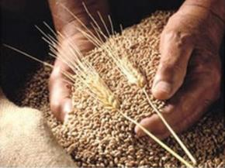
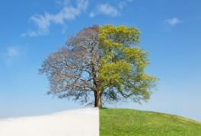
“As long as the earth endures, seedtime and harvest, cold and heat, summer and winter, day and night will never cease.”

