Slide 1
ACTS
Dig Site 16
Acts 21:27-22:3, 17-29

Slide 2
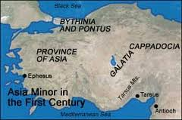
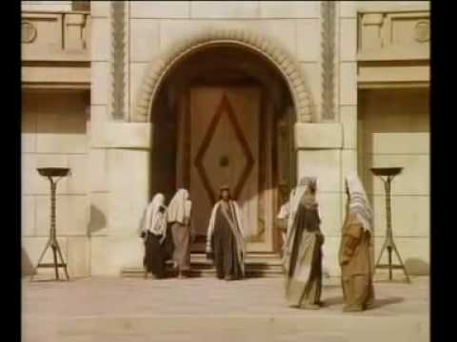
When the 7 days were nearly over, some Jews from the province of Asia saw Paul at the temple.

Slide 3
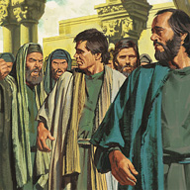
They stirred up the whole crowd and seized him, shouting,
Fellow Israelites, help us! This is the man who teaches everyone everywhere against our people and our law and this place. And besides, he has brought Greeks into the temple and defiled this holy place.

Slide 4
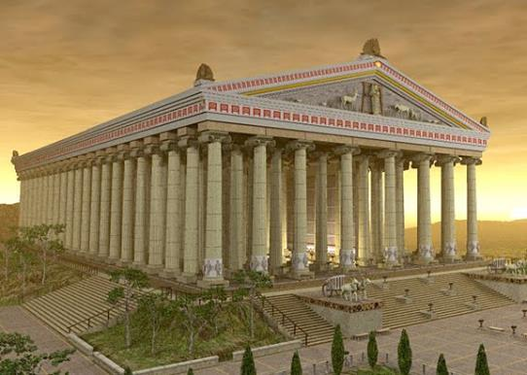
(They had previously seen Trophimus the Ephesian in the city with Paul and assumed that Paul had brought him into the temple).

Slide 5


The whole city was aroused, and the people came running from all directions.*

Slide 6
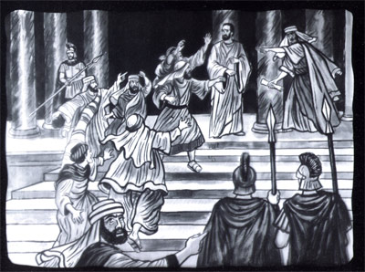
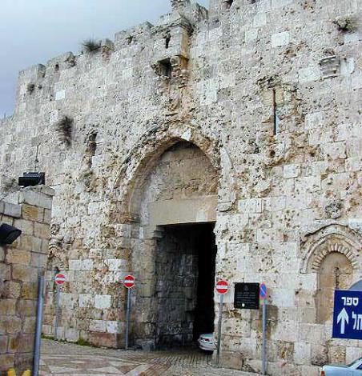
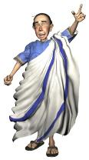
Seizing Paul, they dragged him from the temple,* and immediately the gates were shut.

Slide 7
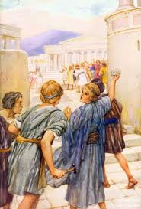
While they were trying to kill him, news reached the commander of the Roman troops that the whole city of Jerusalem was in an uproar.

Slide 8
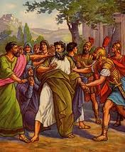
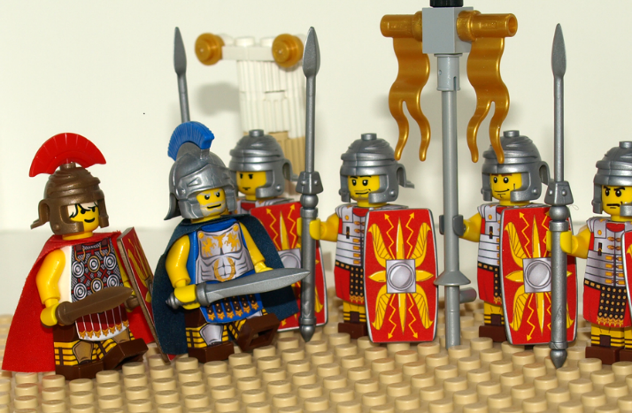
He at once took some officers and soldiers and ran down to the crowd. When the rioters saw the commander and his soldiers, they stopped beating Paul.

Slide 9
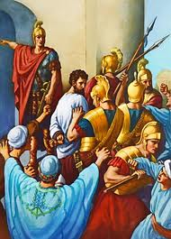
The commander came up and arrested him and ordered him to be bound with 2 chains.* Then he asked who he was and what he had done.

Slide 10
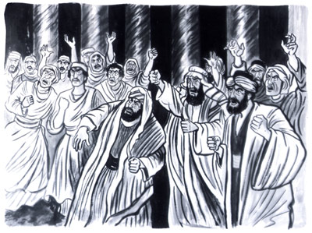
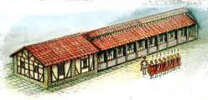
Some in the crowd shouted one thing and some another, and since the commander could not get at the truth because of the uproar, he ordered that Paul be taken into the barracks.

Slide 11
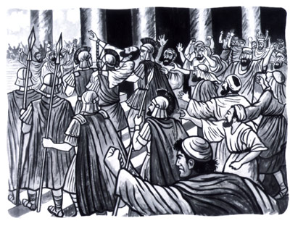
When Paul reached the steps, the violence of the mob was so great he had to be carried by the soldiers. The crowd that followed kept shouting,*
Get rid of him!

Slide 12
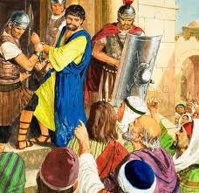
As the soldiers were about to take Paul into the barracks, he asked the commander,
May I say something to you?
Do you speak Greek?
Aren’t you the Egyptian who started a revolt and led 4000 terrorists out into the wilderness some time ago?

Slide 13
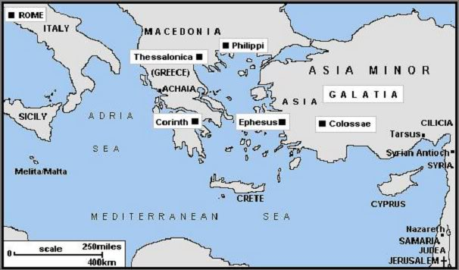
Paul answered,
I am a Jew, from Tarsus in Cilicia, a citizen of no ordinary city. Please let me speak to the people.

Slide 14
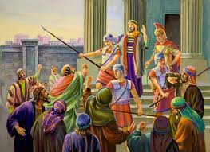
After receiving the commander’s permission,
Paul stood on the steps and motioned to the crowd. When they were all silent, he said to them in Aramaic:
Brothers and fathers, listen now to my defense.

Slide 15
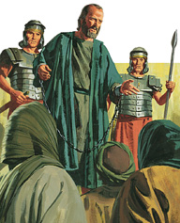
When they heard him speak to them in Aramaic, they became very quiet.

Slide 16
Then Paul said:
I am a Jew, born in Tarsus of Cilicia, but brought up in
this city.
I studied under Gamaliel and was thoroughly trained in the law of our ancestors. I was just as zealous for God as any of you are today.

Slide 17
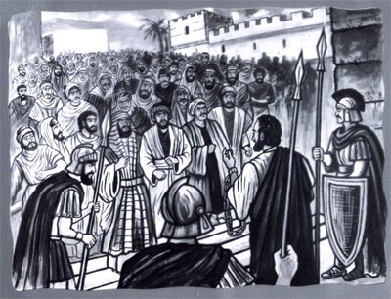
When I returned to Jerusalem and was praying at the temple, I fell into a trance and saw the Lord speaking to me.

Slide 18
‘Quick!’ he said. ‘Leave Jerusalem immediately, because the people here will not accept your testimony about me.’

Slide 19
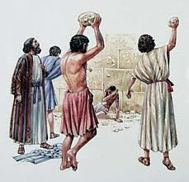
And when the blood of your martyr Stephen was shed, I stood there giving my approval and guarding the clothes of those who were killing him.
‘Lord,’ I replied, ‘these people know that I went from one synagogue to another to imprison and beat those who believe in you.

Slide 20
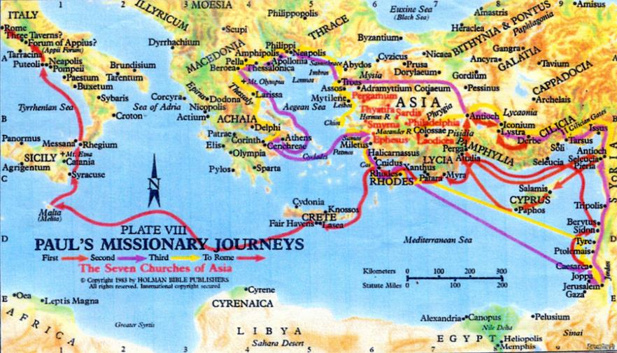
Then the Lord said to me, ‘Go; I will send you far away to the Gentiles.’

Slide 21
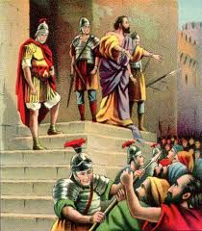
The crowd listened to Paul until he said this. Then they raised their voices and shouted,
Rid the earth of him! He’s not fit to live!

Slide 22


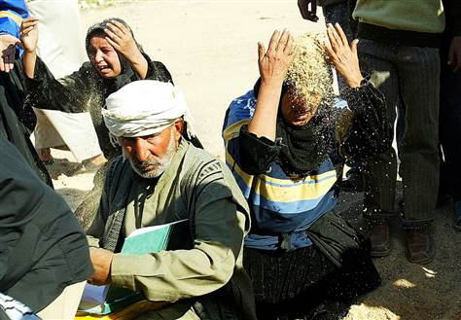

*As they were shouting and throwing off their cloaks and flinging dust into the air,

Slide 23
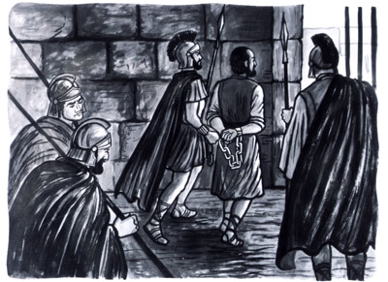
…the commander ordered that Paul to be taken into the barracks. He directed that he be flogged and interrogated in order to find out why the people were shouting at him like this.

Slide 24
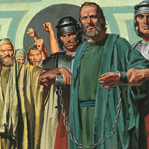
As they stretched him out to flog him, Paul said to the centurion standing there,
Is it legal for you to flog a Roman citizen who hasn’t even been found guilty?

Slide 25
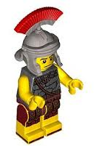
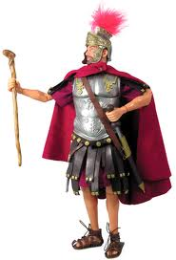
When the centurion heard this, he went to the commander and reported it.
What are you going to do? This man is a Roman citizen.

Slide 26
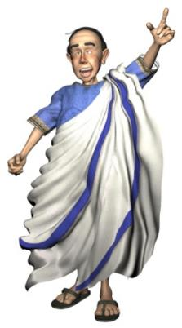

The commander went to Paul and asked,
Tell me, are you a Roman citizen?
Yes, I am.
I had to pay a lot of money for my citizenship.
But I was born a citizen.

Slide 27
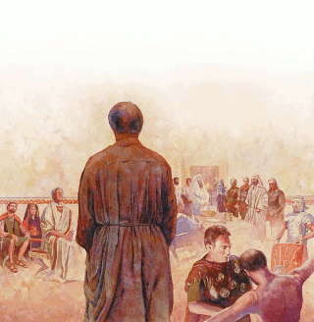
Those who were about to interrogate him withdrew immediately.
The commander himself was alarmed when he realized that he had put Paul, a Roman citizen, in chains.

