Slide 1
ACTS Dig Site 11
Acts 16:6-40

Slide 2
Paul’s Witness in Philippi

Slide 3
Memory
Verse
Acts 2:38
Peter replied,
Repent and be baptized, every one of you,
in the name of Jesus Christ
for the forgiveness of your sins.
And you will receive the gift of the Holy Spirit.
DS #11

Slide 4
aCts
Of the
apostles
Arti Facts

Slide 5
God’s
Characteristics
aCts
Of the
apostles
God calls us to spread the gospel
God is all powerful

Slide 6
Faith Words
Forgiveness
The act of pardoning a person who has done wrong.
aCts
Of the
apostles

Slide 7
People
aCts
Of the
apostles
Lydia
A woman who lived in Philippi and sold purple cloth. She was the first European person to become a Christian.

Slide 8
Places
aCts
Of the
apostles
Macedonia
A Roman province north of Greece which was visited by Paul

Slide 9
Places
aCts
Of the
apostles
Philippi
A city in eastern Macedonia named after Philip II, the father of Alexander the Great

Slide 10
Did You Know?
aCts
Of the
apostles
If a prisoner in a Roman prison escaped the guard or guards of that person would be killed in place of the prisoner.
That was why the jailer was planning to kill himself with a sword.

Slide 11
Paul’s Vision of the Man of Macedonia
Acts 16:6-10

Slide 12
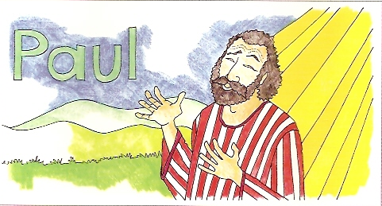
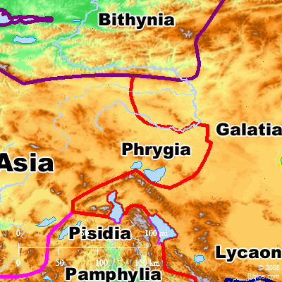
Paul* and his companions traveled throughout the region* of Phrygia* and Galatia,* having been kept by the Holy Spirit from preaching the word in the province of Asia.

Slide 13
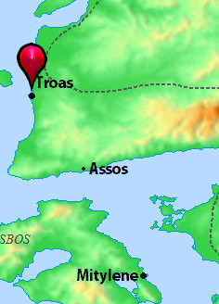
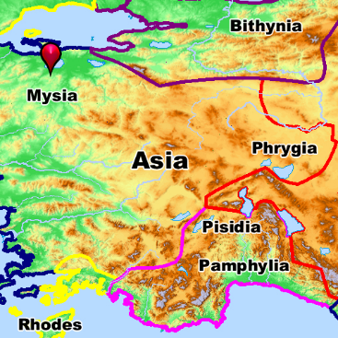
When they came to the border of Mysia,* they tried to enter Bithynia,* but the Spirit of Jesus would not allow them to.** So they passed by Mysia and went down to Troas.*

Slide 14
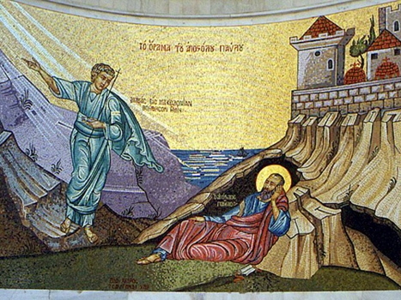
During the night Paul had a vision of a man of Macedonia standing and begging him,
Come over to Macedonia and help us.

Slide 15
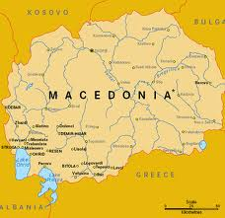
After Paul had seen the vision, we got ready at once to leave for Macedonia,* concluding that God had called us to preach the gospel to them.

Slide 16
Lydia’s Conversion in Philippi
Acts 16:11-15

Slide 17
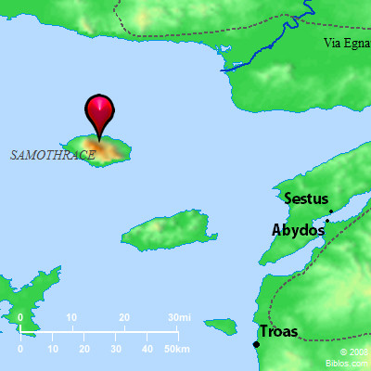
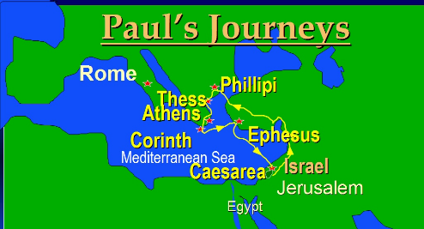
From Troas we put out to sea* and sailed** straight for Samothrace,* and the next day we went on to Neapolis. From there we traveled to Philippi,** a Roman colony and the leading city of that district of Macedonia. And we stayed there several days.

Slide 18
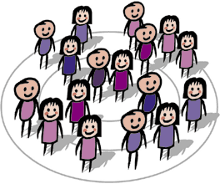
On the Sabbath we went outside the city gate to the river,* where we expected to find a place of prayer.* We sat down and began to speak to the women* who had gathered there.

Slide 19
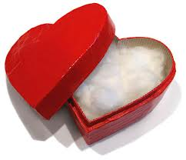
One of those* listening was a woman from the city of Thyatira named Lydia,* a dealer in purple cloth.* She was a worshiper of God. The Lord opened her heart* to respond to Paul’s message.
LYDIA!!

Slide 20
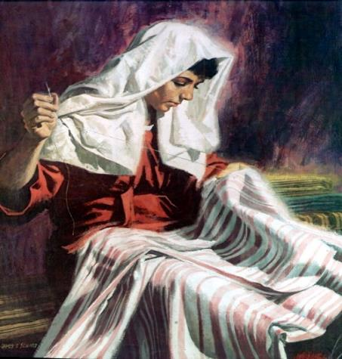
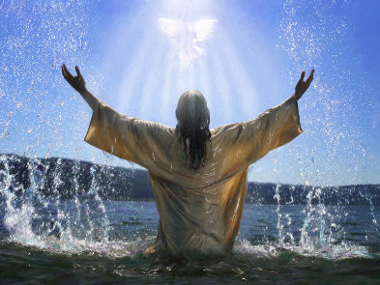
If you consider me a believer in the Lord,
come and stay at my house.
When she and the members of her household were baptized,** she* invited us to her home.*
She said,**
And she persuaded us.

Slide 21
Paul and Silas in Prison
Acts 16:16-15

Slide 22
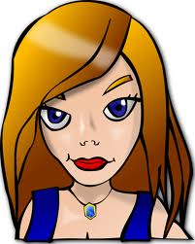
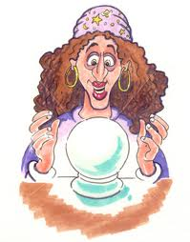
Once when we were going to the place of prayer, we were met by a female slave* who had a spirit by which she predicted the future. She earned a great deal of money* for her owners by fortune-telling.*

Slide 23
She followed Paul and the rest of us, shouting,
These men are servants of the Most High God, who are telling you the way to be saved.

Slide 24
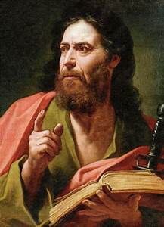
She kept this up for many days. Finally Paul* became so annoyed that he turned around and said to the spirit,*
In the name of Jesus Christ I command you to come out of her!
At that moment the spirit left her. *

Slide 25
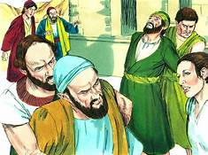
When her owners realized that their hope of making money was gone,* they seized Paul and Silas* and dragged them into the marketplace to face the authorities.*

Slide 26
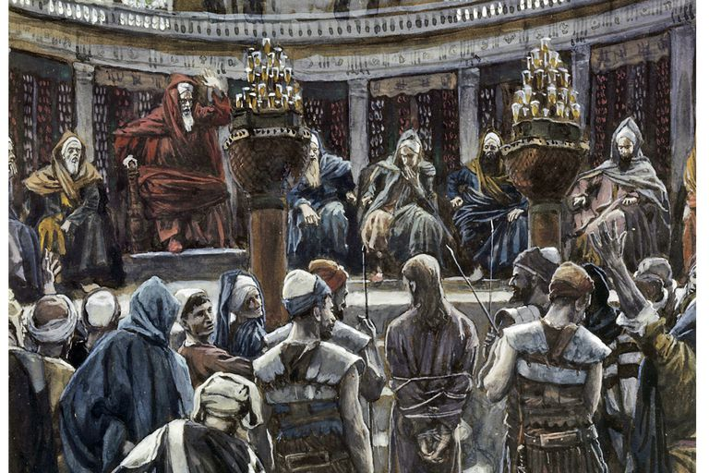
They brought them before the magistrates* and said,
These men are Jews, and are throwing our city into an uproar by advocating customs unlawful for us Romans to accept or practice.

Slide 27
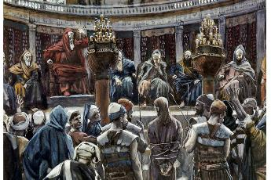
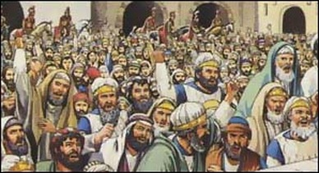
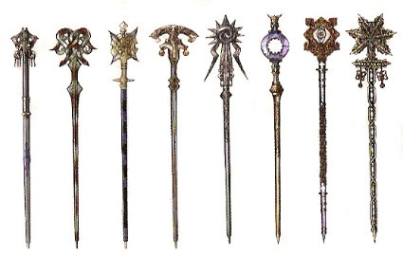
The crowd joined in the attack against Paul and Silas,* and the magistrates* ordered them to be stripped and beaten with rods.**

Slide 28
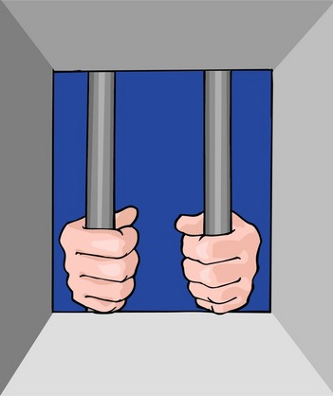
After they had been severely flogged, they were thrown into prison, and the jailer was commanded to guard them carefully. When he received these orders, he put them in the inner cell and fastened their feet in the stocks.*

Slide 29
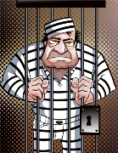
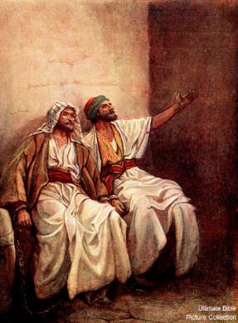
About midnight* Paul and Silas* were praying and singing hymns* to God, and the other prisoners* were listening to them.

Slide 30
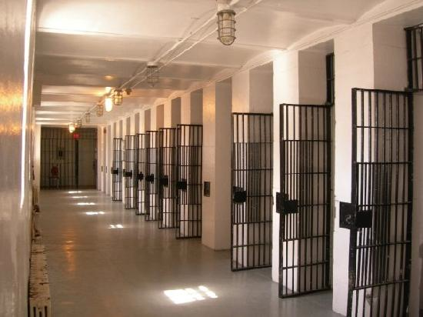
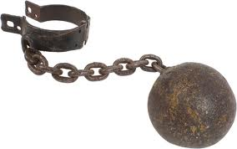
Suddenly there was such a violent earthquake that the foundations of the prison were shaken.** At once all the prison doors flew open,* and everyone’s chains came loose.*

Slide 31
The jailer woke up, and when he saw the prison doors open,* he drew his sword* and was about to kill himself because he thought the prisoners had escaped.** But Paul* shouted,
“Don’t harm yourself! We are all here!”

Slide 32
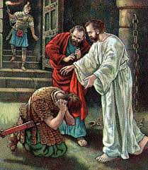
The jailer* called for lights,* rushed in and fell trembling before Paul and Silas. He then brought them out and asked,*
“Sirs, what must I do to be saved?”

Slide 33
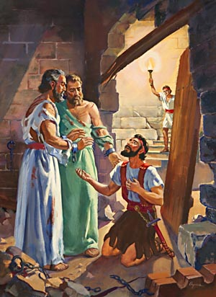
They replied,
Believe in the Lord Jesus, and you will be saved—you and your household.

Slide 34
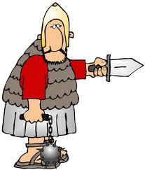
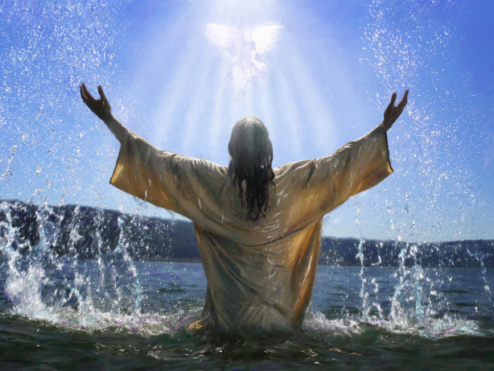
Then they spoke the word of the Lord to him and to all the others in his house. At that hour of the night the jailer* took them and washed their wounds;* then immediately he and all his household were baptized.*

Slide 35
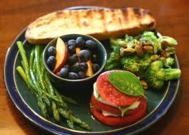
The jailer* brought them into his house and set a meal* before them; he was filled with joy because he had come to believe in God—he and his whole household.

Slide 36
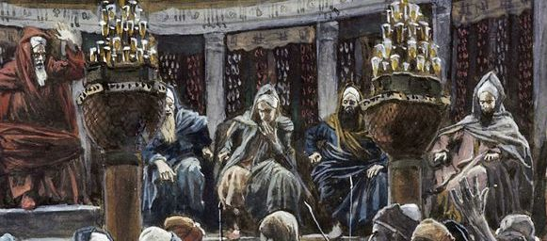
“The magistrates have ordered that you and Silas be released. Now you can leave. Go in peace.”
“Release those men.”*
The jailer told Paul,*
When it was daylight, the magistrates* sent their officers to the jailer with the order:*

Slide 37
But Paul* said to the officers:*
They beat us publicly without a trial, even though we are Roman citizens, and threw us into prison. And now do they want to get rid of us quietly? No! Let them come themselves and escort us out.

Slide 38
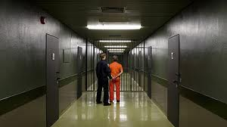
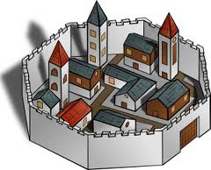
The officers reported this to the magistrates,* and when they heard that Paul and Silas* were Roman citizens, they were alarmed.** They came to appease them and escorted them from the prison,* requesting them to leave the city.**

Slide 39
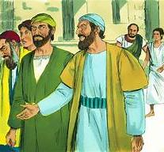
After Paul and Silas* came out of the prison,* they went to Lydia’s house,* where they met with the brothers and sisters and encouraged them. Then they left.*

