Slide 1
CQ Lesson #1
Acts 1:1-11
2:1-8,12-21,36-47

Slide 2
Acts 5:32
We are witnesses of these things, and so is the Holy Spirit,
whom God has given to those
who obey Him.
Acts 5:32

Slide 3
Acts 1
Jesus Taken Up into Heaven

Slide 4
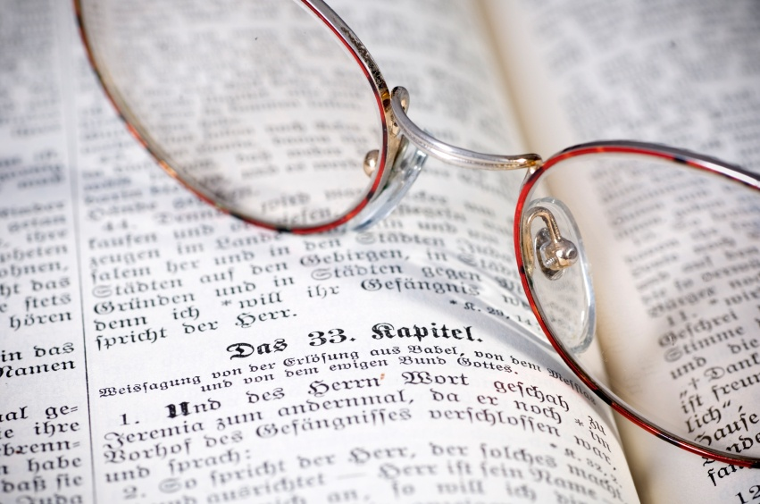
In my former book, Theophilus,…
The Gospel According to Luke

Slide 5
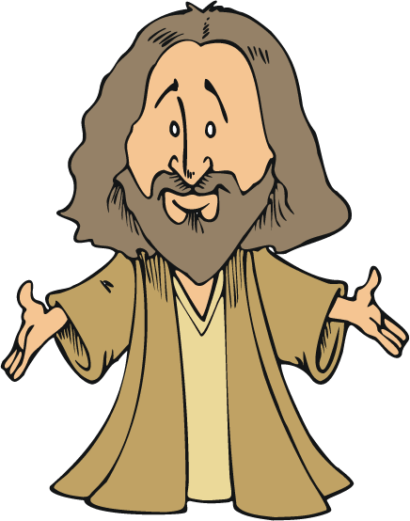
…I wrote about all that Jesus began to do and to teach…

Slide 6
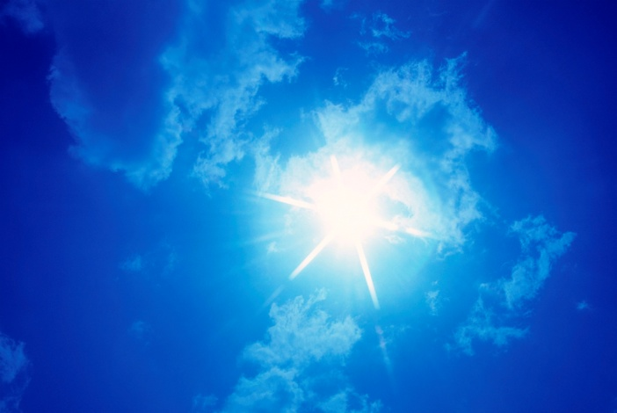
…until the day He was taken up to heaven,

Slide 7
…after giving instructions through the Holy Spirit to the apostles He had chosen.

Slide 8
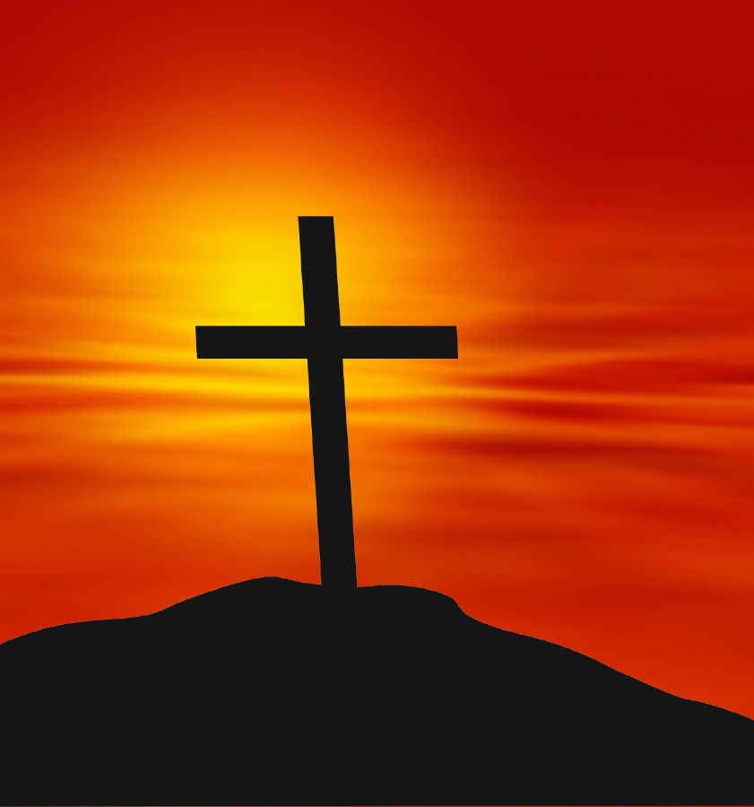
After His suffering,…

Slide 9
…He presented himself to them and gave many convincing proofs that He was alive.

Slide 10
He appeared to them over a period of days and spoke about the kingdom of God.
40

Slide 11
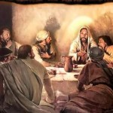
On one occasion, while he was eating with them, he gave them this command:
Do not leave Jerusalem, but wait for the gift my Father promised, which you have heard me speak about.

Slide 12
For John baptized with water,
but in a few days you will be baptized with the Holy Spirit.

Slide 13
Then they gathered around him and asked him,
Lord, are you at this time going to restore the kingdom to Israel?

Slide 14
He said to them:
It is not for you to know the times or dates the Father has set by his own authority.

Slide 15
Acts 1:8
But you will receive power when the Holy Spirit comes on you;

Slide 16
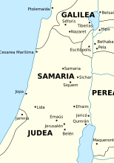
…and you will be my witnesses in *Jerusalem, and in all
*Judea and *Samaria, and to the
*ends of the earth.
Acts 1:8

Slide 17
After he said this,
*he was taken up before their very eyes, and a cloud hid him from their sight.

Slide 18
They were looking intently up into the sky as he was going, when suddenly* two men dressed in white stood beside them.

Slide 19
they said
Men of Galilee,
Why do you stand here looking into the sky?
This same Jesus, who has been taken from you into heaven, will come back in the same way
you have seen him go into heaven.

Slide 20
ACTS 2
1-8,12-21,36-47

Slide 21

When the day of Pentecost came, they were all together in one place.

Slide 22
Suddenly a sound like the blowing of a violent wind came from heaven and filled the whole house where they were sitting.

Slide 23

They saw what seemed to be tongues of fire that separated and came to rest on each of them.

Slide 24


All of them were filled with the Holy Spirit and began to speak in other tongues as the Spirit enabled them.

Slide 25
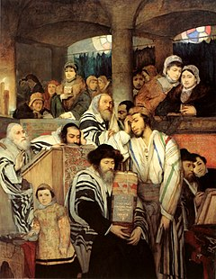
Now there were staying in Jerusalem
God-fearing Jews from every nation under heaven.

Slide 26
When they heard this sound, a crowd came together in bewilderment, because each one heard their own language being spoken.

Slide 27
Utterly amazed, they asked:
Aren’t all these who are speaking Galileans?
Then how is it that each of us hears them in our native language?

Slide 28
Some, however, made fun of them and said,
Amazed and perplexed, they asked one another,
What does this mean?
They have had too much wine!

Slide 29
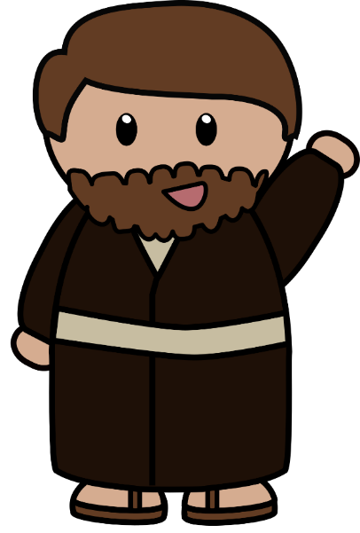
Peter Addresses the Crowd
Then Peter stood up with the Eleven, raised his voice and addressed the crowd:

Slide 30
Fellow Jews and all of you who live in Jerusalem, let me explain this to you; listen carefully to what I say.
These people are not drunk, as you suppose.
It’s only 9:00 in the morning!

Slide 31
“No, this is what was spoken by the prophet Joel:

Slide 32

In the last days, God says,
I will pour out my Spirit on all people.
Your sons and daughters will prophesy, your young men will see visions, your old men will dream dreams.

Slide 33
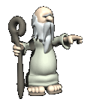
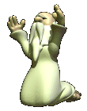
I will show wonders in the heavens above and signs on the earth below, blood and fire and billows of smoke.
Even on my servants, both men and women,
I will pour out my Spirit in those days,
and they will prophesy.

Slide 34

The sun will be turned to darkness*
and the moon to blood

Slide 35

…before the coming of the great and glorious day of the Lord.

Slide 36
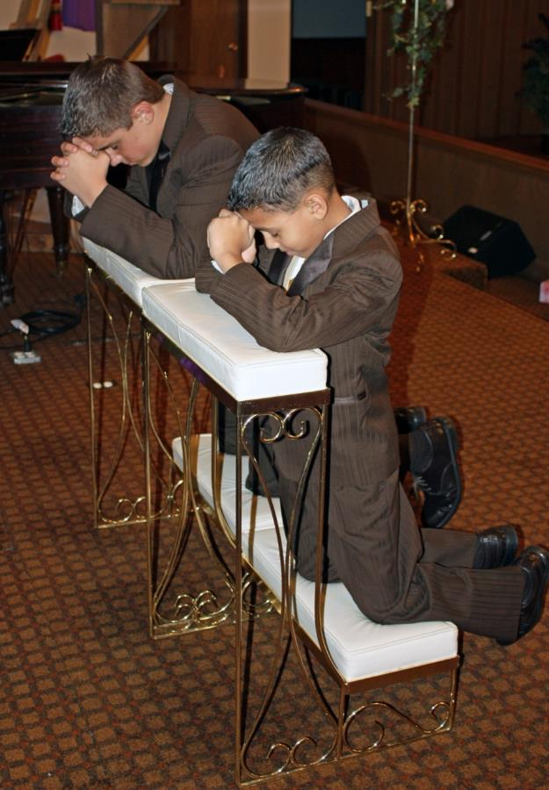
And everyone who calls on the
name of the Lord
will be saved.
Acts 2:21

Slide 37
“Therefore let all Israel be assured of this:
God has made this Jesus, whom you crucified, both Lord and Messiah.”

Slide 38
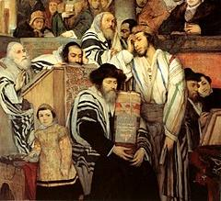

When the people heard this, they were cut to the heart and said to Peter and the other apostles,
Brothers, what shall we do?

Slide 39
Peter replied
Repent and be baptized,
every one of you,
in the name of Jesus Christ
for the forgiveness of your sins
And you will receive the gift of the Holy Spirit.

Slide 40
The promise is for you and your children and for all who are far off —for all whom the Lord our God will call.

Slide 41
With many other words he warned them; and he pleaded with them,
Save yourselves
from this corrupt generation.

Slide 42
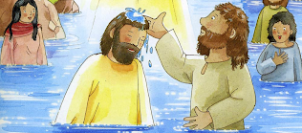
Those who accepted his message were baptized, and about 3000 were added to their number that day.

Slide 43
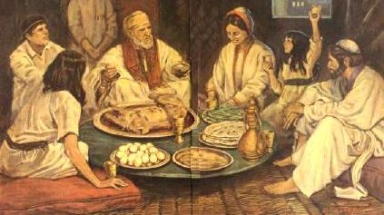
They devoted themselves to the apostles’ teaching and to fellowship, to the breaking of bread and to prayer.
The Fellowship of the Believers

Slide 44
Everyone was filled with awe at the many wonders and signs performed by the apostles.

Slide 45


All the believers were together and had everything in common. They sold property and possessions to give to anyone who had need.*
$
$

Slide 46
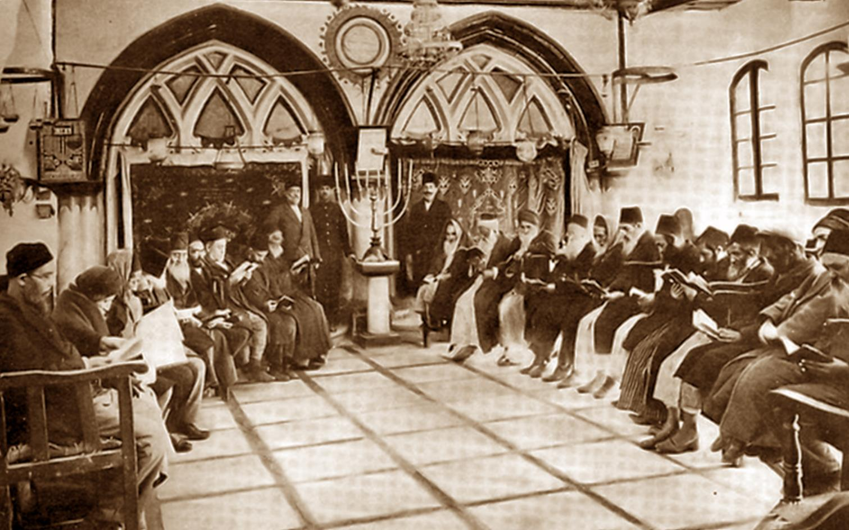
Every day they continued to meet together in the temple courts.

Slide 47
They broke bread in their homes and ate together with glad and sincere hearts, praising God and enjoying the favor of all the people.

Slide 48
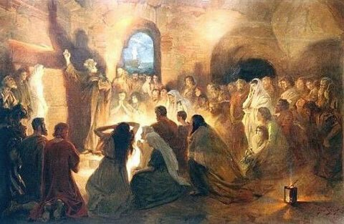
And the Lord added to their number daily those who were being saved.

