Slide 1
Dig Site 18
Matthew 27:11-31

Slide 2
Memory Verse
What shall I do, then, with Jesus who is called the Messiah?
Matthew 27:22a

Slide 3
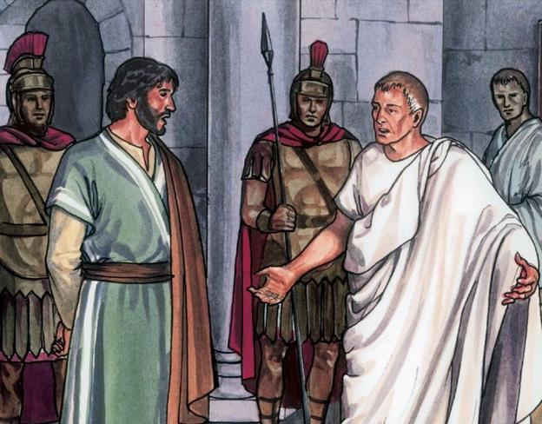
¹¹ Meanwhile Jesus stood before the governor, and the governor asked him, “Are you the king of the Jews?” “You have said so,” Jesus replied.
Jesus Before Pilate

Slide 4
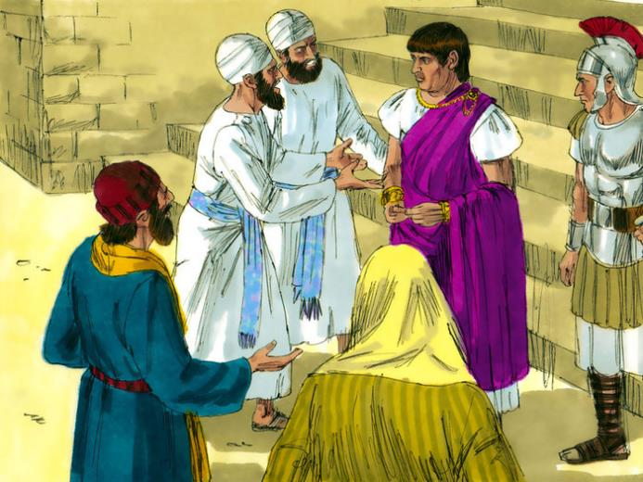
¹² When he was accused by the chief priests and the elders, he gave no answer.

Slide 5
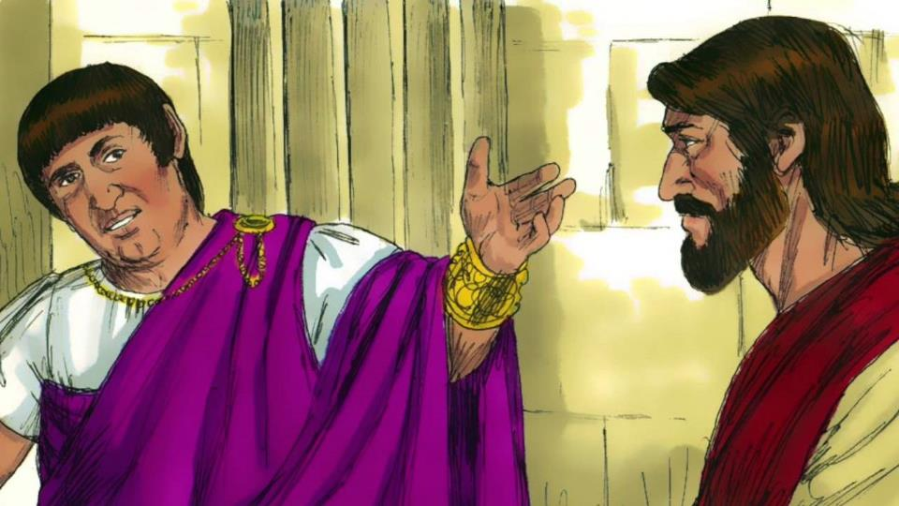
¹³ Then Pilate asked him, “Don’t you hear the testimony they are bringing against you?”

Slide 6
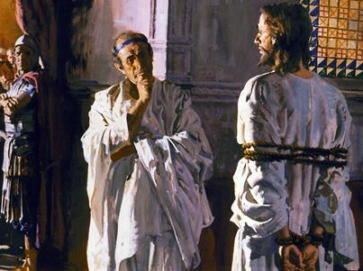
¹⁴ But Jesus made no reply, not even to a single charge—to the great amazement of the governor.

Slide 7
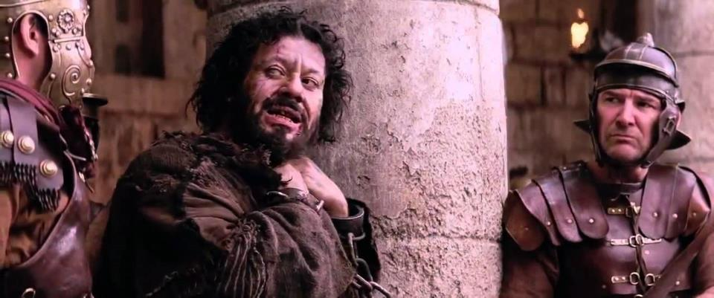
¹⁵ Now it was the governor’s custom at the festival to release a prisoner chosen by the crowd. ¹⁶ At that time they had a well-known prisoner whose name was Jesus Barabbas.

Slide 8
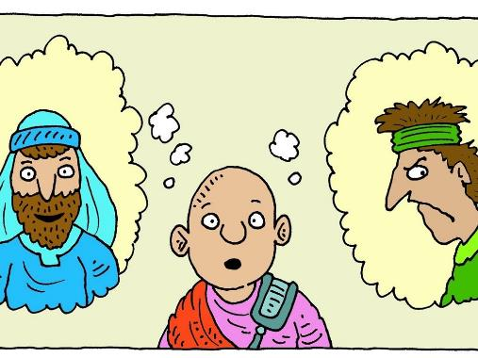
¹⁷ So when the crowd had gathered, Pilate asked them, “Which one do you want me to release to you: Jesus Barabbas, or Jesus who is called the Messiah?” ¹⁸ For he knew it was out of self-interest that they had handed Jesus over to him.

Slide 9
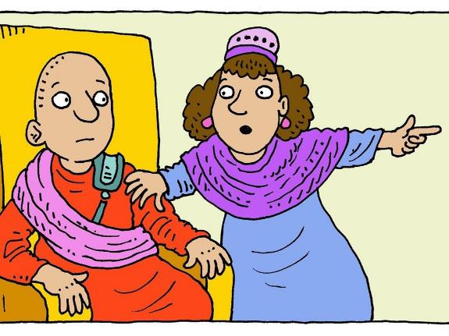
¹⁹ While Pilate was sitting on the judge’s seat, his wife sent him this message: “Don’t have anything to do with that innocent man, for I have suffered a great deal today in a dream because of him.”

Slide 10
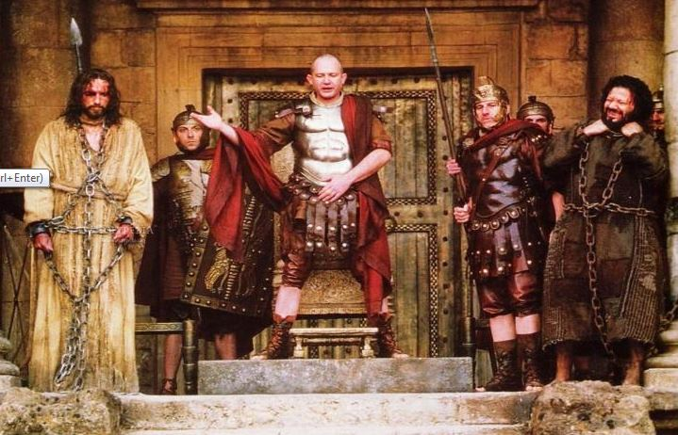
²⁰ But the chief priests and the elders persuaded the crowd to ask for Barabbas and to have Jesus executed.

Slide 11
²¹ “Which of the two do you want me to release to you?” asked the governor. “Barabbas,” they answered.

Slide 12
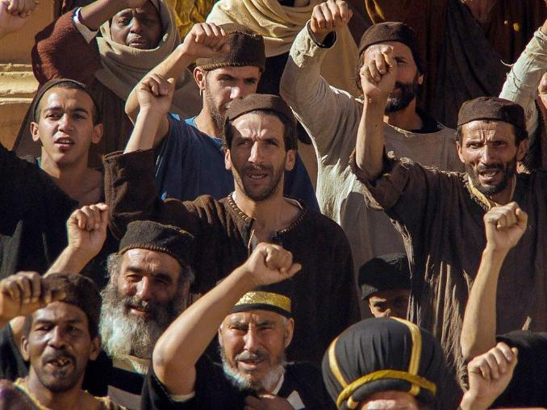
²² “What shall I do, then, with Jesus who is called the Messiah?” Pilate asked. They all answered, “Crucify him!”

Slide 13
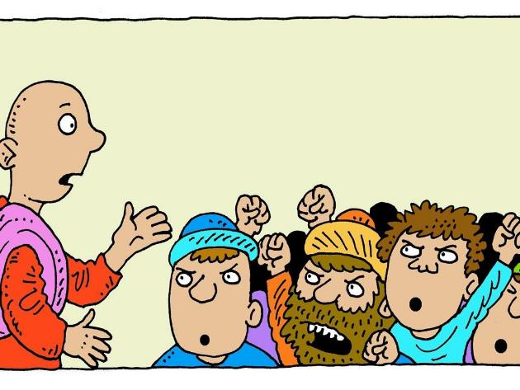
²³ “Why? What crime has he committed?” asked Pilate.
But they shouted all the louder, “Crucify him!”

Slide 14
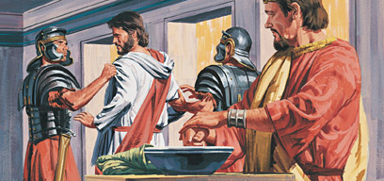
²⁴ When Pilate saw that he was getting nowhere, but that instead an uproar was starting, he took water and washed his hands in front of the crowd. “I am innocent of this man’s blood,” he said. “It is your responsibility!”

Slide 15
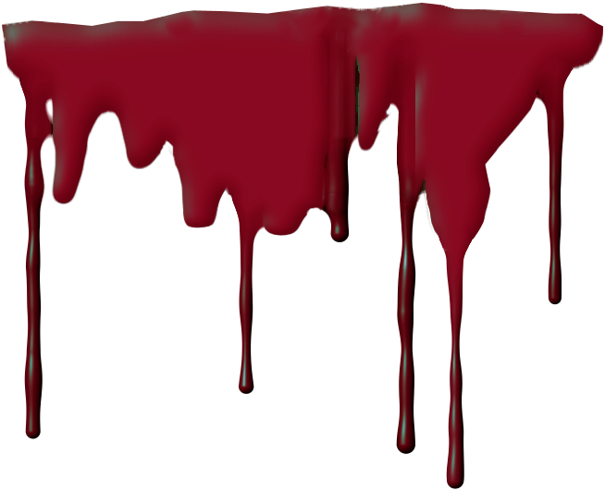
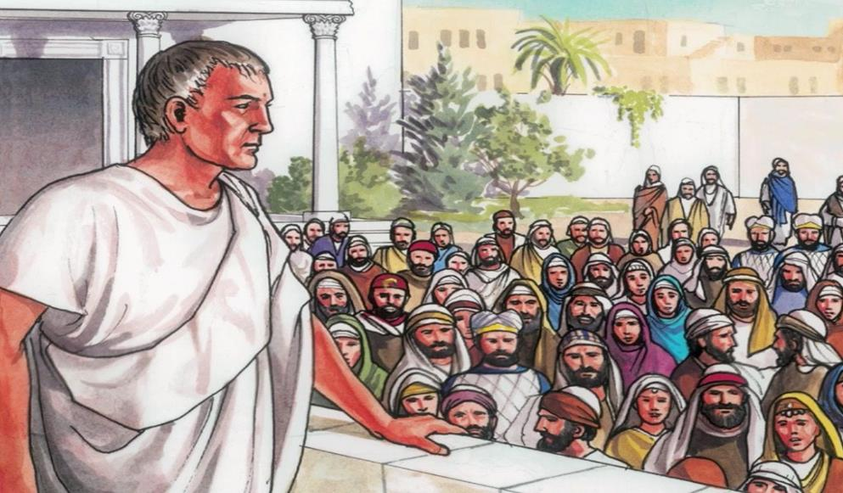
²⁵ All the people answered, “His blood is on us and on our children!”

Slide 16
²⁶ Then he released Barabbas to them. But he had Jesus flogged, and handed him over to be crucified.

Slide 17
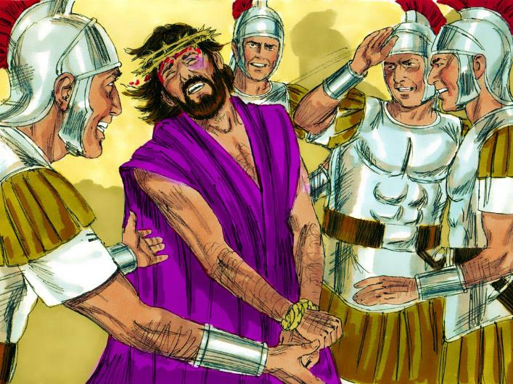
²⁷ Then the governor’s soldiers took Jesus into the Praetorium and gathered the whole company of soldiers around him.

Slide 18
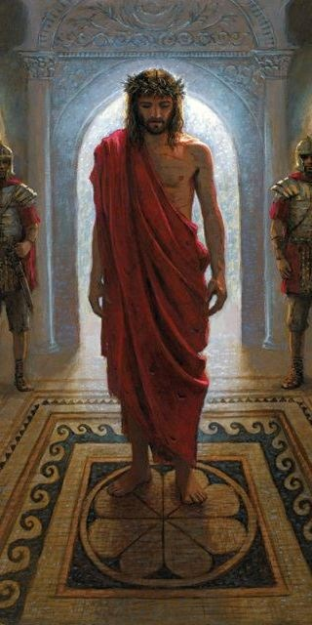
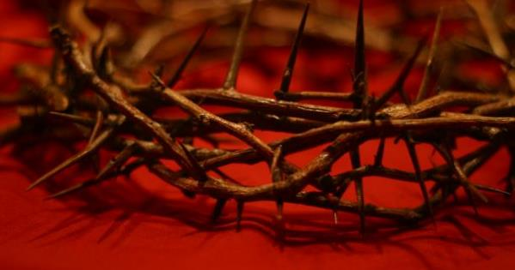
²⁸ They stripped him and put a scarlet robe on him, ²⁹ and then twisted together a crown of thorns and set it on his head.

Slide 19
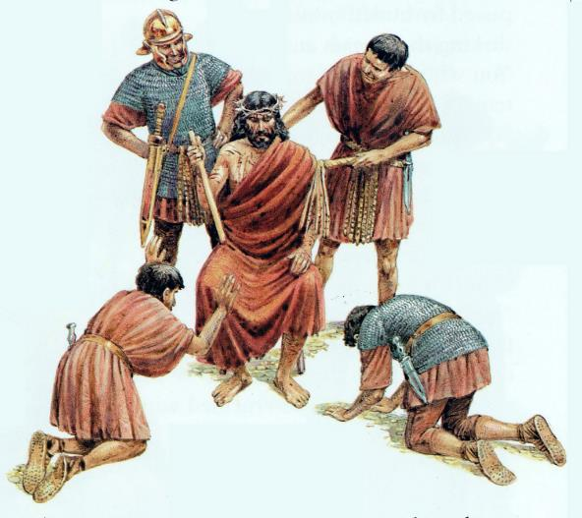
They put a staff in his right hand. Then they knelt in front of him and mocked him. “Hail, king of the Jews!” they said.

Slide 20
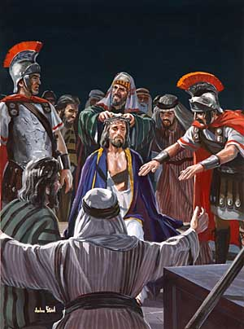
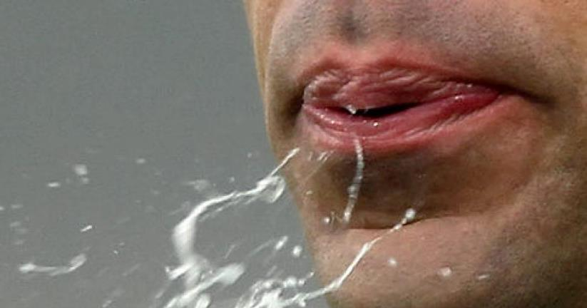
³⁰ They spit on him, and took the staff and struck him on the head again and again.

Slide 21
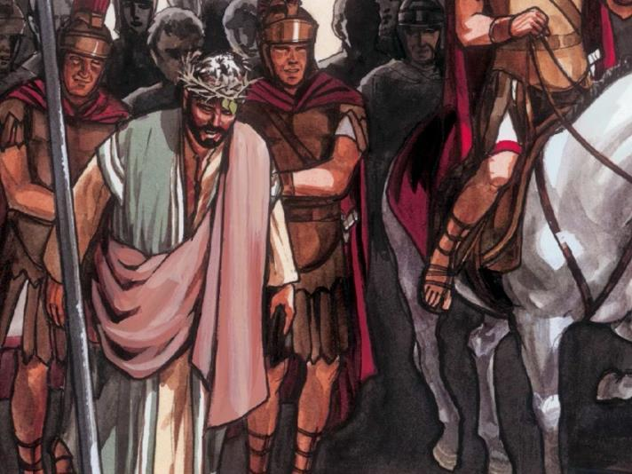
³¹ After they had mocked him, they took off the robe and put his own clothes on him. Then they led him away to crucify him.

