Slide 1
Matthew Dig Site 17
Matthew 26:57-27:5

Slide 2
Memory Verse
“Then Jesus said to his disciples,
“Whoever wants to be my disciple
Matthew 16:24
must deny themselves
17
and take up their cross
and follow me.”

Slide 3
Jesus before the Sanhedrin

Slide 4
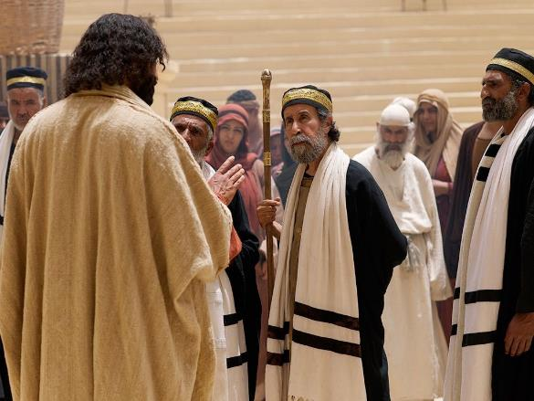
⁵⁷ Those who had arrested Jesus took him to Caiaphas the high priest, where the teachers of the law and the elders had assembled.

Slide 5
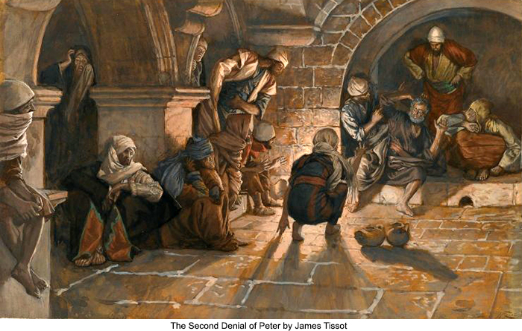
⁵⁸ But Peter followed him at a distance, right up to the courtyard of the high priest. He entered and sat down with the guards to see the outcome.

Slide 6
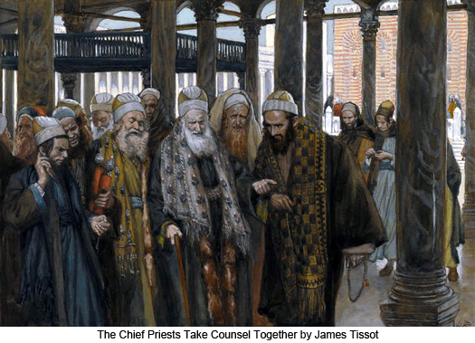
⁵⁹ The chief priests and the whole Sanhedrin were looking for false evidence against Jesus so that they could put him to death.

Slide 7
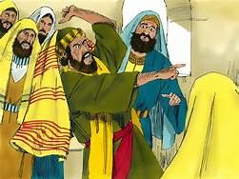
⁶⁰ But they did not find any, though many false witnesses came forward. Finally two came forward ⁶¹ and declared, “This fellow said, ‘I am able to destroy the temple of God and rebuild it in three days.’”

Slide 8
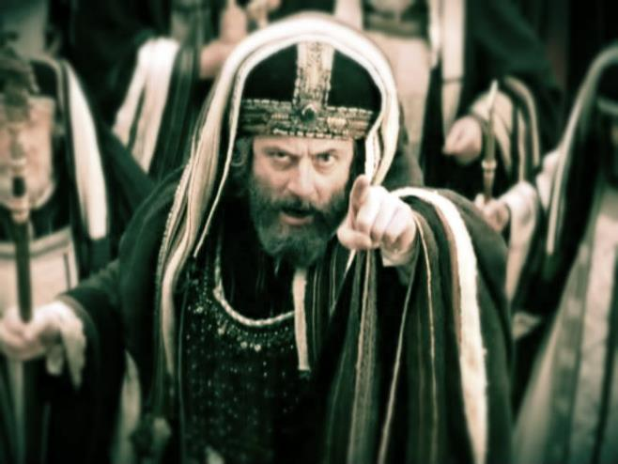
⁶² Then the high priest stood up and said to Jesus, “Are you not going to answer? What is this testimony that these men are bringing against you?”

Slide 9
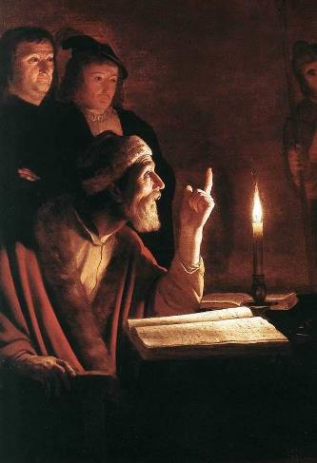
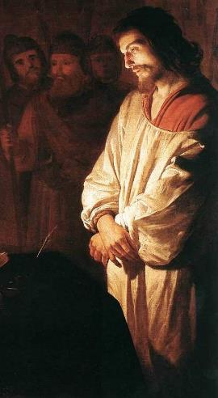
⁶³ But Jesus remained silent. The high priest said to him, “I charge you under oath by the living God: Tell us if you are the Messiah, the Son of God.”

Slide 10
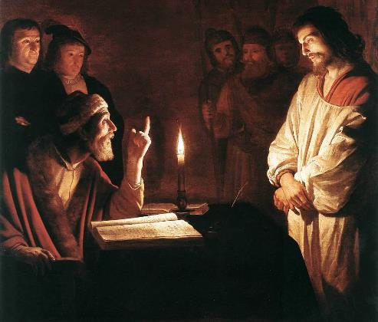
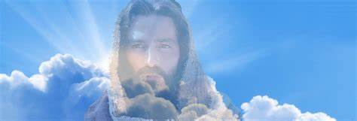
⁶⁴ “You have said so,” Jesus replied. “But I say to all of you: From now on you will see the Son of Man* sitting at the right hand of the Mighty One and coming on the clouds of heaven.”

Slide 11
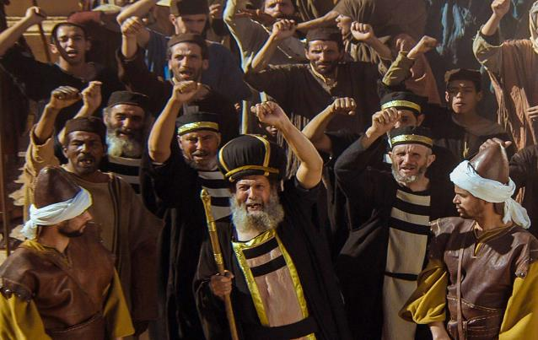
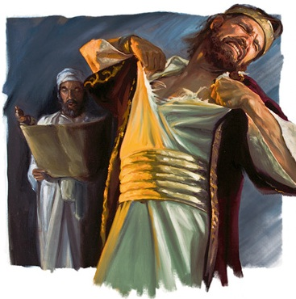
⁶⁵ Then the high priest tore his clothes and said, “He has spoken blasphemy! Why do we need any more witnesses? Look, now you have heard the blasphemy. ⁶⁶ What do you think?*” “He is worthy of death,” they answered.

Slide 12
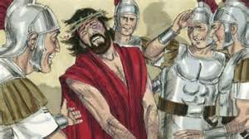
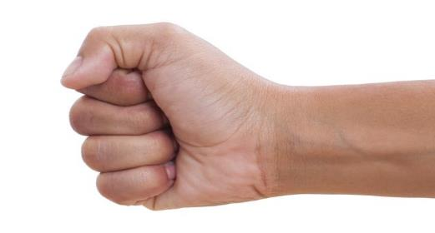
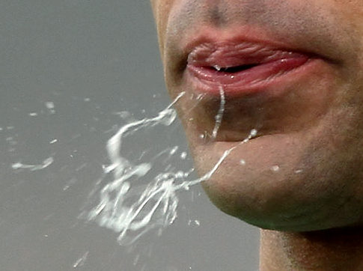
⁶⁷ Then they spit* in his face and struck him with their fists*. Others slapped* him ⁶⁸ and said*, “Prophesy to us, Messiah. Who hit you?”

Slide 13
Peter disowns Jesus

Slide 14
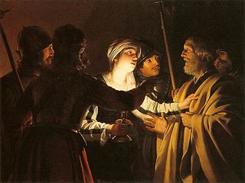
⁶⁹ Now Peter was sitting out in the courtyard, and a servant girl came to him. “You also were with Jesus of Galilee,” she said.
⁷⁰ But he denied it before them all. “I don’t know what you’re talking about,” he said.

Slide 15
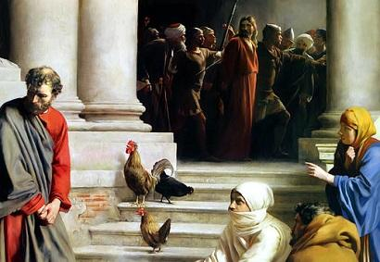
⁷¹ Then he went out to the gateway, where another servant girl saw him and said to the people there, “This fellow was with Jesus of Nazareth.”
⁷² He denied it again, with an oath: “I don’t know the man!”

Slide 16
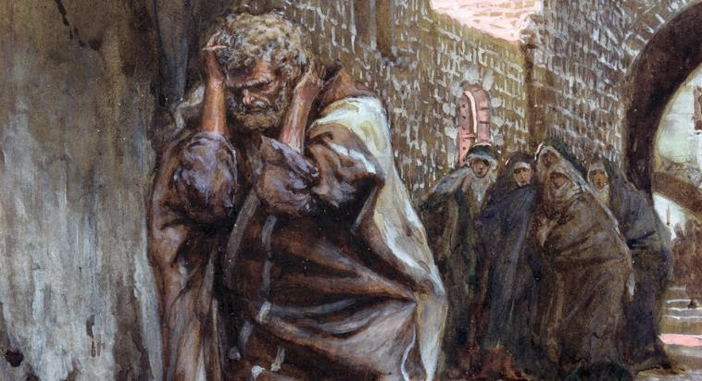
⁷³ After a little while, those standing there went up to Peter and said, “Surely you are one of them; your accent gives you away.”
⁷⁴ Then he began to call down curses, and he swore to them, “I don’t know the man!”

Slide 17
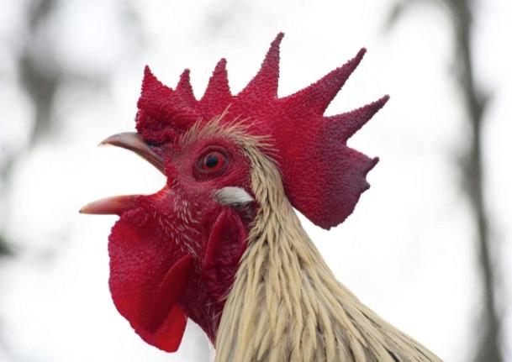
Immediately a rooster crowed.

Slide 18
⁷⁵ Then Peter remembered the word Jesus had spoken: “Before the rooster crows, you will disown me three times.”
And he went outside and wept bitterly.

Slide 19
Judas Hangs Himself

Slide 20
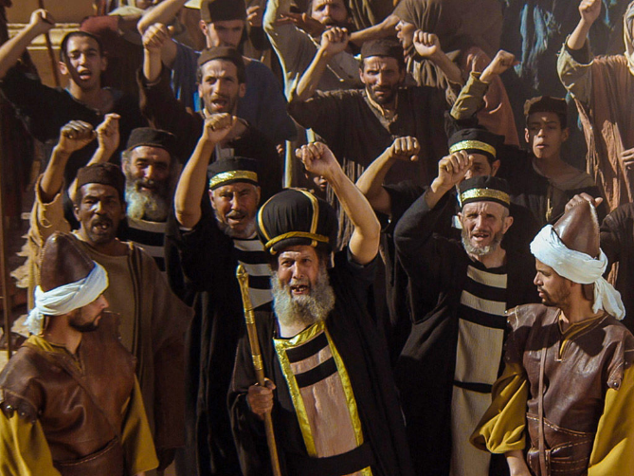
¹ Early in the morning, all the chief priests and the elders of the people made their plans how to have Jesus executed.

Slide 21
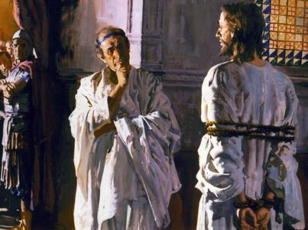
² So they bound him, led him away and handed him over to Pilate the governor.

Slide 22
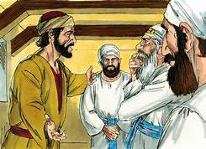
³ When Judas, who had betrayed him, saw that Jesus was condemned, he was seized with remorse and returned the thirty pieces of silver to the chief priests and the elders.

Slide 23
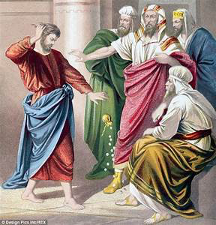
⁴ “I have sinned,” he said, “for I have betrayed innocent blood.”
“What is that to us?” they replied. “That’s your responsibility.”

Slide 24
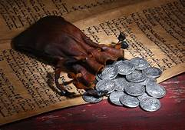
⁵ So Judas threw the money into the temple and left. Then he went away and hanged himself.

