Slide 1
Matthew Dig Site 14
Matthew 24:36-42;
25:1-30

Slide 2
Memory Verse
“Because of the increase of wickedness,
the love of most will grow cold,
but he who stands firm to the end
will be saved.
Matthew 24:12-13
14

Slide 3
Matthew
Arti Facts

Slide 4
God’s
Characteristics
Matthew
God knows when Jesus will return, and wants us to be ready for it.
God prepares us to do His work.

Slide 5
Faith Words
Matthew
Second Coming
The time when Jesus will come back to earth.
Evil will be destroyed and Jesus will reign.

Slide 6
People
Matthew
Ten Virgins
Young women who were
friends or family members
of the bride or groom

Slide 7
People
Matthew
Bridegroom
A man about to be married

Slide 8
Other NT Terms
Matthew
Lamps
New Testament lamps were clay pots with a spout. Oil was poured into the pot and a wick was placed in the spout. Sometimes it was put on the top of a pole to carry.

Slide 9
Other NT Terms
Matthew
“trimmed their lamps”
The women cut off the burnt end of the lamp’s wick

Slide 10
Other NT Terms
Matthew
Interest
An amount of money earned if someone deposits money into a bank

Slide 11
Did You Know?
Matthew
The lamps mentioned in this story would probably only stay lit for 15 minutes before having to use new oil.

Slide 12
Ready for the Return
Matthew 24:36-42; 25:1-30

Slide 13
The Day and Hour Unknown

Slide 14
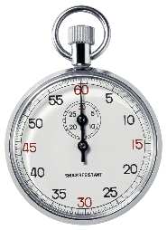
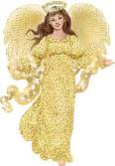
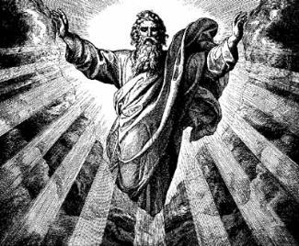
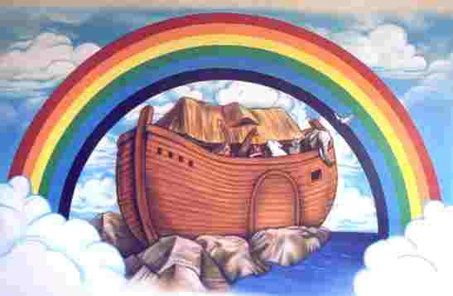
But about that day or hour no one knows,*, not even the angels** in heaven, nor the Son, but only the Father.*
As it was in the days of Noah*, so it will be at the coming of the
Son of Man.

Slide 15
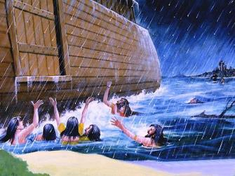
For in the days before the flood*, people were eating and drinking, marrying* and giving in marriage, up to the day Noah entered the ark;

Slide 16
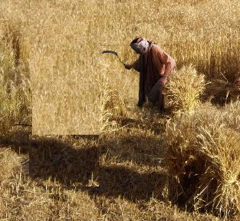
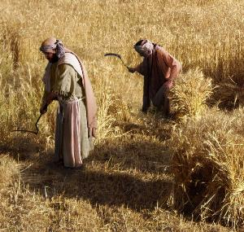
and they knew nothing about what would happen until the flood came and took them all away. That is how it will be at the coming of the Son of Man.
Two men will be in the field; *one will be taken and the other left.

Slide 17
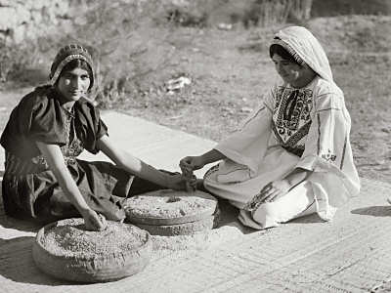
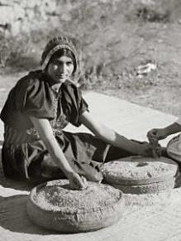
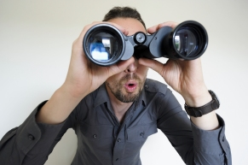
Two women will be grinding* with a hand mill; one will be taken* and the other left.
Therefore keep watch*, because you do not know on what day your Lord will come.

Slide 18
The Parable of the Ten Virgins

Slide 19
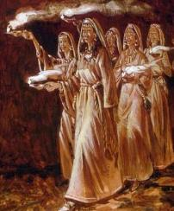
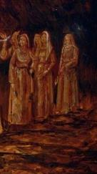
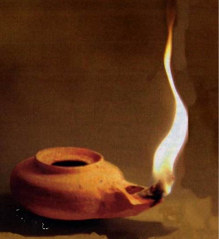
At that time the kingdom of heaven will be like ten virgins* who took their lamps* and went out to meet the bridegroom.*
Five of them were foolish* and five were wise.*

Slide 20
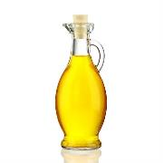
The foolish ones took their lamps* but did not take any oil* with them.*
The wise, however, took oil in jars* along with their lamps.**

Slide 21
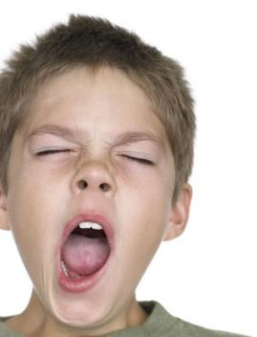
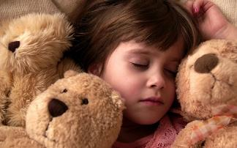
The bridegroom* was a long time in coming, and they all became drowsy* and fell asleep.*
At midnight* the cry rang out:*
Here’s the bridegroom! Come out to meet him!

Slide 22
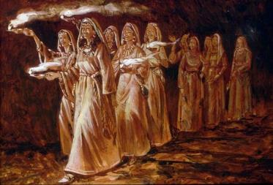
Then all the virgins* woke up and trimmed their lamps. The foolish ones said to the wise,*
Give us some of your oil;* our lamps are going out.

Slide 23
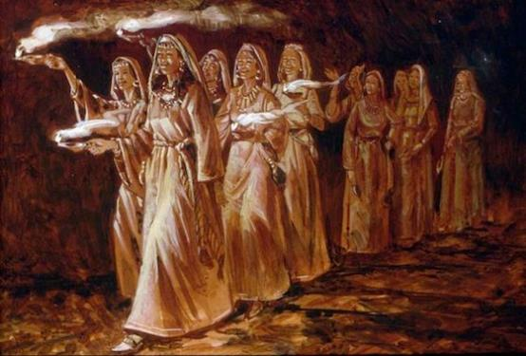
NO,
they replied,
there may not be enough for both us and you. Instead, go to those who sell oil and buy some for yourselves.

Slide 24
But while they were on their way to buy oil,* the bridegroom* arrived. The virgins who were ready went in with him to wedding banquet. And the door was shut.*

Slide 25
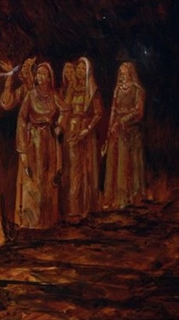
Later the others also came.
Lord! Lord!
they said.
Open the door for us!

Slide 26
But he* replied,
Truly I tell you.
I don’t know you.
Therefore keep watch,* because you do not know the day or the hour.

Slide 27
The Parable of the Bags of Gold

Slide 28
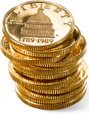
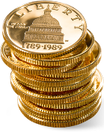
Again, it will be like a man going on a journey, who called his servants and entrusted his wealth to them.
To one he gave five* bags* of gold, to another two* bags,* and to another one* bag,* each according to his ability. Then he went on his journey.

Slide 29
The man* who had received the five* bags of gold went at once and put his money to work and gained* five* bags more.*
So also, the one* with the two* bags of gold gained* two* more.

Slide 30
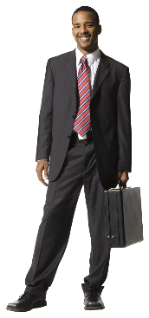
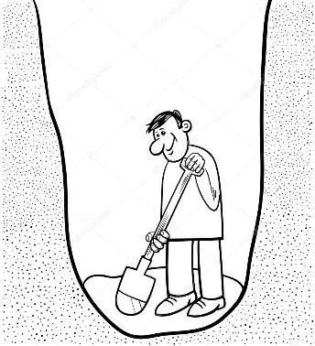
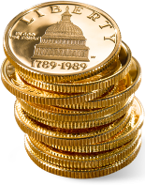
But the man* who had received the one* bag* went off, dug a hole* in the ground and hid his master’s money.
After a long time the master of those servants returned and settled accounts with them.

Slide 31
The man* who had received the five* bags brought the other five.
Master,
he said,
you entrusted me with five bags of gold. See, I have gained five more.

Slide 32
His master replied,
Well done, good and faithful servant! You have been faithful* with a few things; I will put you in charge of many things. Come and share your master’s happiness!

Slide 33
The man* with the two* bags* also came.
Master,
he said,
you entrusted me with two bags; see* I have gained two more.

Slide 34
His master replied,
Well done, good and faithful servant! You have been faithful* with a few things; I will put you in charge of many things. Come and share your master’s happiness!

Slide 35
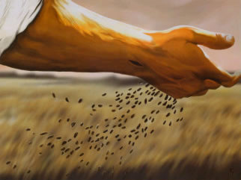
Then the man* who had received the one bag came.
Master,
he said,
I knew that you are a hard man, harvesting where you have not sown* and gathering where you have not scattered seed.
So I was afraid and went out and hid your gold in the ground. See*, here is what belongs to you.

Slide 36
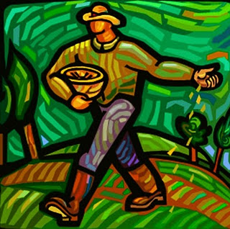
His master replied,
You wicked lazy* servant! So you knew that I harvest where I have not sown* and gather where I have nor scattered seed?

Slide 37
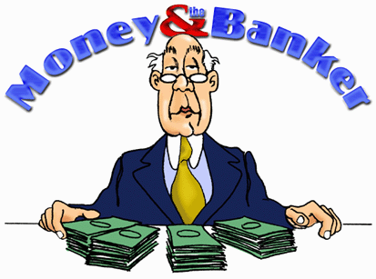
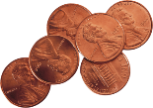
Well then, you should have put my money on deposit with the bankers,* so that when I returned I would have received it back with interest.

Slide 38
So take the bag of gold from him and give it to the one who has ten bags.
For whoever who has will be given more, and they will have an abundance. Whoever does not have, even what they have will be taken from them.

Slide 39
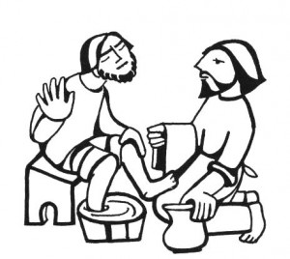
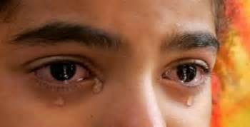
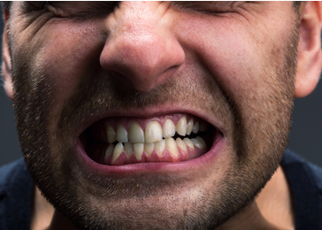
And throw that worthless servant* outside, into the darkness,* where there will be weeping* and gnashing* of teeth.

