Slide 1
Memory Verse
“Jesus said, ‘Let the little children come to me, and do not hinder them, for the kingdom of heaven belongs to such as these.’”
Matthew 19:14

Slide 2
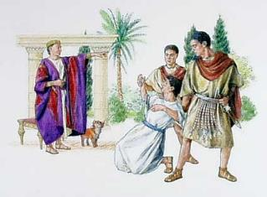
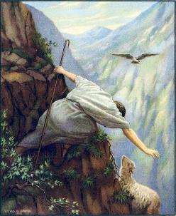
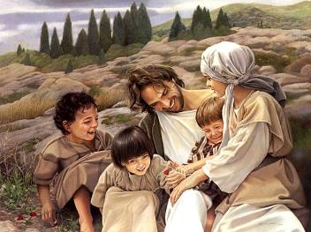
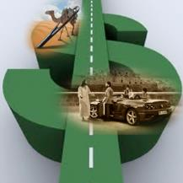
WHAT DO YOU VALUE?
FORGIVENESS?
THE LOST?
WEALTH?
Children, Women, Poor??
Matthew 18:10-14, 21-35; 19:13-30
LESSON #12

Slide 3
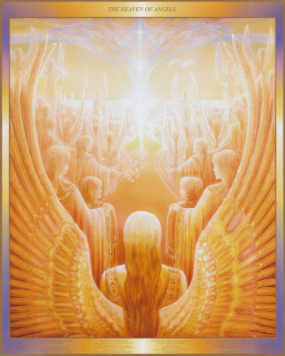
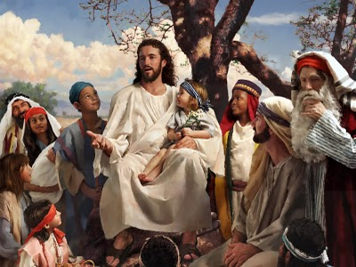
[Jesus said:] See that you do not despise one of these little ones. For I tell you that their angels in heaven* always see the face of my Father in heaven.

Slide 4
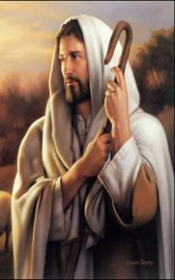
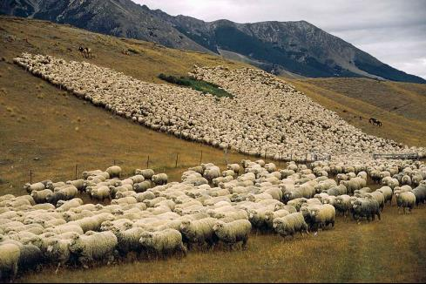
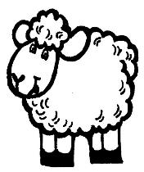
What do you think? *If a man owns a hundred sheep, and one of them wanders away*, will he not leave the ninety-nine on the hills* and go to look for the one that wandered off?

Slide 5
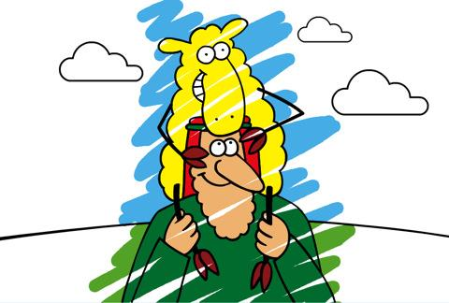
And if he finds it*, truly I tell you, he is happier about that one sheep than about the ninety-nine that did not wander off.

Slide 6
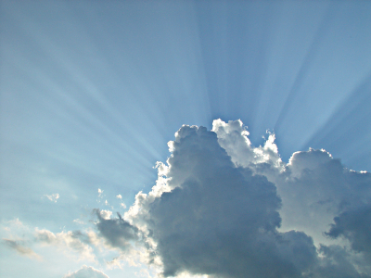
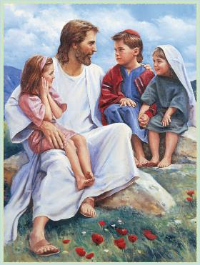
In the same way* your Father in heaven is not willing that any of these little ones should perish.

Slide 7
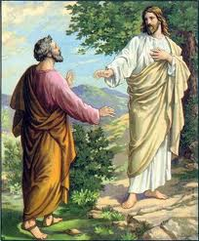
Then Peter came to Jesus and asked,*
Lord, how many times shall I forgive my brother or sister who sins against me?*
7 Times
Up to seven times?

Slide 8
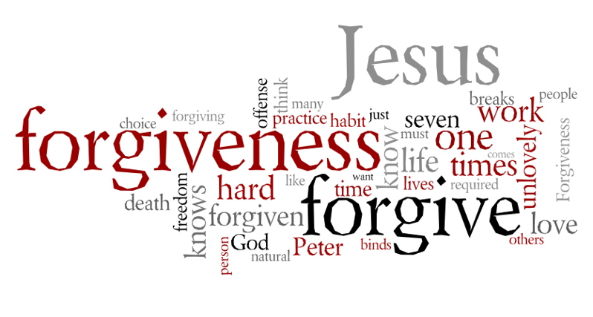
Jesus answered,*
I tell you, not seven times, but seventy-seven times.
77 Times

Slide 9
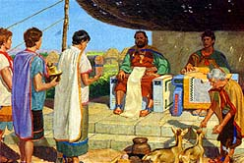
Therefore, the kingdom of heaven is like a king who wanted to settle accounts with his servants.

Slide 10
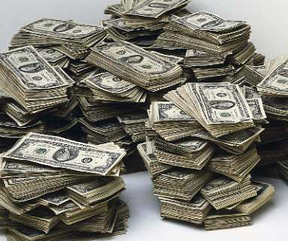
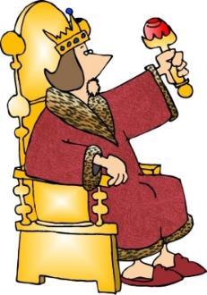
As he began the settlement, a man* who owed him ten thousand bags of gold* was brought to him.
That’s like a million dollars!!!

Slide 11
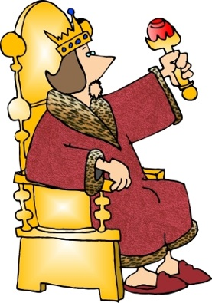

Since he was not able to pay, the master ordered that he and his wife and his children and all that he had be sold* to repay the debt.

Slide 12
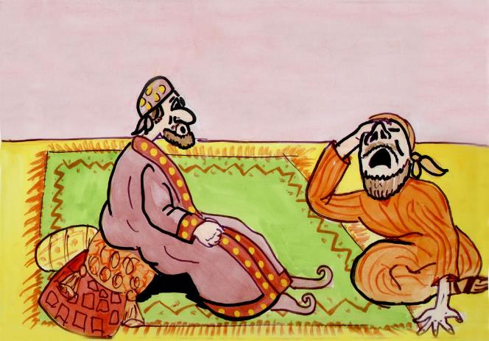
At this, the servant fell on his knees before him.*
Be patient with me,
and I will pay back everything.
he begged,

Slide 13
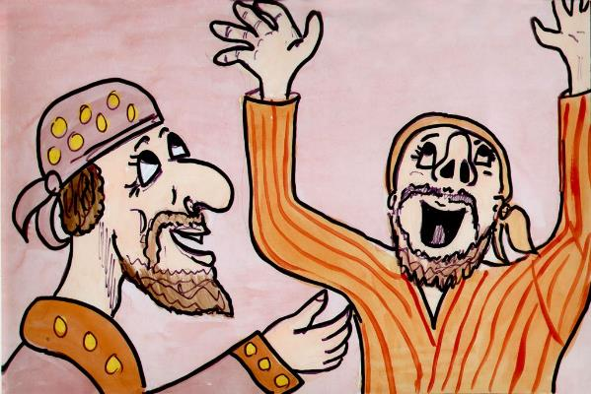
The servant’s master took pity on him, canceled the debt and let him go.

Slide 14
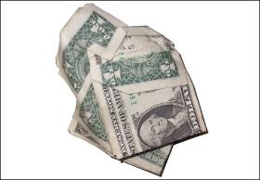
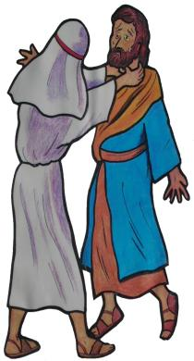
But when that servant went out, he found one of his fellow servants who owed him a hundred silver coins*. He grabbed him and began to choke him.*
Pay back what you owe me!
That’s just a few bucks!
he demanded.

Slide 15
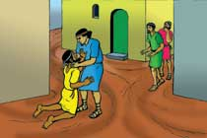
His fellow servant fell to his knees and begged him*,
Be patient with me, and I will pay it back.

Slide 16
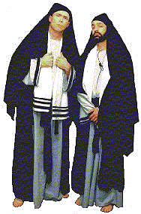
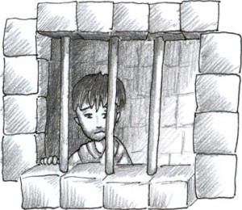
But he refused. Instead, he went off and had the man* thrown into prison until he could pay the debt.*
When the other servants saw what had happened, they were outraged and went* and told their master everything that had happened.

Slide 17
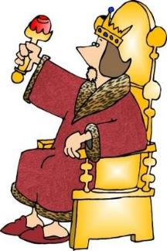
Then the master called the servant in.*
You wicked servant, he said, I canceled all that debt of yours because you begged me to. Shouldn’t you have had mercy on your fellow servant just as I had on you?

Slide 18
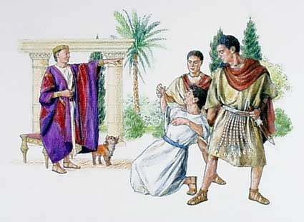
In anger his master handed him over to the jailers to be tortured, until he should pay back all he owed.

Slide 19
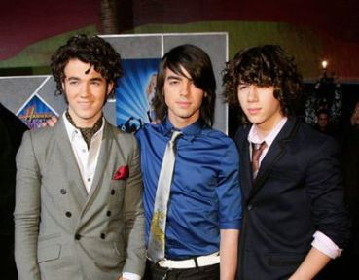
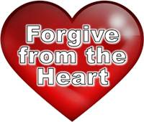
This is how my* heavenly Father will treat each of you unless you forgive your* brother or sister from your* heart.

Slide 20
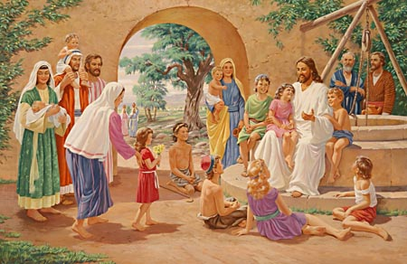
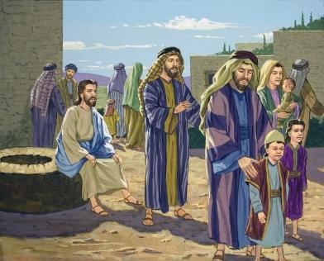
Then people brought little children* to Jesus for him to place his hands on them and pray for them. But the disciples* rebuked them.

Slide 21
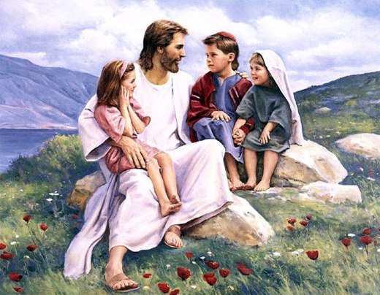
Jesus said*,
Let the little children come to me, and do not hinder them, for the kingdom of heaven belongs to such as these.”

Slide 22
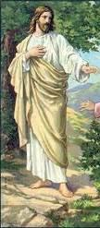
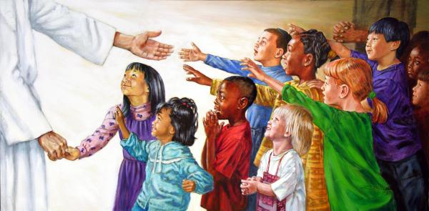
When he had placed his hands* on them, he went on from there*.

Slide 23
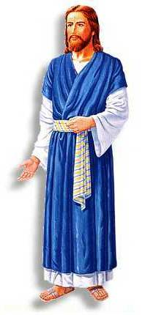
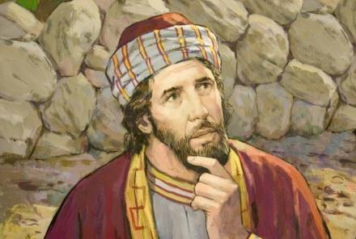
Just then a man came up to Jesus and asked,*
Teacher, what good thing must I do to get eternal life?

Slide 24
Why do you ask me about what is good?
Jesus replied
There is only One who is good. If you want to enter life, keep the commandments.

Slide 25
Which ones?
he inquired. Jesus replied,
You shall not murder, you shall not commit adultery, you shall not steal, you shall not give false testimony, honor your father and mother, and love your neighbor as yourself.

Slide 26
All these I have kept,
the young man said.*
What do I still lack?
Jesus answered
If you want to be perfect, go, sell your possessions and give to the poor, and you will have treasure in heaven. Then come, follow me.

Slide 27
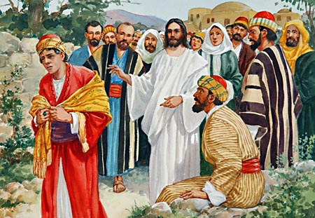
When the young man heard this, *he went away sad, because he had great wealth

Slide 28
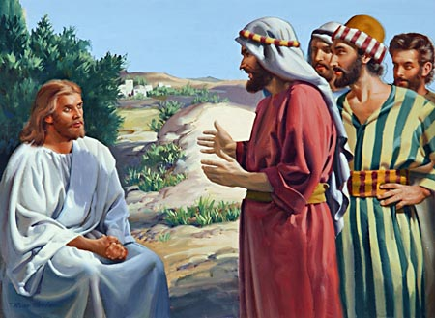
Then Jesus said to his disciples,*
Truly I tell you, it is hard for someone who is rich to enter the kingdom of heaven.

Slide 29
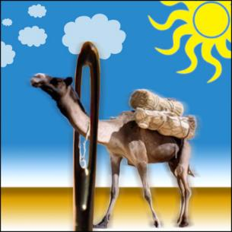
Again I tell you, it is easier for a camel* to go through the eye of a needle than for someone who is rich to enter the kingdom of God

Slide 30
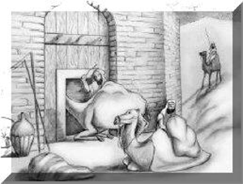
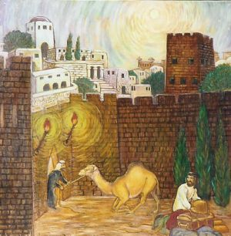
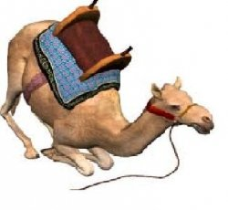
٭٭٭Actually, most people think that during Bible times, the phrase “eye of a needle” referred to a doorway in the wall of a city. Camels with packs on their back could not fit through the door. Camels had to kneel and have their packs removed in order to fit through the door. ٭٭٭

Slide 31
When the disciples heard this, they were greatly astonished and asked,*
Who then can be saved?

Slide 32
Jesus looked at them and said,*
With man this is impossible, but with GOD all things are possible.

Slide 33
Peter answered him,*
We have left everything to follow you! What then will there be for us?

Slide 34
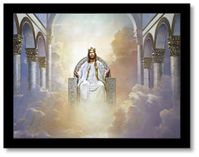
Jesus said to them,*
Truly I tell you, at the renewal of all things, when the Son of Man *sits on his glorious throne,

Slide 35






you who have followed me will also sit *on twelve thrones, judging the twelve tribes of Israel.

Slide 36


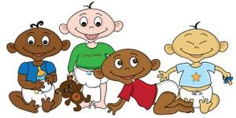

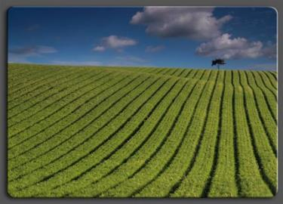
And everyone who has left houses* or brothers or sisters* or father or mother* or wife or children* or fields* for my sake will receive a hundred times* as much and will inherit eternal life.
100 Times

Slide 37
But many who are first *will be last, and many who are last *will be first.

