Slide 1
Matthew Dig Site 8
Matthew 11:1-11, 25-30;
12:1-14

Slide 2
Memory Verse
Come to me,
all you who are weary and burdened,
and I will give you rest.
Take my yoke upon you and learn from me.
Matthew 11:28-29a
8

Slide 3
Memory Verse
Your ways, God, are holy.
What god is as great as our God?
You are the God who performs miracles;
you display your power among the peoples.
Psalm 77:13-14
6

Slide 4
Memory Verse
Then he said to his disciples,
“The harvest is plentiful
but the workers are few.
Ask the Lord of the harvest, therefore,
to send out workers into his harvest field.”
Matthew 9:37-38
7

Slide 5
Matthew
Arti Facts

Slide 6
God’s
Characteristics
Matthew
Jesus proves that He is the Messiah
Jesus cares about those who are weary

Slide 7
Faith Words
Matthew
Prophet
Someone God has chosen to receive and delivers His messages to people
A prophet speak for God.

Slide 8
Other NT Terms
Matthew
Sabbath
The day God set aside for rest and worship

Slide 9
Other NT Terms
Matthew
Yoke
A wooden bar that connects two animals so they can work together.

Slide 10
Other NT Terms
Matthew
Humble
To focus more on God and others than ourselves,
And to give God praise for what he has done for us

Slide 11
Did You Know?
Matthew
A yoke helps evenly distribute the weight two or more animals need to carry or pull.

Slide 12
Rest for the weary

Slide 13
Jesus and John the Baptist

Slide 14
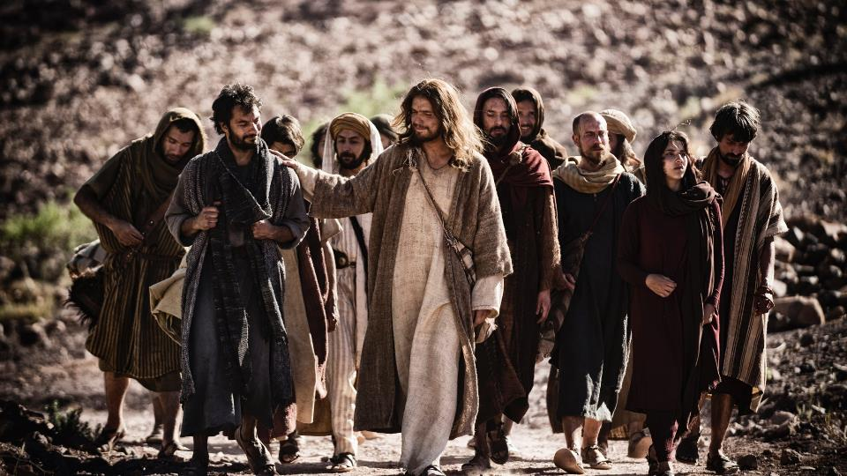
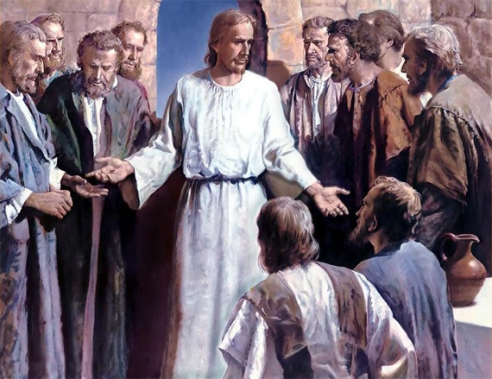
Picture of Jesus and disciples and or teaching and preaching
¹After Jesus had finished instructing his twelve disciples*, he went on from there to teach and preach in the towns of Galilee.

Slide 15
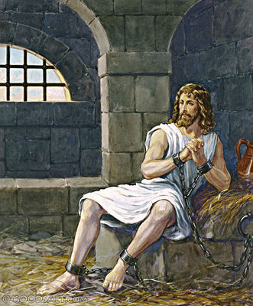
² When John, who was in prison, heard about the deeds of the Messiah, he sent his disciples ³ to ask him,

Slide 16
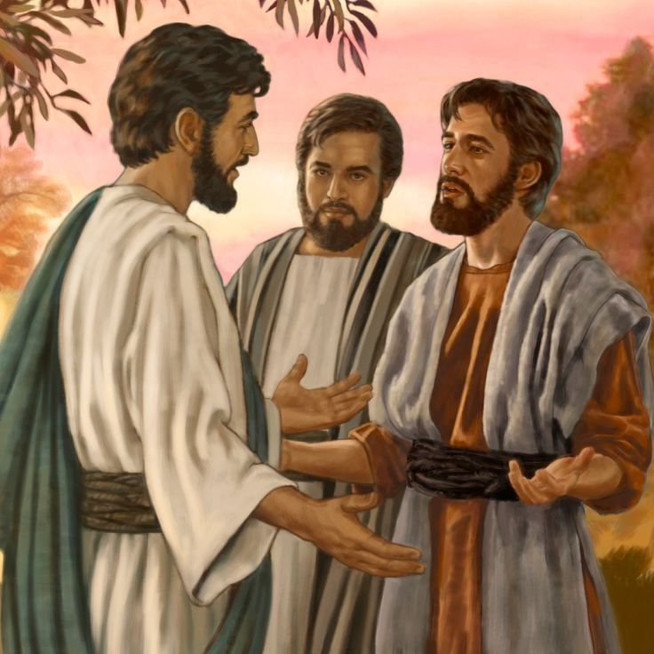
“Are you the one who is to come,
or should we expect someone else?”

Slide 17
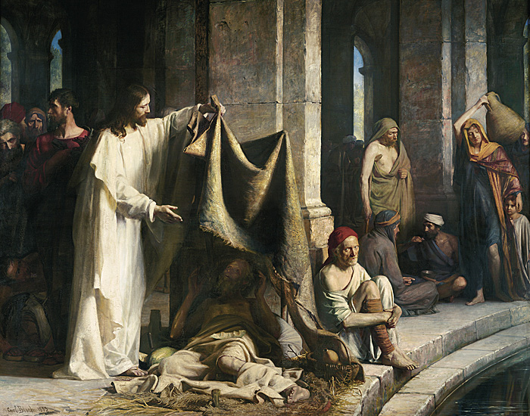
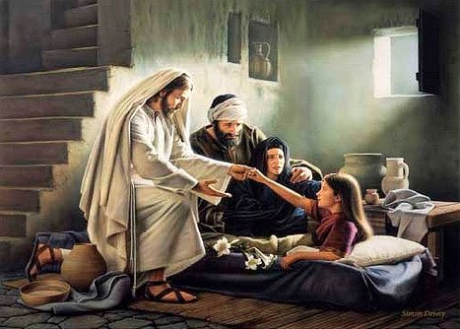
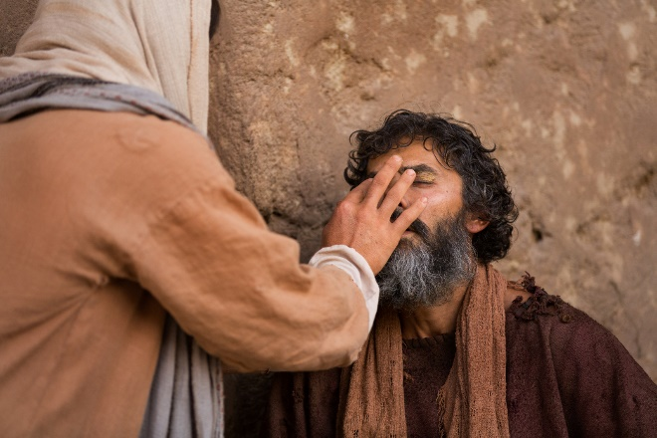
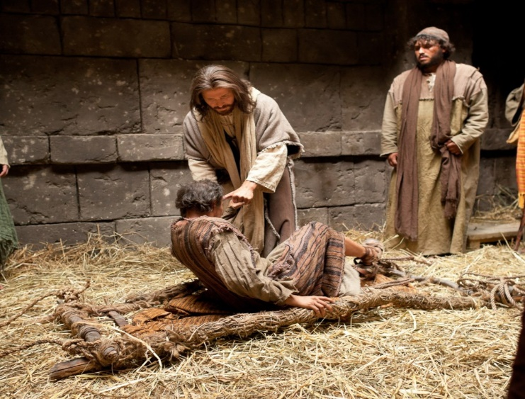
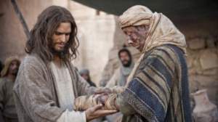
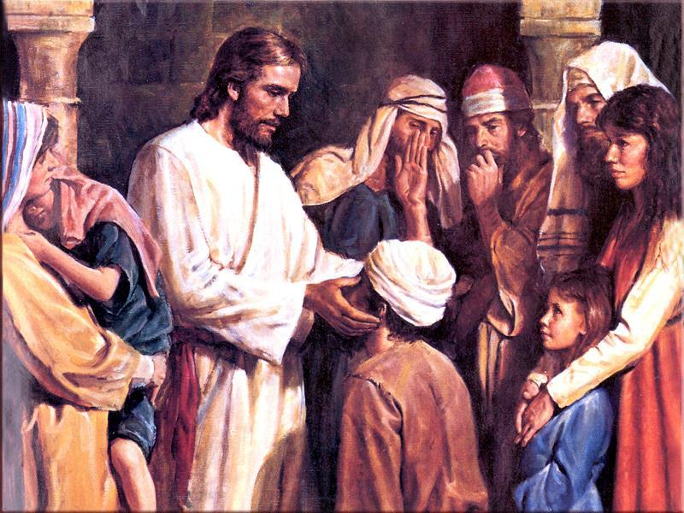
⁴ Jesus replied, “Go back and report to John what you hear and see:
⁵ The blind receive sight, the lame walk, those who have leprosy are cleansed, the deaf hear, the dead are raised, and the good news is proclaimed to the poor.

Slide 18
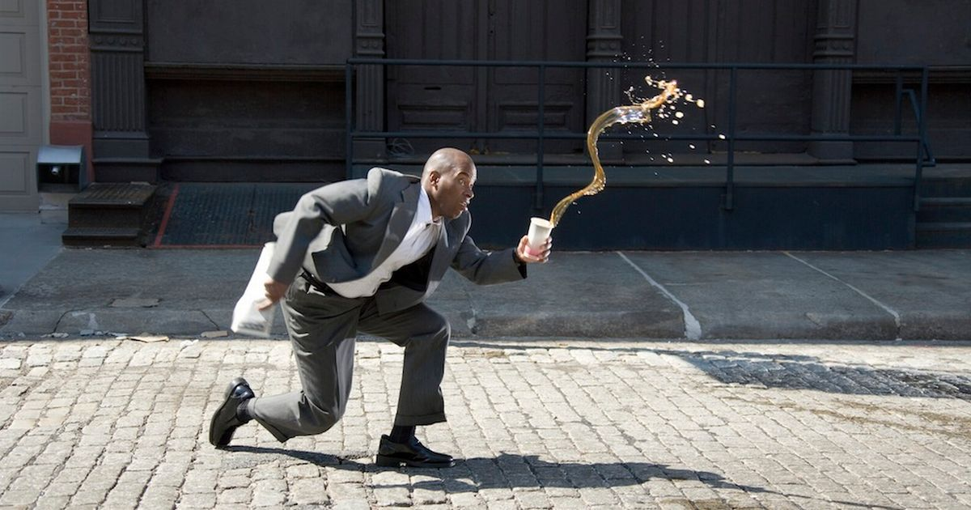
⁶ Blessed is anyone who does not stumble on account of me.”

Slide 19
⁷ As John’s disciples were leaving, Jesus began to speak to the crowd about John: “What did you go out into the wilderness to see? A reed swayed by the wind?

Slide 20
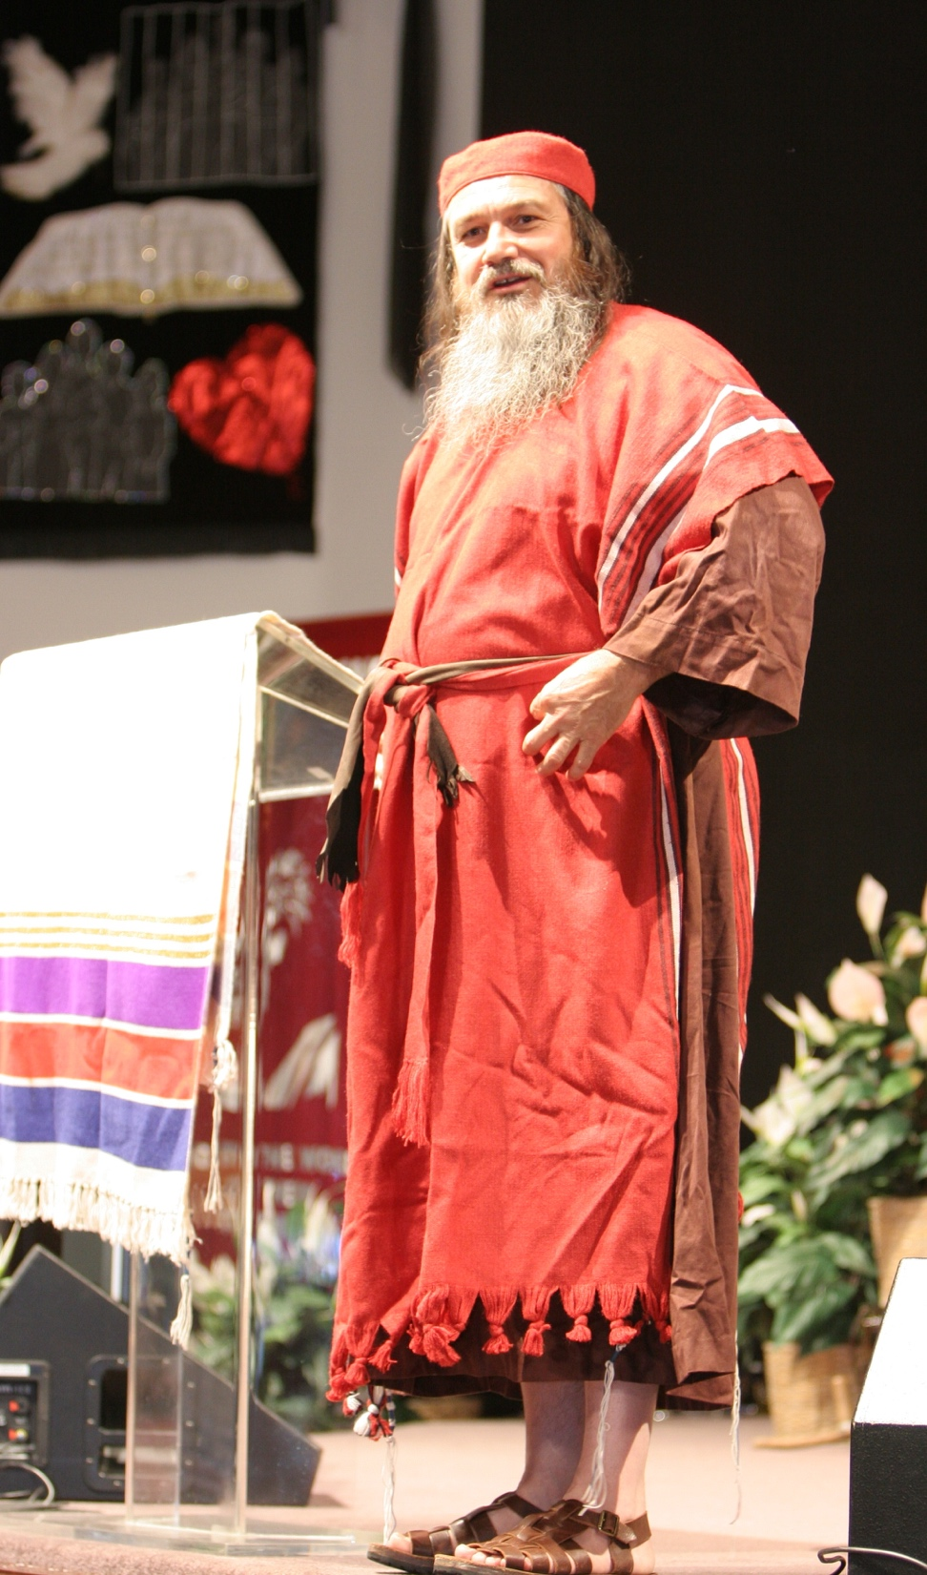
⁸ If not, what did you go out to see?
A man dressed in fine clothes?
No, those who wear fine clothes are in kings’ palaces.

Slide 21
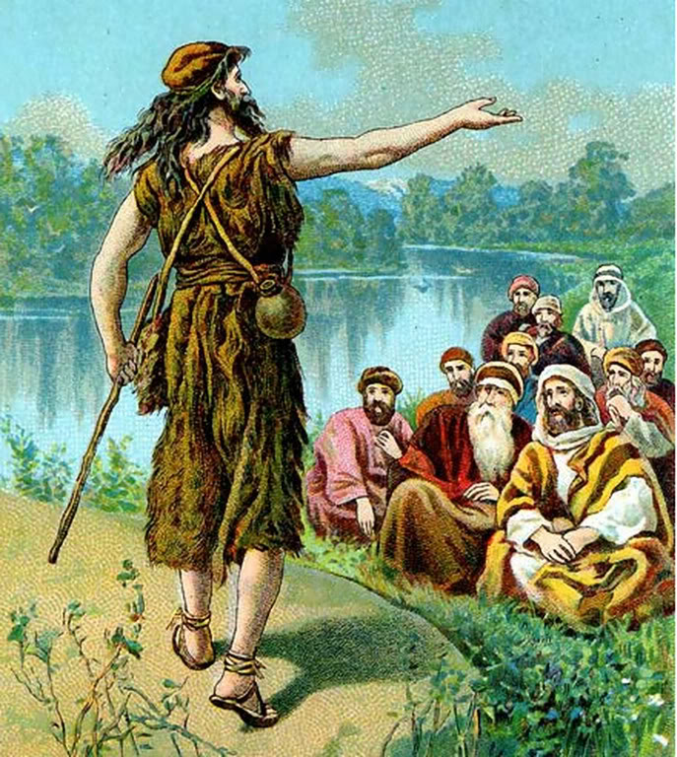
⁹ Then what did you go out to see? A prophet?
Yes, I tell you, and more than a prophet.
¹⁰ This is the one about whom it is written:
“‘I will send my messenger ahead
of you,
who will prepare your way
before you.’

Slide 22
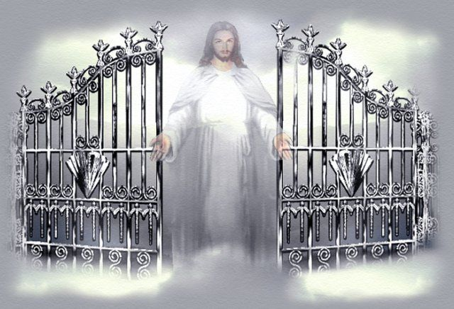
¹¹ Truly I tell you, among those born of women there has not risen anyone greater than John the Baptist; yet whoever is least in the kingdom of heaven is greater than he.

Slide 23
Rest for the weary

Slide 24
²⁵ At that time Jesus said, “I praise you, Father, Lord of heaven and earth, because you have hidden these things from the wise and learned, and revealed them to little children. ²⁶ Yes, Father, for this is what you were pleased to do.

Slide 25
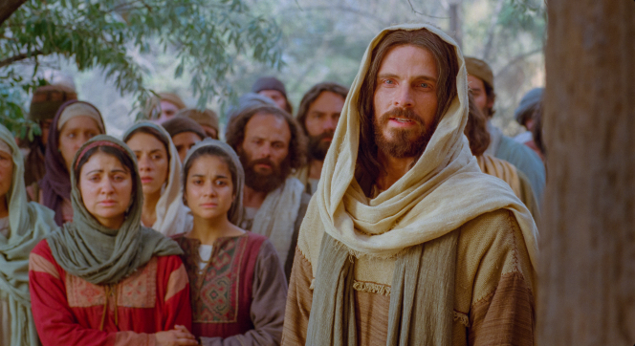
²⁷ “All things have been committed to me by my Father.
No one knows the Son except the Father, and no one knows the Father except the Son and those to whom the Son chooses to reveal him.

Slide 26
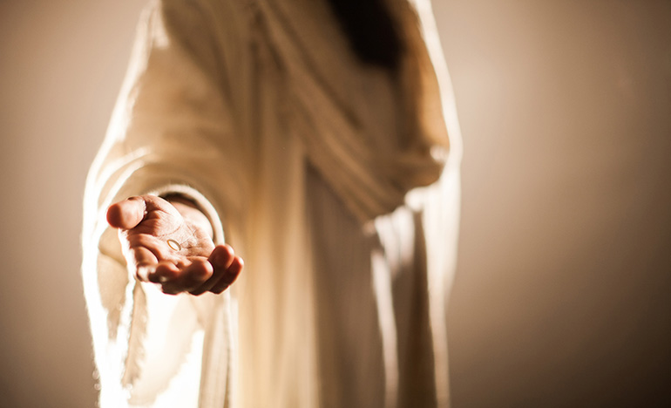
²⁸ “Come to me, all you who are weary and burdened, and I will give you rest.

Slide 27
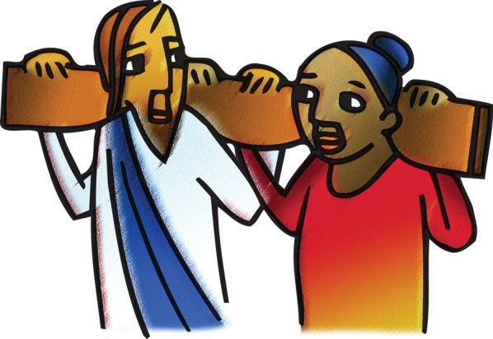
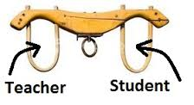
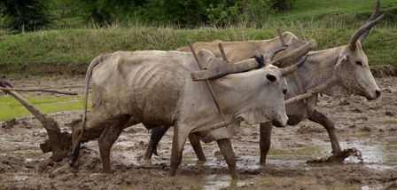
²⁹ Take my yoke* upon you and learn from me, for I am gentle* and humble in heart, and you will find rest for your souls.
³⁰ For my yoke* is easy and my burden is light.”

Slide 28
Lord of the Sabbath

Slide 29
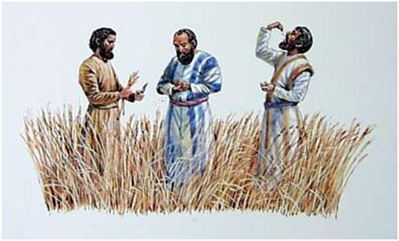
12 At that time Jesus went through the grain fields on the Sabbath. His disciples were hungry* and began to pick some heads of grain and eat them.

Slide 30
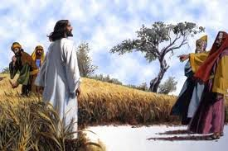
² When the Pharisees saw this, they said to him, “Look! Your disciples are doing what is unlawful on the Sabbath.”

Slide 31
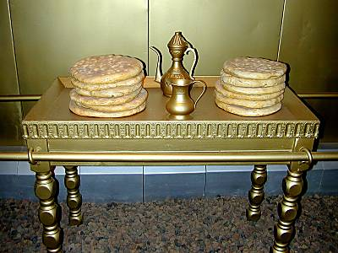
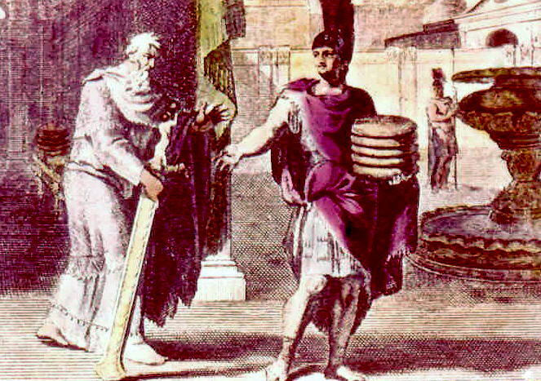
³ He answered, “Haven’t you read what David did when he and his companions were hungry?
⁴ He entered the house of God*, and he and his companions ate the consecrated* bread—which was not lawful for them to do, but only for the priests. ⁵ Or haven’t you read in the Law that the priests on Sabbath duty in the temple desecrate the Sabbath and yet are innocent?

Slide 32
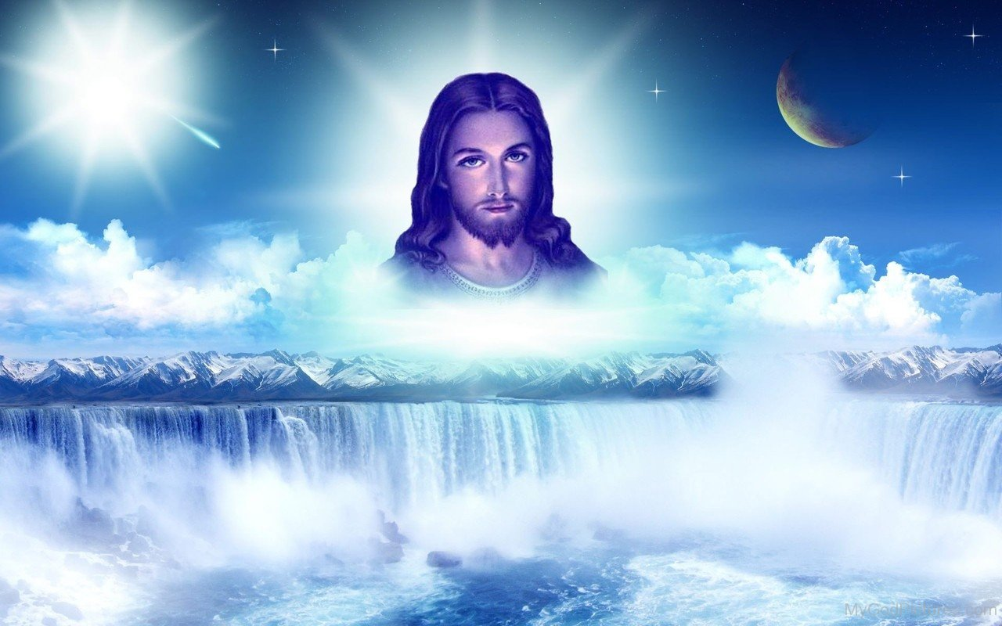
⁶ I tell you that something greater than the temple is here. ⁷ If you had known what these words mean, ‘I desire mercy, not sacrifice,’ you would not have condemned the innocent.
⁸ For the Son of Man is Lord of the Sabbath.”

Slide 33
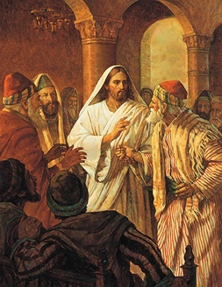
⁹ Going on from that place, he went into their synagogue, ¹⁰ and a man with a shriveled hand was there.
Looking for a reason to bring charges against Jesus, they asked him,
“Is it lawful to heal
on the Sabbath?”

Slide 34
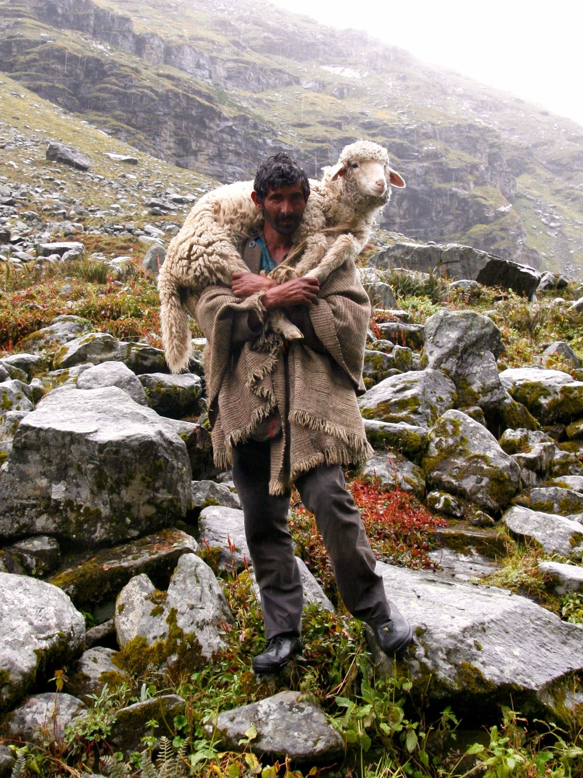
¹¹ He said to them, “If any of you has a sheep and it falls into a pit on the Sabbath, will you not take hold of it and lift* it out? ¹² How much more valuable is a person than a sheep! Therefore it is lawful to do* good on the Sabbath.”
Do Good on the Sabbath

Slide 35
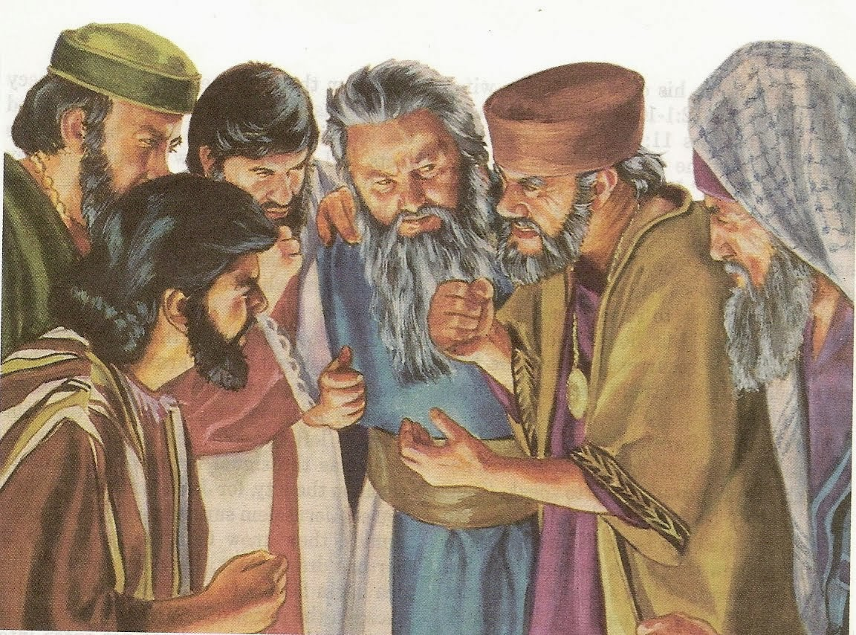
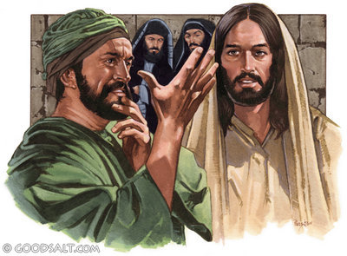
¹³ Then he said to the man*, “Stretch out your hand.” So he stretched it out and it was completely restored, just as sound as the other.
¹⁴ But the Pharisees went out and plotted how they might kill Jesus.

