Slide 1

Kingdom Living
Lesson 3
Matthew 5:1-37

Slide 2
The Truth
Jesus teaches us how to live out God’s commands as members of His kingdom.
Lesson 3
Matthew 5:1-37

Slide 3
Memory Verse
³ “Blessed are the poor in spirit,
for theirs is the kingdom of heaven.
⁴ Blessed are those who mourn,
for they will be comforted.
⁵ Blessed are the meek,
for they will inherit the earth.
⁶ Blessed are those who hunger and thirst for righteousness,
for they will be filled.
Matthew 5:3-6

Slide 4
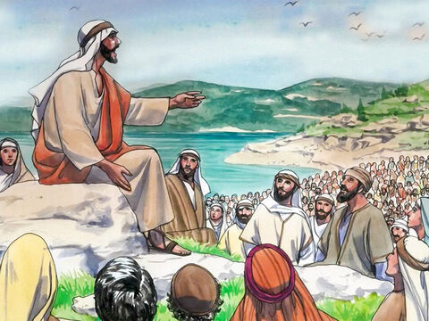
Now when Jesus saw the crowds, he went up on a mountainside and sat down. His disciples came to him,
and he began to teach them.

Slide 5
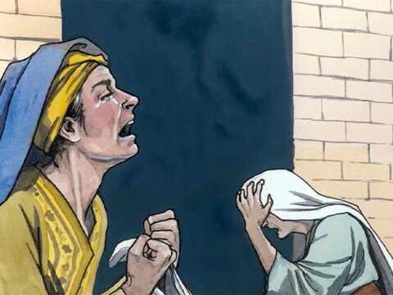
He said: “Blessed are the poor in spirit,
for theirs is the kingdom of heaven.
Blessed are those who mourn,
for they will be comforted.

Slide 6
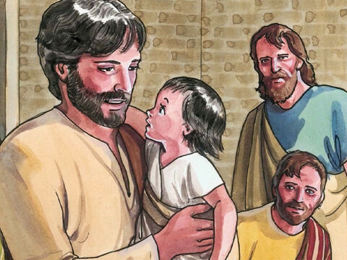
Blessed are the meek,
for they will inherit the earth.

Slide 7
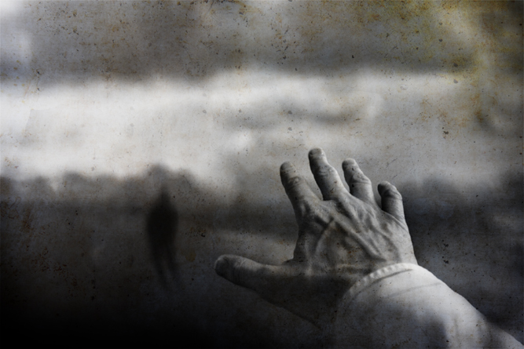
Blessed are those who
hunger and thirst for righteousness,
for they will be filled.

Slide 8

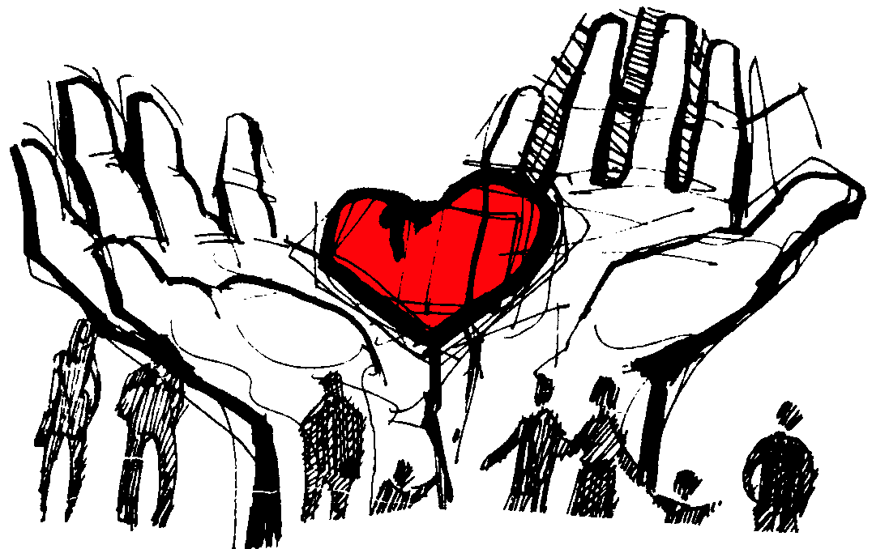
Blessed are the merciful, for
they will be shown mercy.

Slide 9
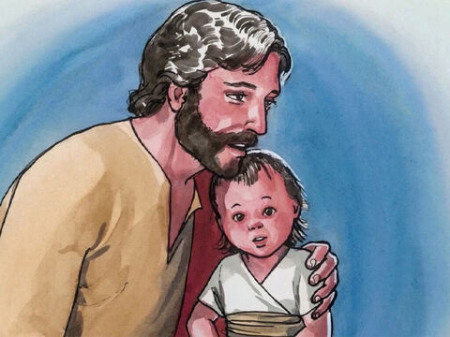

Blessed are the peacemakers,
for they will be called children of God.

Slide 10

Blessed are the pure in heart,
for they will see God.

Slide 11

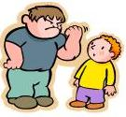

Blessed are those who are persecuted because of righteousness, for theirs is the kingdom of heaven.
“Blessed are you when people insult you, persecute you and falsely say all kinds of evil against you because of me.”

Slide 12

“Rejoice and be glad, because great is your reward in heaven, for in the same way they persecuted
the prophets who were before you.”

Slide 13
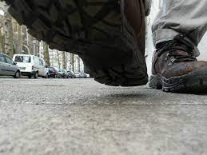

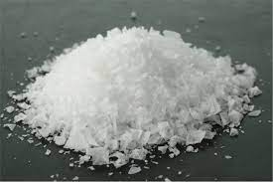
“You are the salt of the earth. But if the salt loses its saltiness, how can it be made salty again? It is no longer good for anything, except to be thrown out and trampled underfoot.

Slide 14
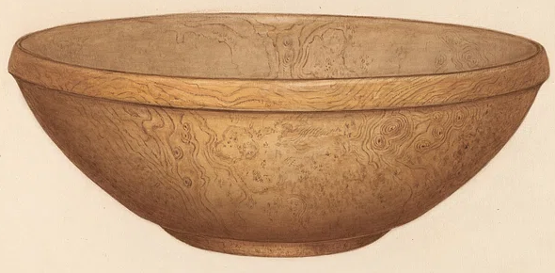
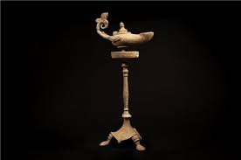
“You are the light of the world. A town built on a hill cannot be hidden. Neither do people light a lamp and put it under a bowl. Instead they put it on its stand, and it gives light to everyone in the house.

Slide 15



In the same way, let your light shine before others, that they may see your good deeds and glorify your Father in heaven.

Slide 16

“Do not think that I have come to abolish the Law or the Prophets; I have not come to abolish them but to fulfill them.

Slide 17
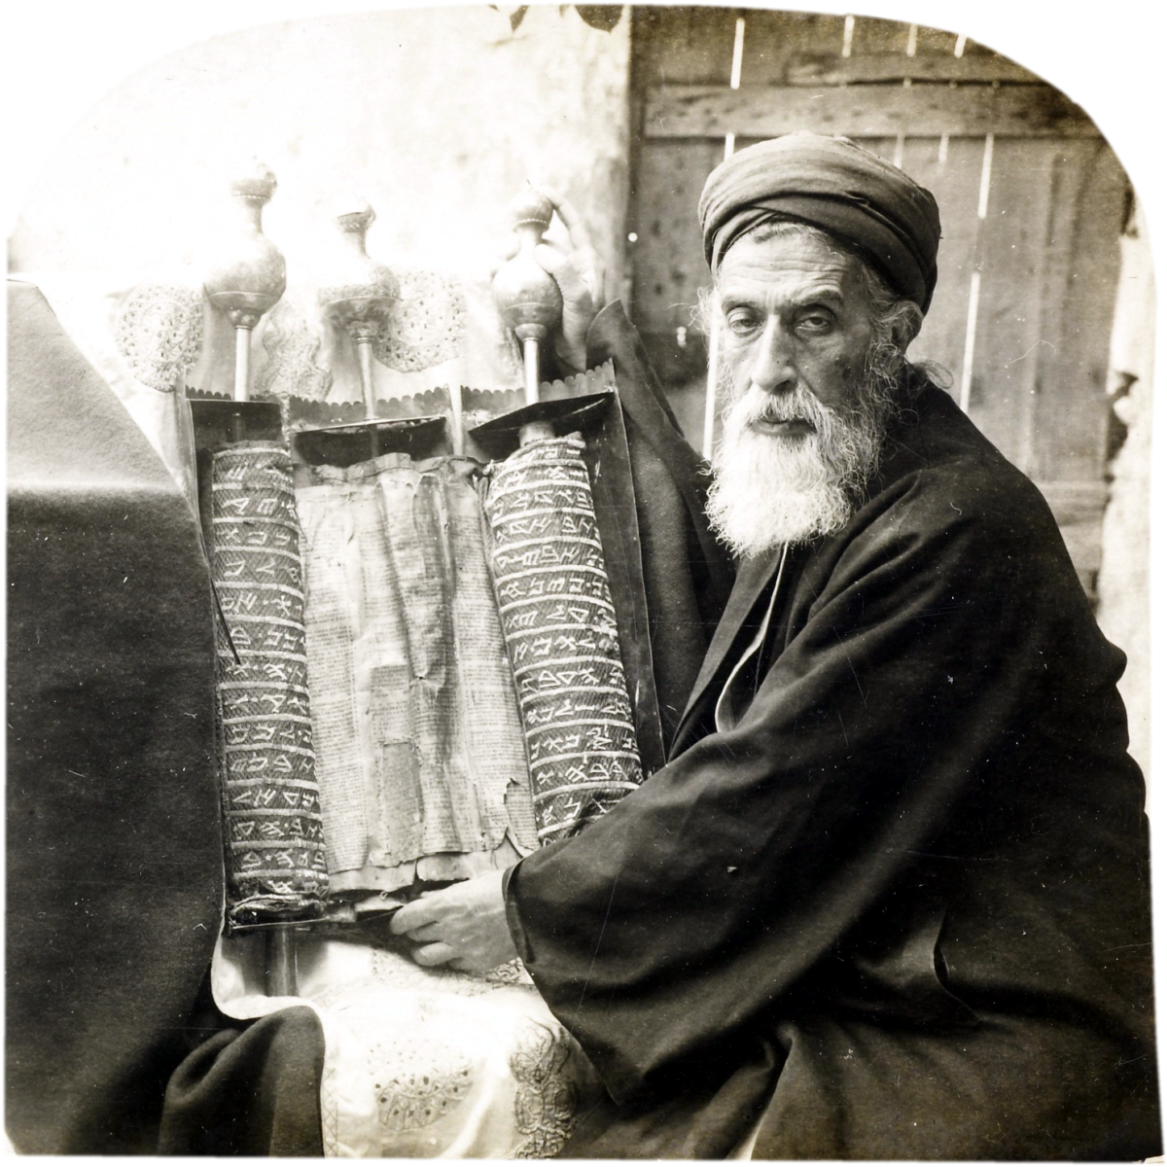


For truly I tell you, until heaven and earth disappear, not the smallest letter,
not the least stroke of a pen,
will by any means disappear from the Law
until everything is accomplished.

Slide 18

Therefore, anyone who sets aside one of the least of these commandments and teaches others accordingly will be called least
in the kingdom of heaven,
but whoever practices and teaches these commands will be called great in the kingdom of heaven.

Slide 19

For I tell you that unless your righteousness surpasses that of the Pharisees and the teachers of the law, you will certainly not enter the kingdom of heaven.

Slide 20

“You have heard that it was said to the people long ago, ‘You shall not murder, and anyone who murders will be subject to judgment.’”

Slide 21
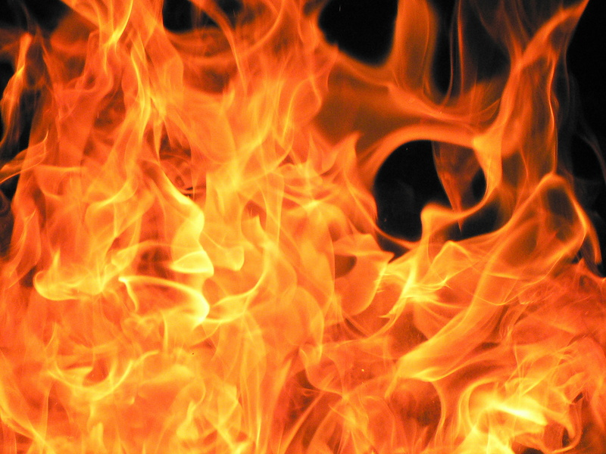


But I tell you that anyone who is angry with a brother or sister will be subject to judgment. Again, anyone who says to a brother or sister, ‘Raca, ’ is answerable to the court. And anyone who says, ‘You fool!’
will be in danger of the fire of hell.
RACA
FOOL

Slide 22
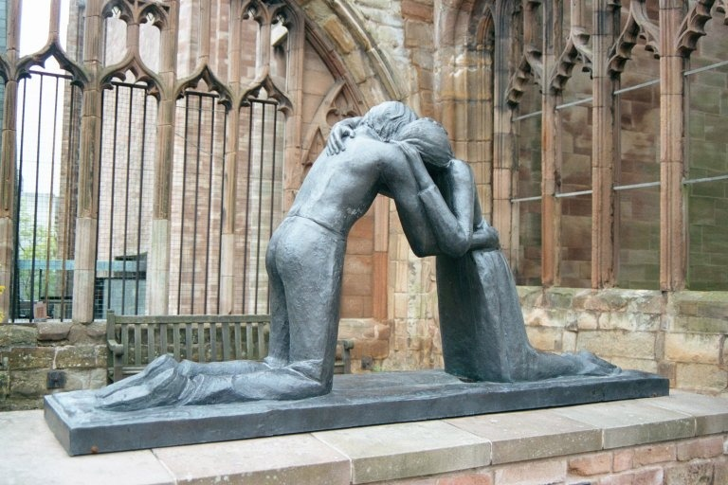
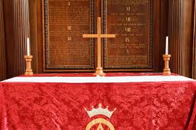
“Therefore, if you are offering your gift at the altar and there remember that your brother or sister has something against you, leave your gift there in front of the altar. First go and be reconciled to them; then come and offer your gift.

Slide 23



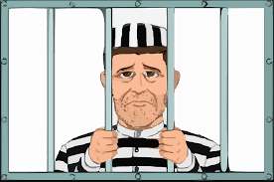
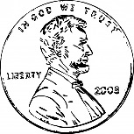

“Settle matters quickly with your adversary who is taking you to court. Do it while you are still together on the way, or your adversary may hand you over to the judge, and the judge may hand you over to the officer, and you may be thrown into prison. Truly I tell you, you will not get out until you have paid the last penny.

Slide 24

“You have heard that it was said, ‘You shall not commit adultery.’ But I tell you that anyone who looks at a woman lustfully has already committed adultery with her in his heart. If your right eye causes you to stumble, gouge it out and throw it away.

Slide 25

It is better for you to lose one part of your body than for your whole body to be thrown into hell.
And if your right hand causes you to stumble, cut it off and throw it away. It is better for you to lose one part of your body than for your whole body to go into hell.

Slide 26

“It has been said, ‘Anyone who divorces his wife must give her a certificate of divorce.’
But I tell you that anyone who divorces his wife, except for sexual immorality, makes her the victim of adultery, and anyone who marries a divorced woman commits adultery.

Slide 27
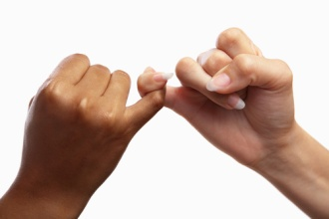





“Again, you have heard that it was said to the people long ago,
‘Do not break your oath,
but fulfill to the Lord the vows you have made.’
But I tell you, do not swear an oath at all:
either by heaven, for it is God’s throne;
or by the earth, for it is his footstool;
or by Jerusalem, for it is the city of the Great King.

Slide 28
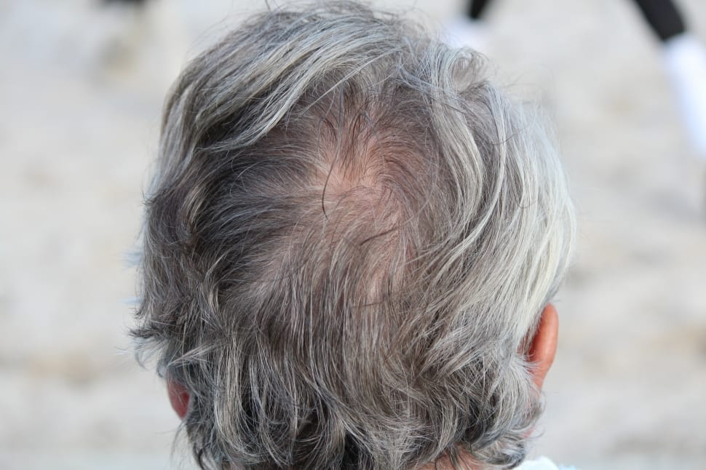
And do not swear by your head, for you cannot make even one hair white or black.
All you need to say is simply ‘Yes’ or ‘No’; anything beyond this comes from the
evil one.

