Slide 1
Matthew Dig Site 2
Matthew 3:1 – 4:12, 17-25

Slide 2
The Truth
Jesus shows us how to use the Word of God to defeat temptation!

Slide 3
Memory Verse Matthew 4:4
Jesus answered, “It is written: ‘Man shall not live on bread alone, but on every word that comes from the mouth of God.’”

Slide 4
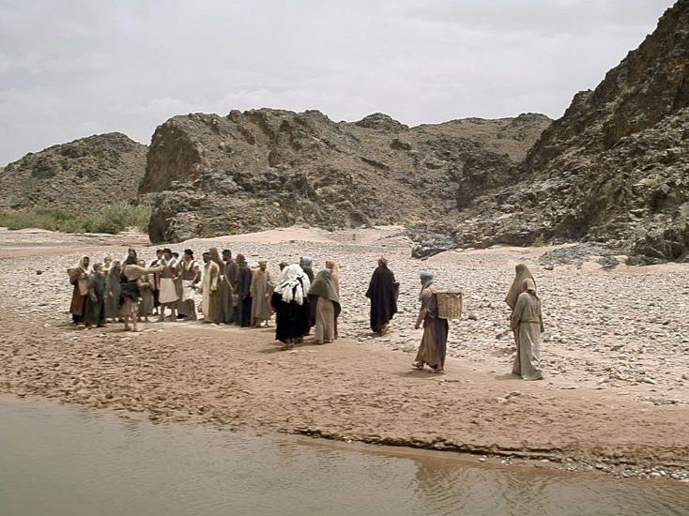
John the Baptist Prepares the Way
3 In those days John the Baptist came, preaching in the wilderness of Judea ² and saying, “Repent, for the kingdom of heaven has come near.”

Slide 5
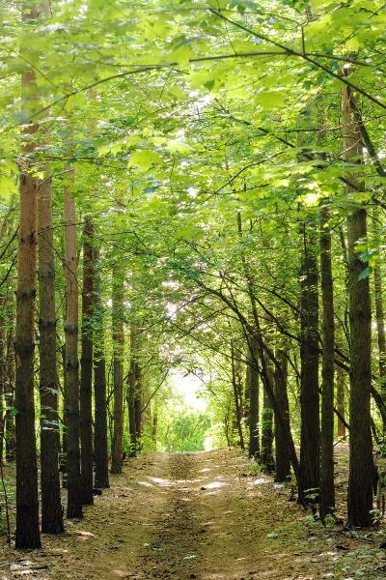
³ This is he who was spoken of through the prophet Isaiah: “A voice of one calling in the wilderness, ‘Prepare the way for the Lord, make straight paths for him.’”

Slide 6
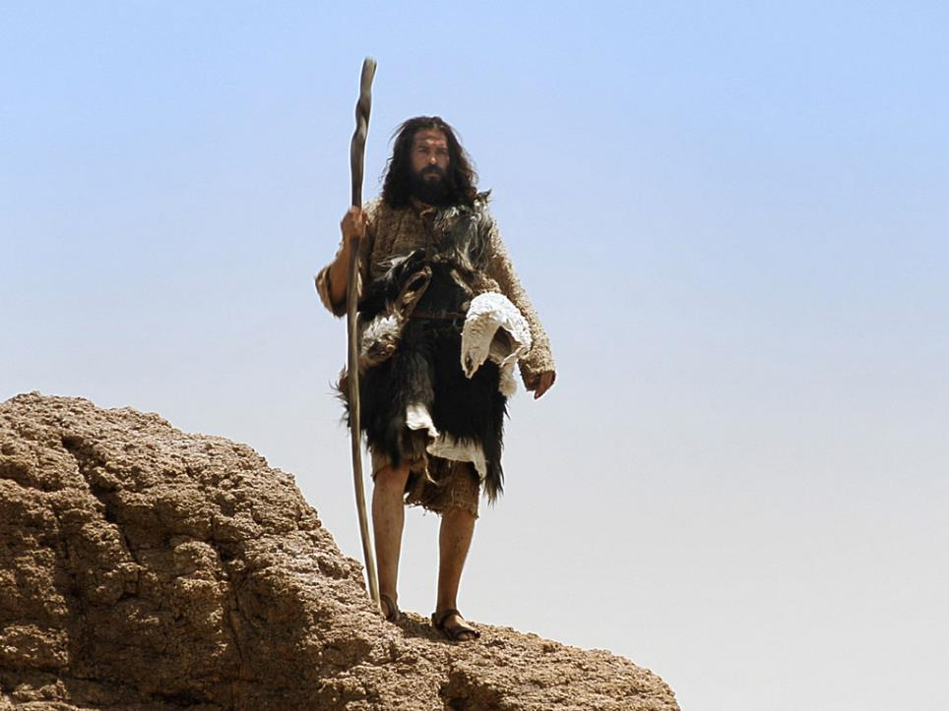
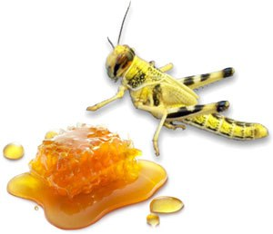
⁴ John’s clothes were made of camel’s hair, and he had a leather belt around his waist. His food was locusts and wild honey.

Slide 7
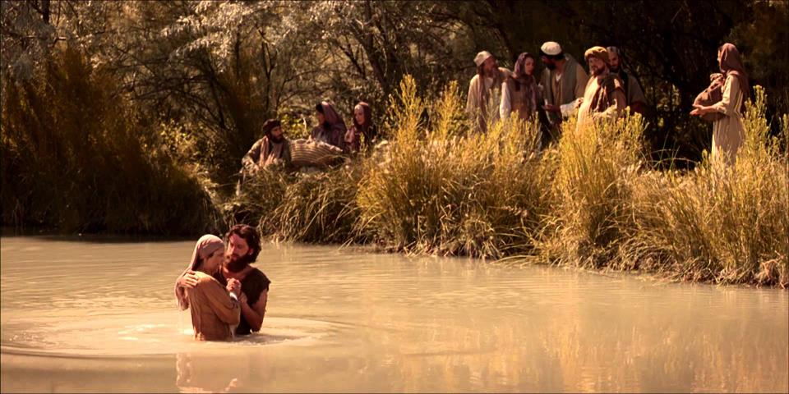
⁵ People went out to him from Jerusalem and all Judea and the whole region of the Jordan.⁶ Confessing their sins, they were baptized by him in the Jordan River.

Slide 8
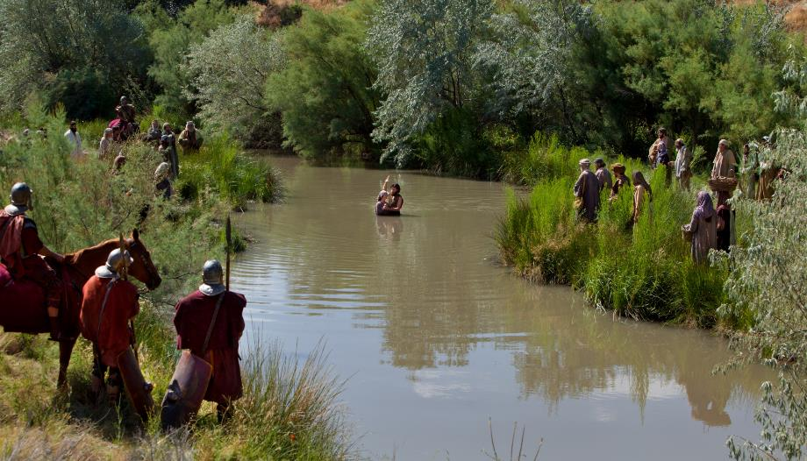
⁷ But when he saw many of the Pharisees and Sadducees coming to where he was baptizing, he said to them:

Slide 9
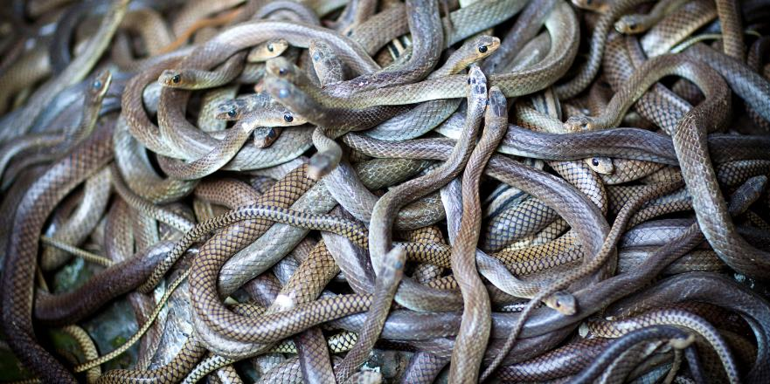
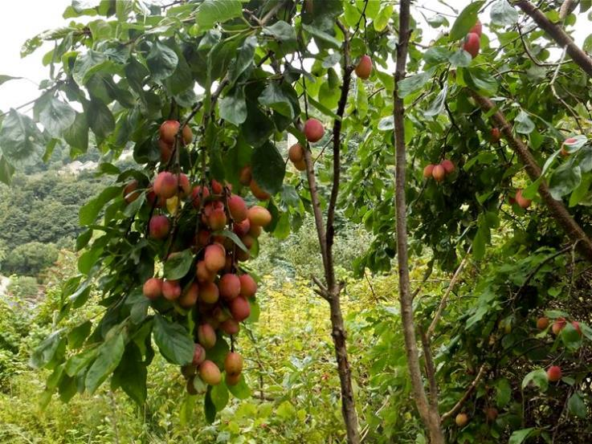
“You brood of vipers! Who warned you to flee from the coming wrath? ⁸ Produce fruit in keeping with repentance.

Slide 10
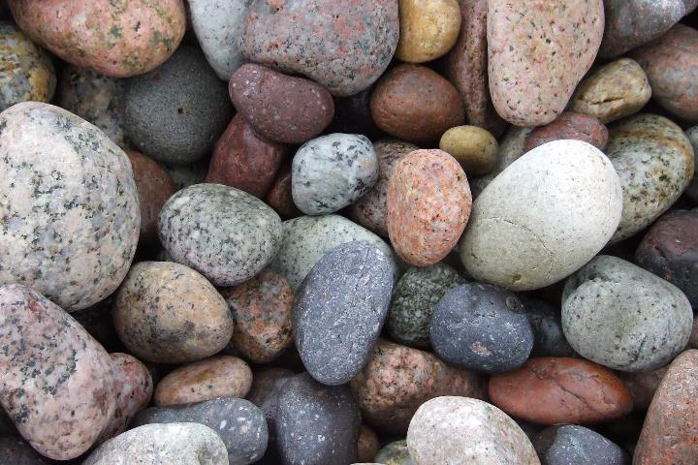
⁹ And do not think you can say to yourselves, ‘We have Abraham as our father.’ I tell you that out of these stones God can raise up children for Abraham.

Slide 11
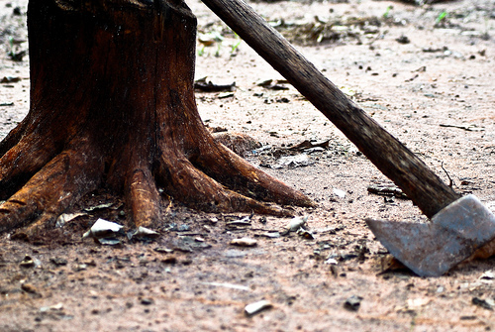
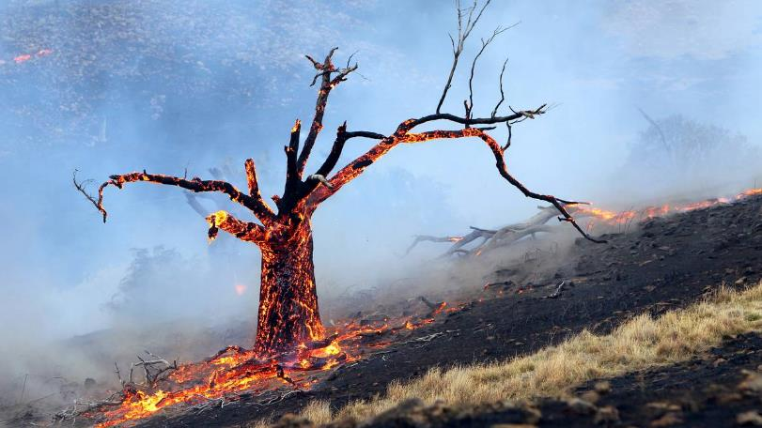
¹⁰ The ax is already at the root of the trees, and every tree that does not produce good fruit will be cut down and thrown into the fire.

Slide 12
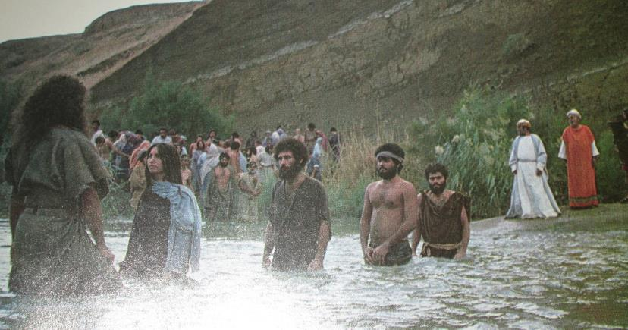
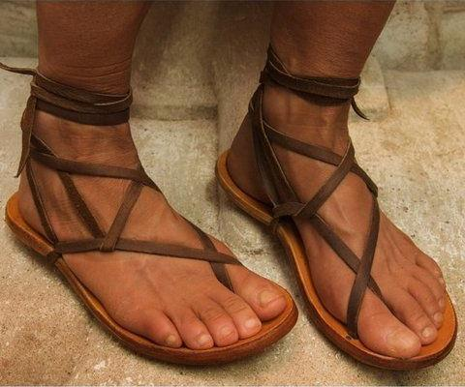
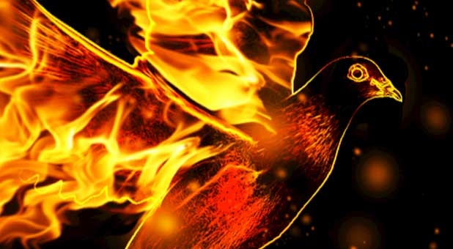
¹¹ “I baptize you with water for repentance. But after me comes one who is more powerful than I, whose sandals I am not worthy to carry. He will baptize you with the Holy Spirit and fire.

Slide 13
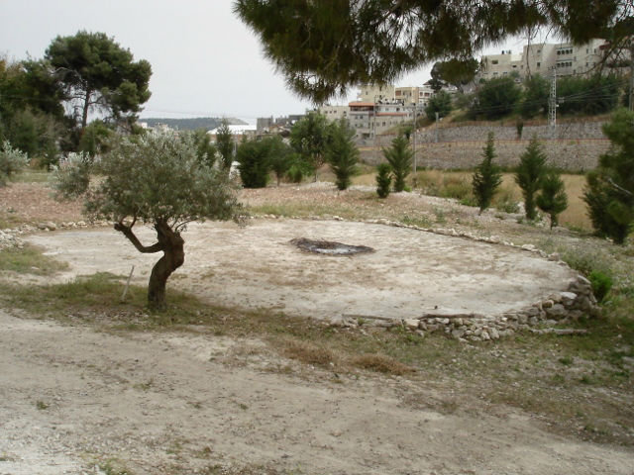
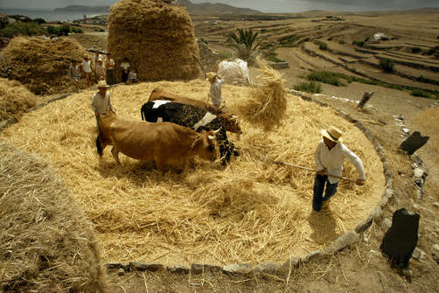
¹² His winnowing fork is in his hand, and he will clear his threshing floor,

Slide 14
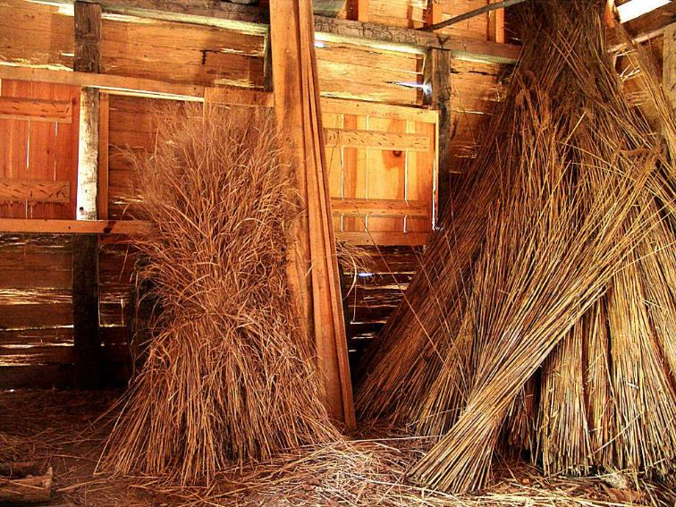
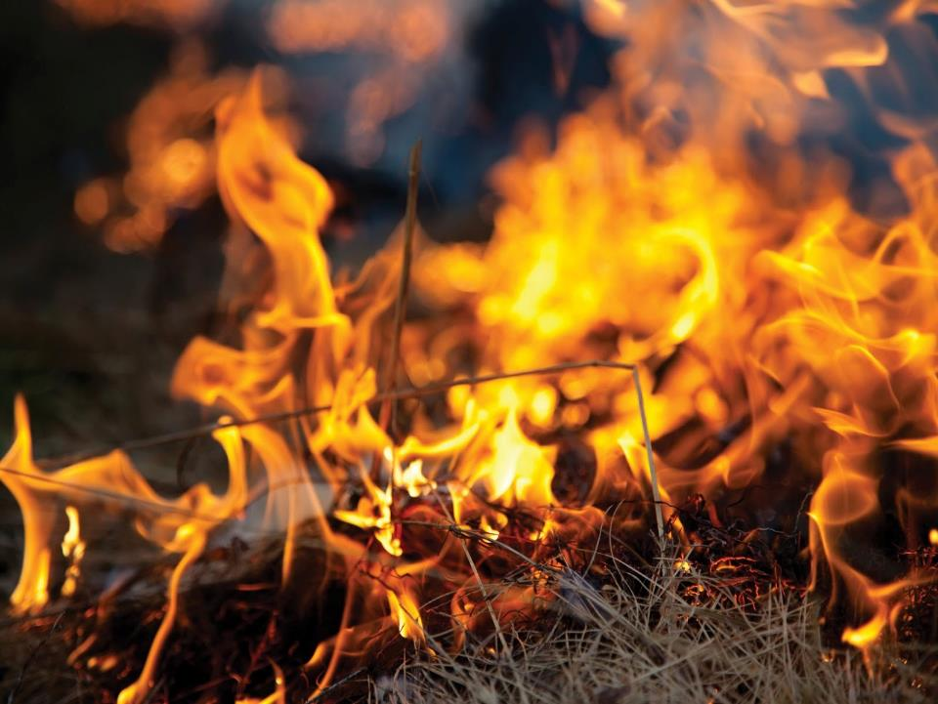
gathering his wheat into the barn and burning up the chaff with unquenchable fire.”

Slide 15
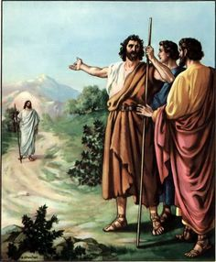
The Baptism of Jesus
¹³ Then Jesus came from Galilee to the Jordan to be baptized by John.

Slide 16
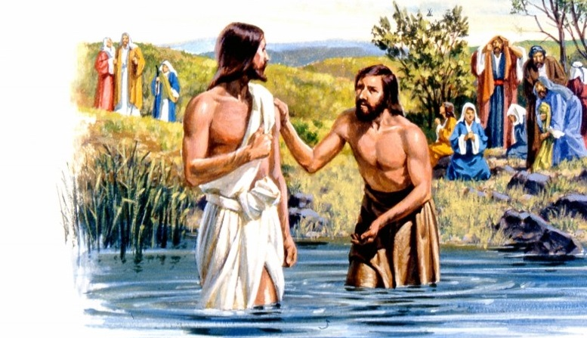
But John tried to deter him, saying, “I need to be baptized by you, and do you come to me?”

Slide 17
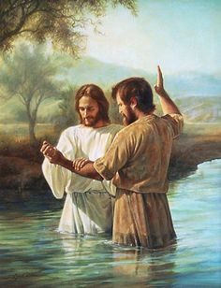
¹⁵ Jesus replied, “Let it be so now; it is proper for us to do this to fulfill all righteousness.”
Then John consented.

Slide 18
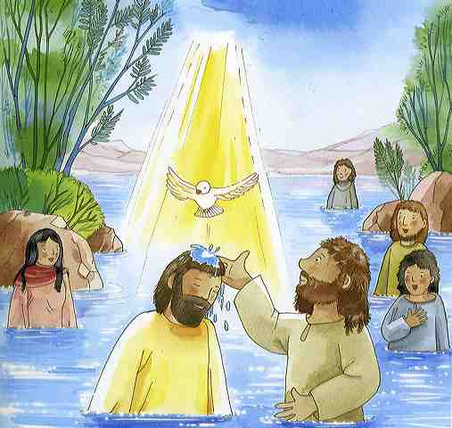
¹⁶ As soon as Jesus was baptized, he went up out of the water. At that moment heaven was opened, and he saw the Spirit of God descending like a dove and alighting on him.

Slide 19
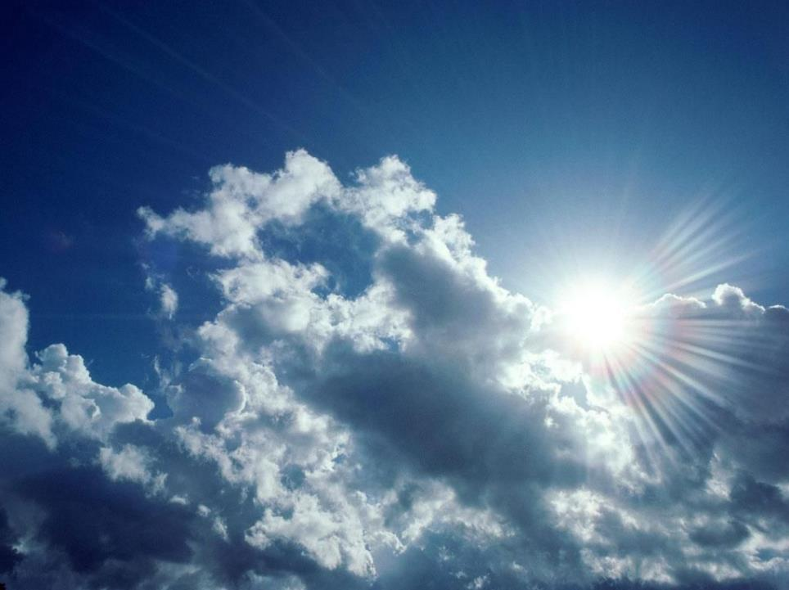
¹⁷ And a voice from heaven said, “This is my Son, whom I love; with him I am well pleased.”

Slide 20
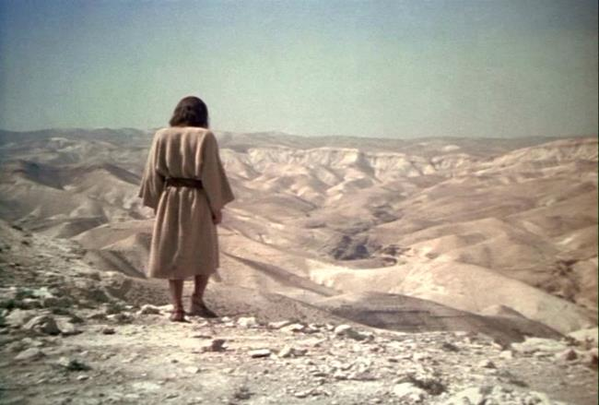
Jesus Is Tested in the Wilderness
4 Then Jesus was led by the Spirit into the wilderness to be tempted by the devil. ² After fasting 40 days and 40 nights, he was hungry.

Slide 21
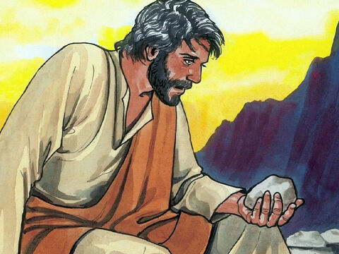
³ The tempter came to him and said,
“If you are the Son of God, tell these stones to become bread.”

Slide 22
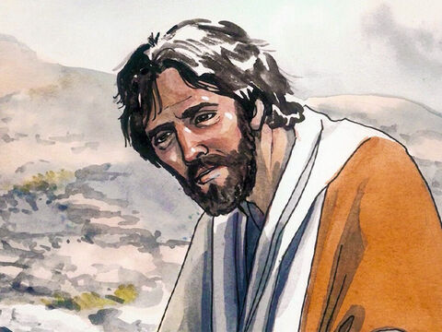
⁴ Jesus answered,
It is written: “Man shall not live on bread alone, but on every word that comes from the mouth of God.”

Slide 23
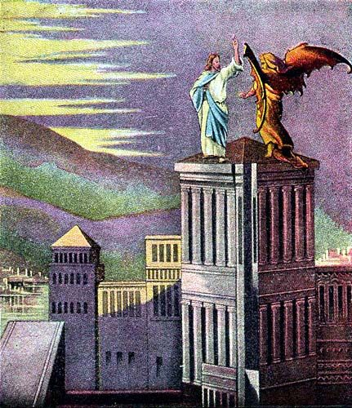
⁵ Then the devil took him to the holy city and had him stand on the highest point of the temple.

Slide 24
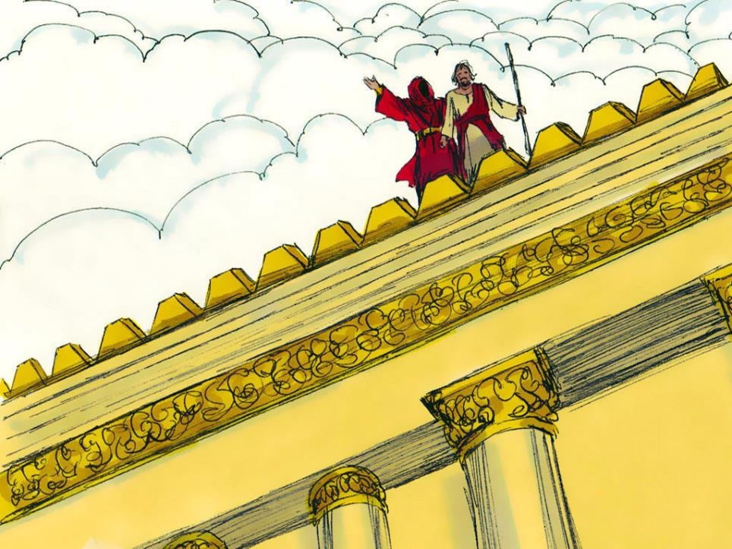
⁶ “If you are the Son of God,” he said, “throw yourself down. For it is written:
“‘He will command his angels concerning you, and they will lift you up in their hands, so that you will not strike your foot against a stone.’”

Slide 25
⁷ Jesus answered him, “It is also written: ‘Do not put the Lord your God to the test.’”

Slide 26
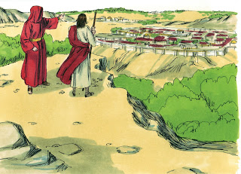
⁸ Again, the devil took him to a very high mountain and showed him all the kingdoms of the world and their splendor. ⁹ “All this I will give you,” he said, “if you will bow down and worship me.”

Slide 27
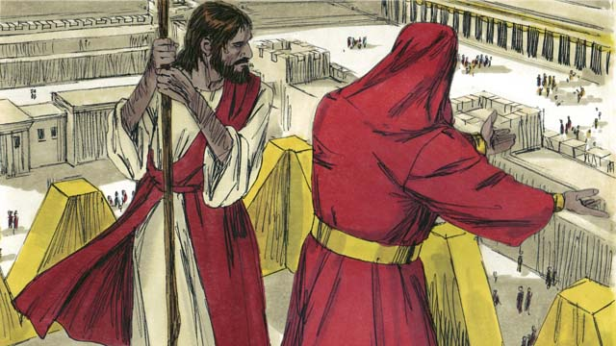
¹⁰ Jesus said to him, “Away from me, Satan! For it is written: ‘Worship the Lord your God, and serve him only.’”

Slide 28
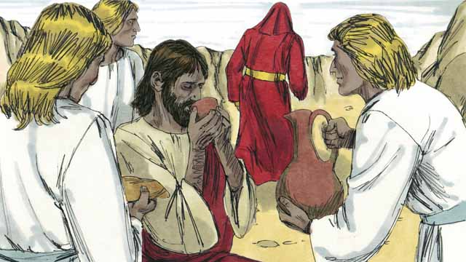
¹¹ Then the devil left him, and angels came and attended him.

Slide 29
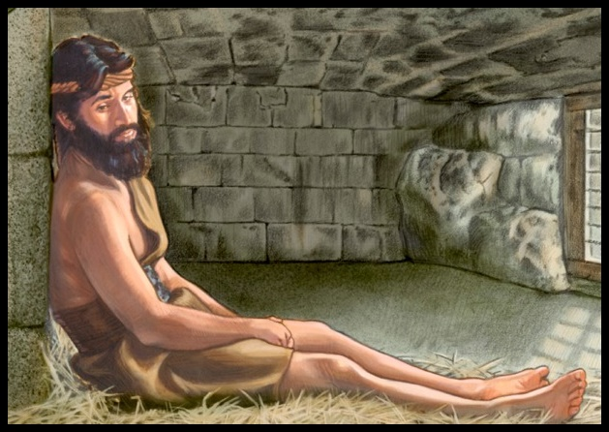
Jesus Begins to Preach
¹² When Jesus heard that John had been put in prison, he withdrew to Galilee.

Slide 30
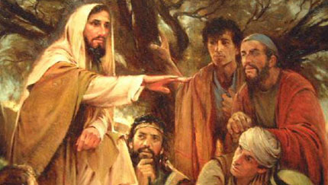
¹⁷ From that time on Jesus began to preach, “Repent, for the kingdom of heaven has come near.”

Slide 31
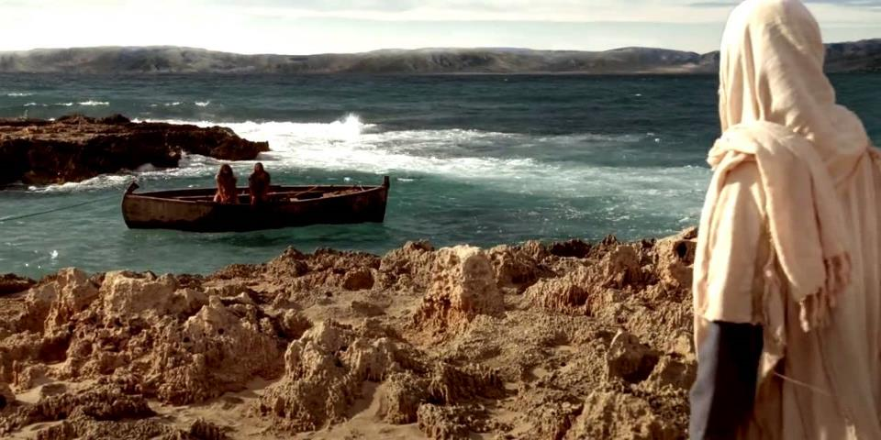
Jesus Calls His First Disciples
¹⁸ As Jesus was walking beside the Sea of Galilee, he saw two brothers, Simon called Peter and his brother Andrew. They were casting a net into the lake, for they were fishermen.

Slide 32
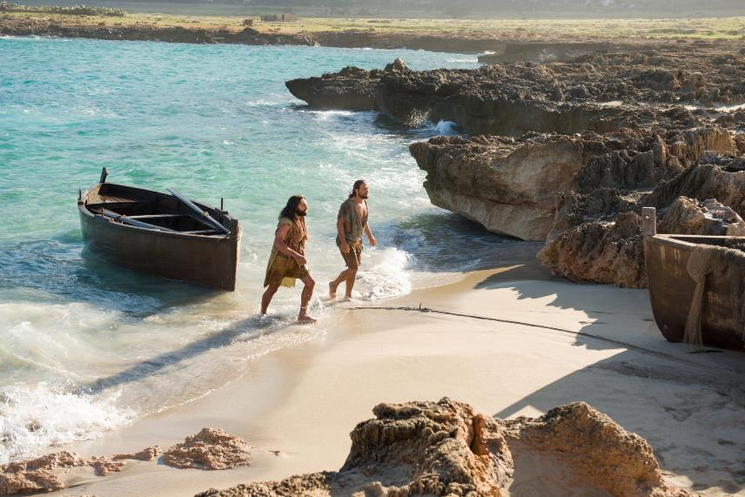
¹⁹ “Come, follow me,” Jesus said, “and I will send you out to fish for people.” ²⁰ At once they left their nets and followed him.

Slide 33
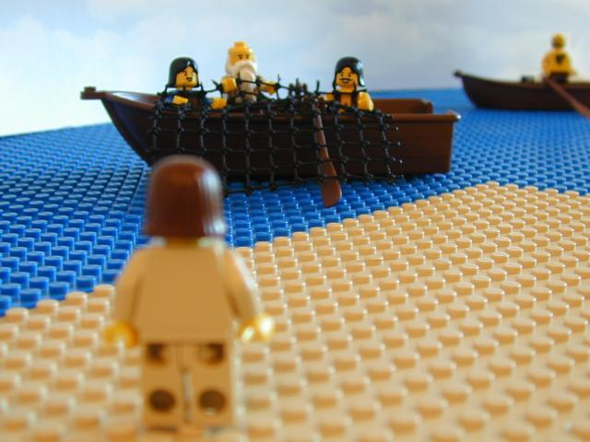
²¹ Going on from there, he saw two other brothers, James son of Zebedee and his brother John. They were in a boat with their father Zebedee, preparing their nets.

Slide 34
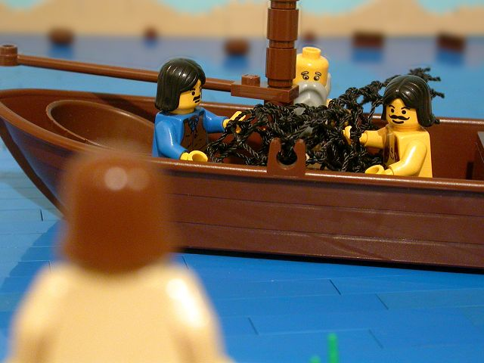
Jesus called them, ²² and immediately they left the boat and their father and followed him.

Slide 35
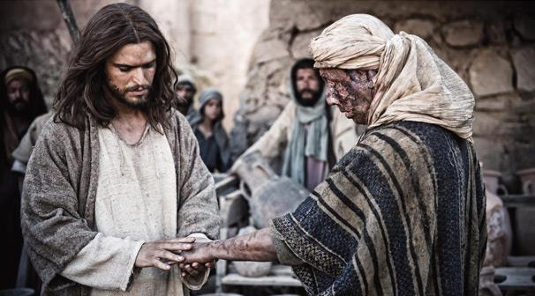
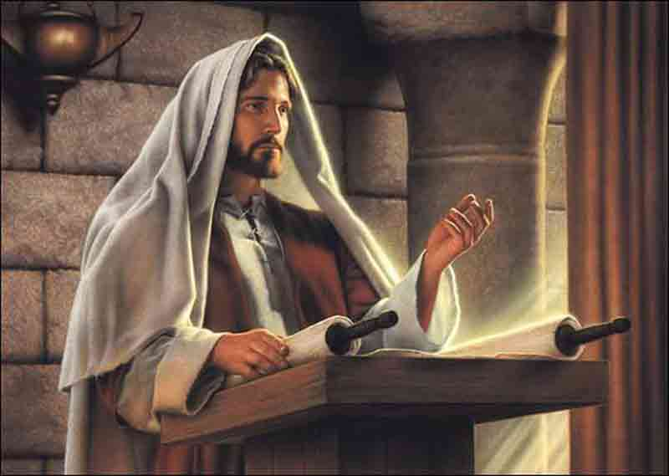
Jesus Heals the Sick
²³ Jesus went throughout Galilee, teaching in their synagogues, proclaiming the good news of the kingdom, and healing every disease and sickness among the people.

Slide 36
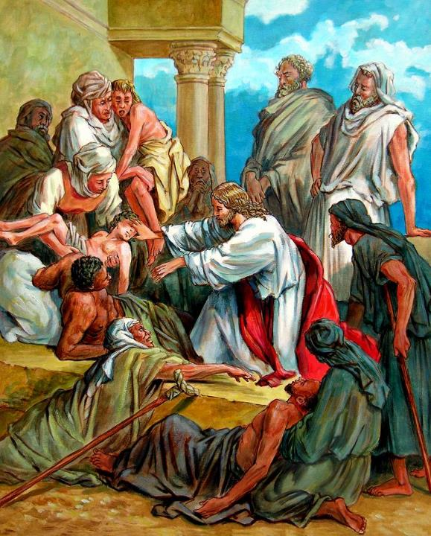
²⁴ News about him spread all over Syria, and people brought to him all who were ill with various diseases, those suffering severe pain, the demon-possessed, those having seizures, and the paralyzed; and he healed them.

Slide 37
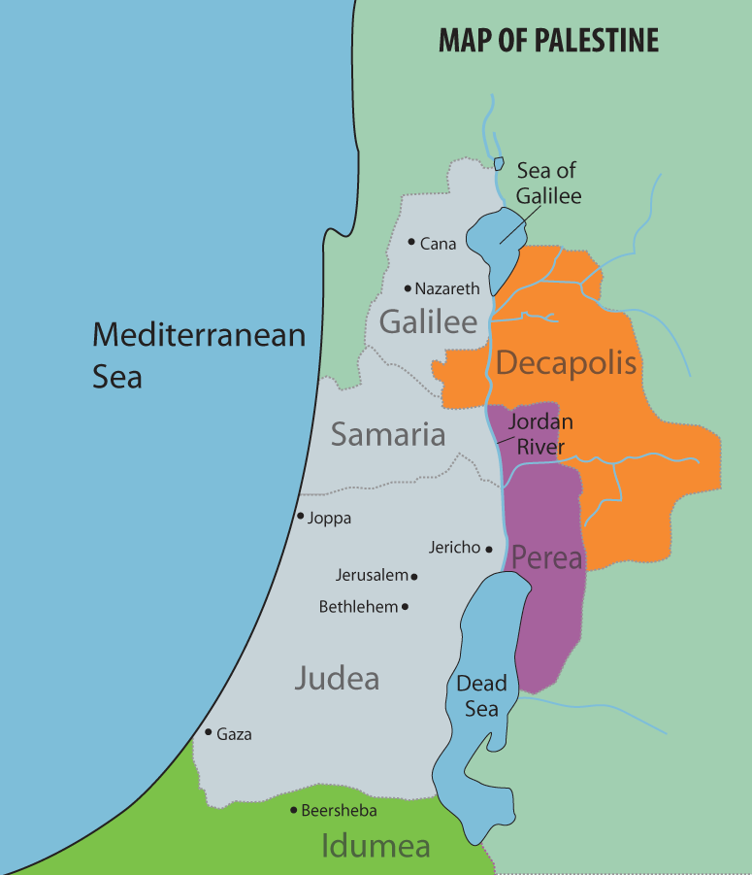
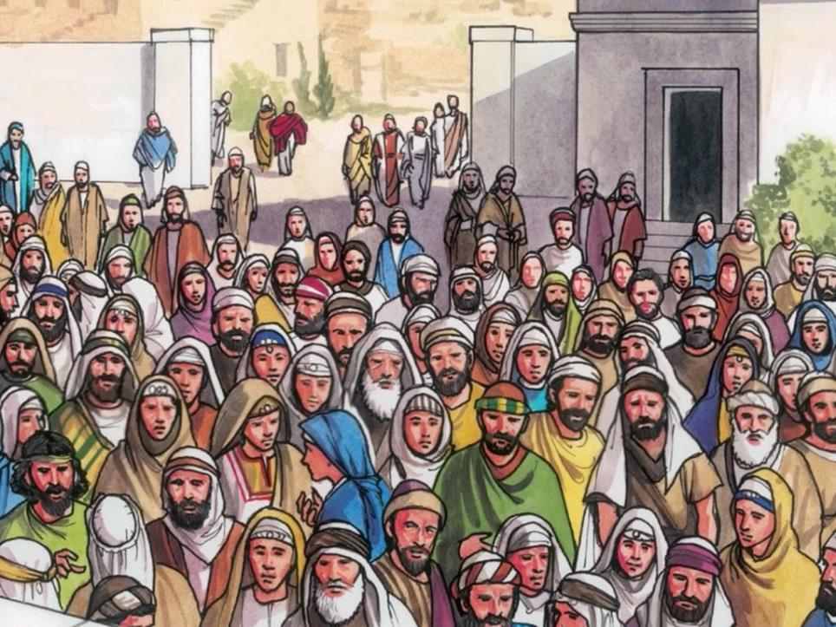
²⁵ Large crowds from Galilee,* the Decapolis,* Jerusalem,* Judea* and the region across the Jordan* followed him.

