Slide 1


Psalm 23:5-6
You prepare a table before me
in the presence of my enemies.
You anoint my head with oil;
my cup overflows.
Surely your goodness and love
will follow me
all the days of my life,
and I will dwell in the
house of the LORD
forever.
Hide it in your
DigSite #19
Notes:
5

Slide 2
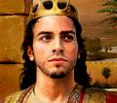
2 Samuel 9:1-13
David and Mephibosheth

Slide 3
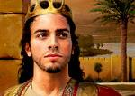
David asked,
Is there anyone still left of the house of Saul to whom I can show kindness for Jonathan’s sake?”

Slide 4
Now there was a servant of Saul’s household named Ziba.

Slide 5
They summoned him to appear before David, and the king said to him,
Are you Ziba?
At your service,
he
replied.

Slide 6
The king asked,
Is there no one still alive from the house of Saul to whom I can show God’s kindness?

Slide 7

Ziba answered the king,
There is still a son of Jonathan; he is lame in both feet.
Where is he?
the king asked.

Slide 8
Ziba answered, “He is at the house of Makir son of Ammiel in Lo Debar.”

Slide 9
So King David had him brought from Lo Debar, from the house of Makir son of Ammiel.

Slide 10
When Mephibosheth son of Jonathan, the son of Saul, came to David, he bowed down to pay him honor.

Slide 11
David said,
Mephibosheth!
At your service,
he replied.

Slide 12
David said to him
Don’t be afraid,
for I will surely show you kindness for the sake of your father Jonathan. I will restore to you all the land that belonged to your grandfather Saul,

Slide 13
and you will always eat at my table.

Slide 14
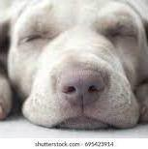
Mephibosheth bowed down and said,
What is your servant, that you should notice a dead dog like me?

Slide 15
Then the king summoned Ziba, Saul’s steward, and said to him,
“I have given your master’s grandson everything that belonged to Saul and his family.

Slide 16
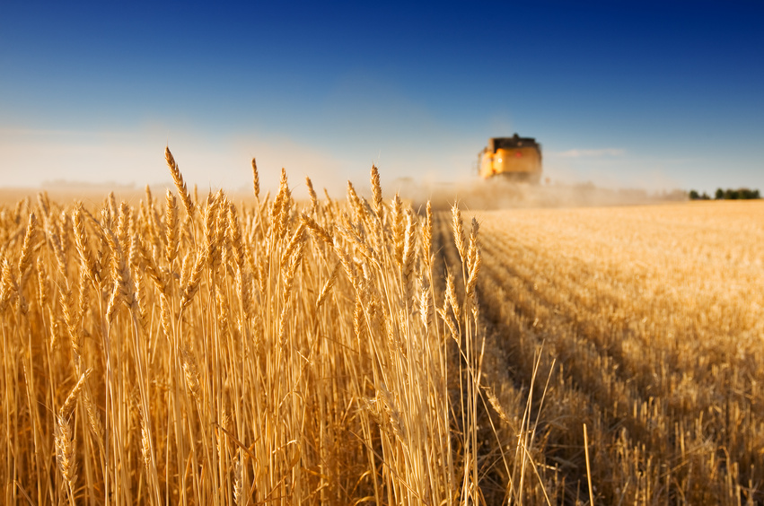
You and your sons and your servants are to farm the land for him and bring in the crops, so that your master’s grandson may be provided for.

Slide 17
And Mephibosheth, grandson of your master, will always eat at my table.”

Slide 18
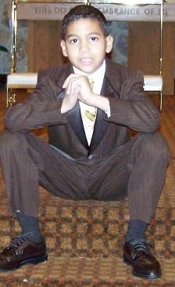
(Now Ziba had fifteen sons and twenty servants.)
x 15
x 20

Slide 19
Then Ziba said to the king, “Your servant will do whatever my lord the king commands his servant to do.”

Slide 20
So Mephibosheth ate at David’s table like one of the king’s sons.

Slide 21

Mephibosheth had a young son named Mica, and all the members of Ziba’s household were servants of Mephibosheth.

Slide 22
And Mephibosheth lived in Jerusalem, because he always ate at the king’s table; he was lame in both feet.

Slide 23
God’s Characteristics
Samuel
God cares about all people, and wants us to do the same.
God expects us to keep our promises.

Slide 24
Faith Words
Promise
Samuel
To give your word that you will or will not do something.
God always keeps his word

Slide 25
People
Jonathan
Samuel
The oldest son of King Saul

Slide 26
People
Ziba
Samuel
A servant of King Saul

Slide 27
People
Makir
Samuel
A wealthy man who took care of Mephibosheth.
He was also loyal to David

Slide 28
Places
Lo Debar
Samuel
A town east of the Jordan River and far from Jerusalem

Slide 29
Other OT Terms
Dead Dog
Samuel
An insulting way to say that someone is worthless.
Mephibosheth believed he wasn’t worthy of David’s kindness or attention

Slide 30
Did you Know?
Samuel
Mephibosheth became crippled at the age of 5. when his nurse heard that Saul and Jonathan were killed.
She was afraid for Mephibosheth. While they were running away he fell and became crippled.

