Slide 1


Psalm 23:1-3
The Lord is my shepherd,
I lack nothing.
He makes me lie down in green pastures,
he leads me beside quiet waters,
he refreshes my soul.
He guides me along the right paths
for his name’s sake.”
Hide it in your
DigSite #17
Notes:
5

Slide 2
“Obedience Brings Blessings”
DigSite #17
2 Samuel 5:6-6:19
Notes:
*

Slide 3
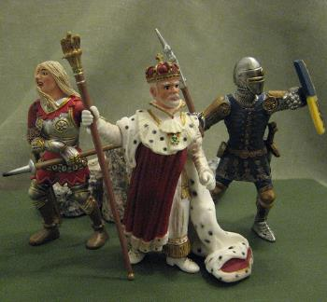
^{6a}The king and his men marched to Jerusalem to attack the Jebusites, who lived there.
Notes:
*

Slide 4


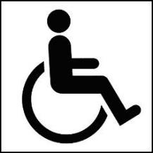
^{6b}The Jebusites said to David,
“You will not get in here; even the blind and the lame can ward you off.”
They thought,
“David cannot get in here.”
No Entrance!
Notes:
*

Slide 5
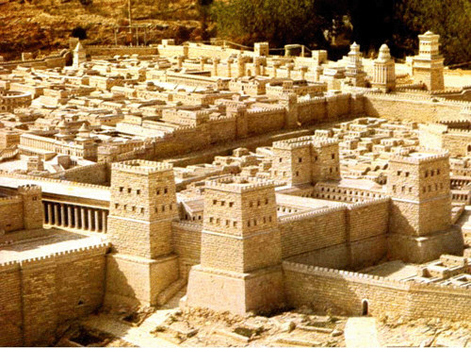
⁷Nevertheless, David captured the fortress of Zion, which is the City of David.
Notes:
*

Slide 6
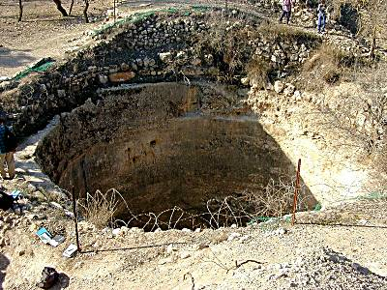
^{8a}On that day, David had said, “Anyone who conquers the Jebusites will have to use the water shaft to reach those ‘lame and blind’ who are David’s enemies.
Notes:
*

Slide 7
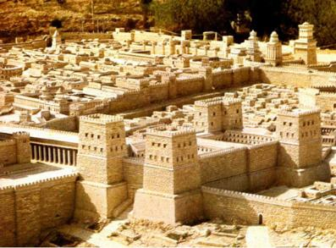

^{8b}That is why they say, “The ‘blind and lame’ will not enter the palace.
You can’t
come in!!
Notes:
*

Slide 8
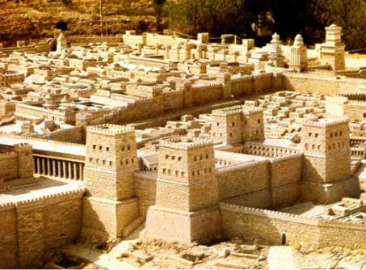
⁹David then took up residence in the fortress and called it the City of David.
He built up the area around it, from the supporting terraces inward.
Welcome to the
City of David
Notes:
*

Slide 9
¹⁰And he became more and more powerful, because the Lord God Almighty was with him.
Lord God Almighty
Notes:
*

Slide 10
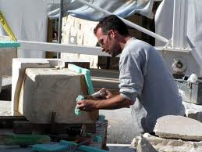
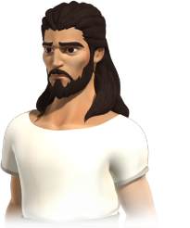
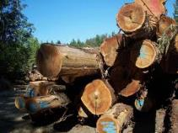
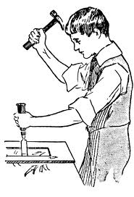
¹¹Now Hiram king of Tyre sent envoys to David, along with cedar logs and carpenters and stonemasons, and they built a palace for David.
Notes:
*

Slide 11
¹²Then David knew that the Lord had established him as *king over Israel and had exalted his kingdom for the sake of his people Israel.
King David
Notes:
*

Slide 12
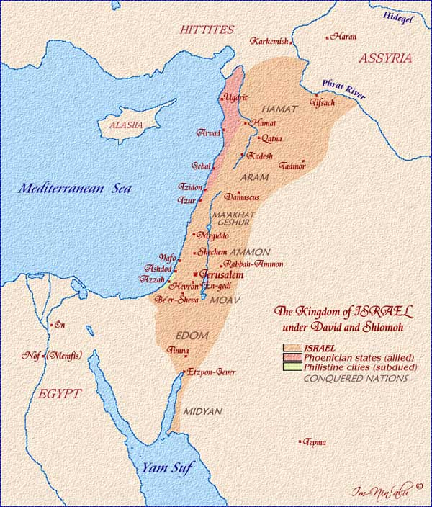
King David
Notes:
*

Slide 13
¹³After he left Hebron,
David took more concubines and wives in Jerusalem, and more sons and daughters were born to him.
Notes:
*

Slide 14
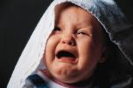
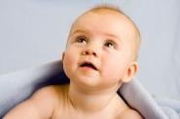

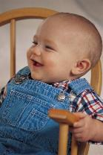


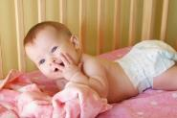

¹⁴These are the names of the children born to him there: Shammua, Shobab, Nathan, Solomon, ¹⁵Ibhar, Elishua, Nepheg, Japhia, ¹⁶Elishama, Eliada, and Eliphelet.
Nathan
Solomon
Ibhar
Shammua
Shobab
Eliphelet
Elishua
Nepheg
Eliada
Japhia
Elishama
Notes:
*

Slide 15
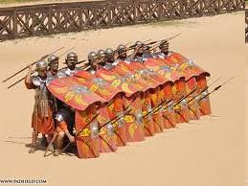
¹⁷When the Philistines heard that David had been anointed king over Israel, they went up in full force to search for him, but David heard about it and it went down to the stronghold.
Have you heard? David is king over Israel!
Notes:
*

Slide 16
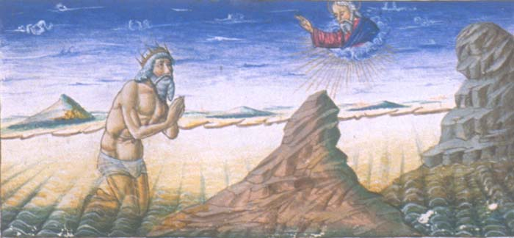
¹⁸Now the Philistines had come and spread out in the Valley of Rephaim; ¹⁹so David inquired of the Lord, “Shall I go and attack the Philistines? Will you deliver them into my hands?
Shall I go and attack the Philistine?
Notes:
*

Slide 17
The Lord answered him,
“Go, for I will surely deliver the Philistines into your hands.
Go, for I will surely deliver the Philistines
into your hands.
Notes:
*

Slide 18
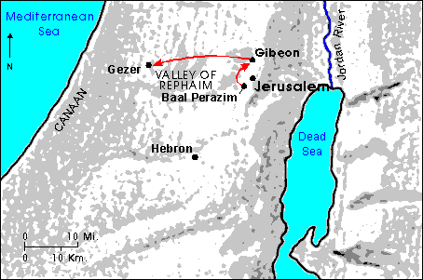
^{20a}So David went to Baal Perazim, and there he defeated them.
Notes:
*

Slide 19
^{20b}He said, “As waters break out, the Lord has broken out against my enemies before me.”
So that place was called Baal Perazim.
Notes:
*

Slide 20
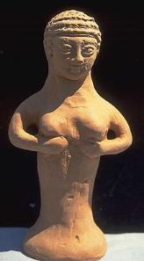
²¹The Philistines abandoned their idols there, and David and his men carried them off.
Notes:
*

Slide 21
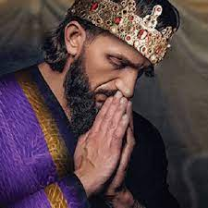
²²Once more the Philistines came up and spread out in the Valley of Rephaim;
²³so David inquired of the Lord, and he answered,
Notes:
*

Slide 22
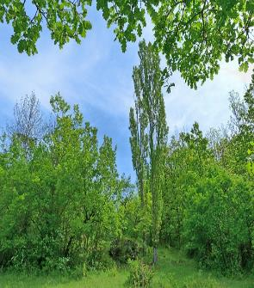

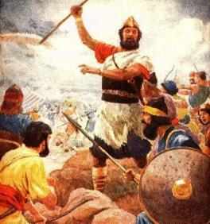
“Do not go straight up, but circle around behind them and attack them in front of the poplar trees.
Notes:
*

Slide 23

²⁴As soon as you hear the sound of marching in the tops of the poplar trees, move quickly, because that will mean the Lord has gone out in front of you to strike the Philistine army.
Notes:
*

Slide 24
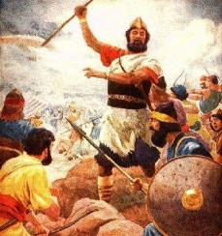
²⁵So David did as the Lord commanded him, and he struck down the Philistines all the way from Gibeon to Gezer.
Gibeon
Gezer
Notes:
*

Slide 25
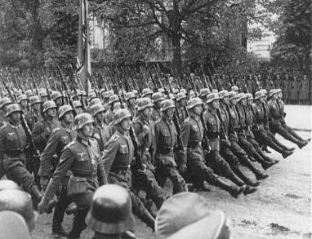
¹David again brought together all the able young men of Israel - thirty thousand.
30,000
Notes:
*

Slide 26
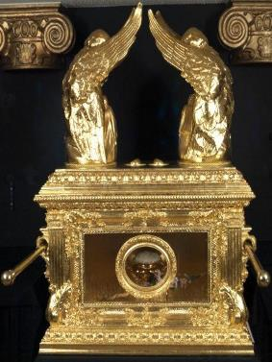
²He and all his men went to Baalah in Judah to bring up from there the ark of God, which is called by the Name, the name of the Lord Almighty, who is enthroned between the cherubim that are on the ark.
Notes:
*

Slide 27


³They set the ark of God on a new cart and brought it from the house of Abinadab, which was on the hill.
Notes:
*

Slide 28
Uzzah and Ahio, sons of Abinadab, were guiding the new cart
⁴with the ark of God on it, and Ahio was walking in front of it.
Notes:
*

Slide 29
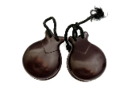

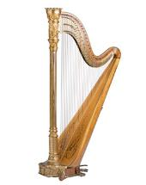

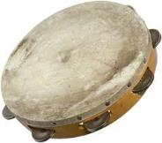
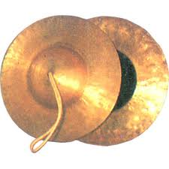
⁵David and all Israel were celebrating with all their might before the Lord, with castanets, harps, lyres, timbrels, sistrums, and cymbals.
Notes:
*

Slide 30
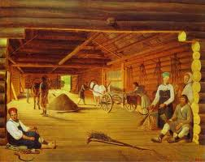
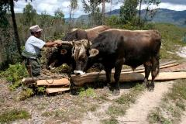
⁶When they came to the threshing floor of Nakon, Uzzah reached out and took hold of the ark of God, because the oxen stumbled.
Notes:
*

Slide 31
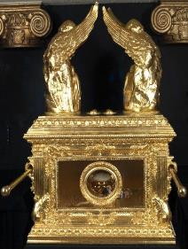
⁷The Lord’s anger burned against Uzzah because of his irreverent act; therefore God struck him down and he died there beside the ark of God.
Notes:
*

Slide 32
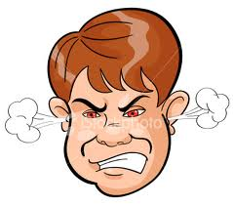
⁸Then David was angry because the Lord’s wrath had broken out against Uzzah, and to this day that place is called Perez Uzzah.
Perez Uzzah
Notes:
*

Slide 33
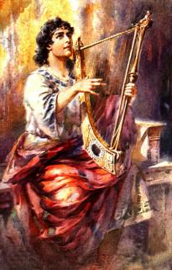
⁹David was afraid of the Lord that day and said,
“How can the ark of the Lord ever come to me?”
Notes:
*

Slide 34
¹⁰He was not willing to take down the ark of the Lord to be with him in the City of David. Instead, he took it aside to the house of Obed-Edom the Gittite.
House of Obed-Edom the Gittite
Notes:
*

Slide 35
¹¹The ark of the Lord remained in the house of Obed-Edom the Gittite for 3 months, and the Lord blessed him and his entire household.
House of Obed-Edom the Gittite
Notes:
*

Slide 36

¹²Now King David was told,
“The Lord has blessed the household of Obed-Edom and everything he has, because of the ark of God.”
City of David
Notes:
*

Slide 37
So David went to bring up the ark of God from the house of Obed-Edom to the City of David with rejoicing.
City of David
Notes:
*

Slide 38
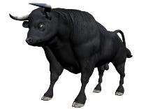
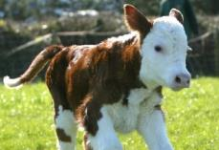
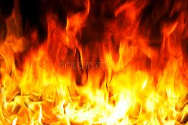
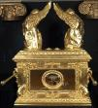
¹³When those who were carrying the ark of the Lord had taken six steps, he sacrificed a bull and a fattened calf.
6
Notes:
*

Slide 39
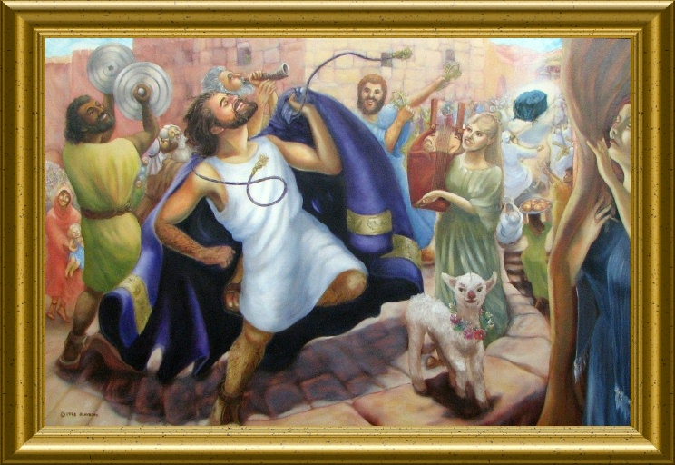
¹⁴Wearing a linen ephod, David was dancing before the Lord with all his might,
Notes:
*

Slide 40
¹⁵while he and all Israel were bringing up the ark of the Lord with shouts and sounds of trumpets.
Notes:
*

Slide 41

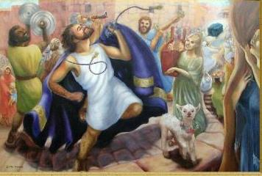
¹⁶As the ark of the Lord was entering the city of David, Michal daughter of Saul watched from a window.
Notes:
*

Slide 42

she despised him in her heart.
Notes:
*

Slide 43

¹⁷They brought the ark of the Lord and set it in its place
Notes:
*

Slide 44
inside the tent that David had pitched for it,
Notes:
*

Slide 45
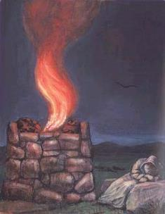
and David sacrificed burnt offerings and fellowship offerings before the Lord.
Notes:
*

Slide 46
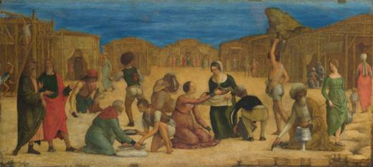
¹⁸After he had finished sacrificing the burnt offerings and fellowship offerings, he blessed the people in the name of the Lord Almighty.
Blessings
Notes:
*

Slide 47








¹⁹Then he gave a loaf of bread, a cake of dates and a cake of raisins to each person in the whole crowd of Israelites,
both men and women.
And all the people went to their homes.
Notes:
*

