Slide 1

Nahum 1:7
The Lord is good,
a refuge
in times of trouble.
He cares for those who trust in him.
Hide it in your
DigSite #13
Notes:
5

Slide 2
Trouble at Nob
I Samuel 21:1-9,
22:6-23,
23:14-18

Slide 3
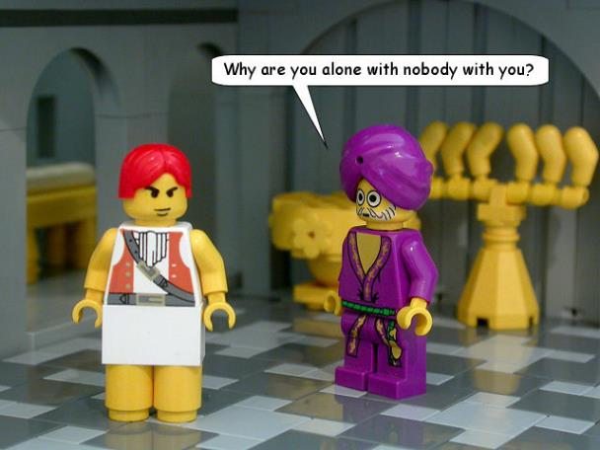
David went to Nob, to Ahimelek the priest. Ahimelek trembled when he met him,
and asked.
"Why are you alone?

Slide 4
David went to Nob, to Ahimelek the priest. Ahimelek trembled when he met him,
and asked.
Why is no one with you?"

Slide 5
David answered Ahimelek the priest,
"The king sent me on a mission and said to me, 'No one is to know anything about the mission I am sending you on.'

Slide 6
As for my men, I have told them to meet me at a certain place.
Now then, what do you have on hand? Give me five loaves of bread,
or whatever you can find."

Slide 7

But the priest answered David, "I don't have any ordinary bread on hand;
however, there is some consecrated bread here—provided the men have kept themselves from women."

Slide 8
David replied, "Indeed women have been kept from us, as usual whenever I set out.

Slide 9
The men's bodies are holy even on missions
that are not holy.
How much more so today!"

Slide 10
So the priest gave him the consecrated bread, since there was no bread there except the bread of the Presence that had been removed from before the LORD and replaced by hot bread on the day it was taken away.

Slide 11
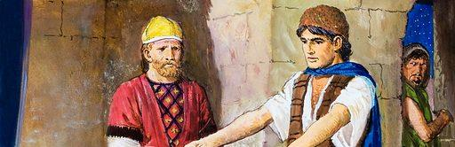
Now one of Saul's servants was there that day, detained before the LORD;
he was Doeg the Edomite, Saul's chief shepherd.
D

Slide 12
David asked Ahimelek,
"Don't you have a spear or a sword here?
D

Slide 13
I haven't brought my sword or any other weapon,
because the king's mission was urgent."
D

Slide 14
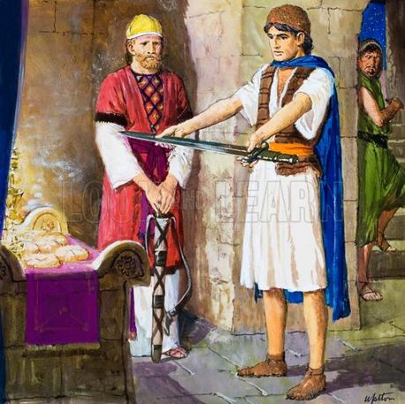
The priest replied,
"The sword of Goliath the Philistine,
whom you killed in the Valley of Elah, is here;
it is wrapped in a cloth behind the ephod.

Slide 15
If you want it, take it; there is no sword here but that one."

Slide 16
David said, "There is none like it;
give it to me.

Slide 17
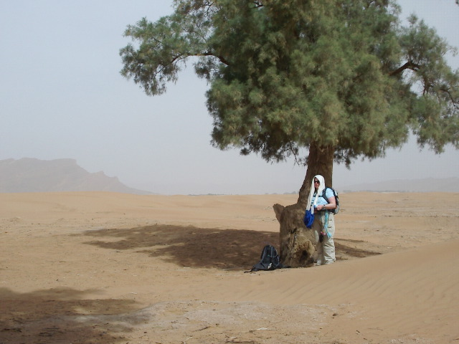
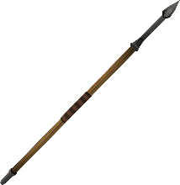
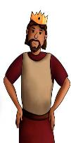
Now Saul heard that David and his men had been discovered.
And Saul was seated, spear in hand,
under the tamarisk tree
on the hill at Gibeah,
with all his officials standing at his side.
  G I B E A H
D

Slide 18
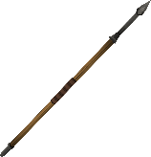
He said to them, "Listen, men of Benjamin! Will the son of Jesse give all of you fields and vineyards?
  G I B E A H
D

Slide 19
Will he make all of you commanders of thousands and commanders of hundreds?
  G I B E A H
D

Slide 20
Is that why you have all conspired against me?
No one tells me when my son makes a covenant with the son of Jesse
  G I B E A H
D

Slide 21
None of you is concerned about me or tells me that my son has incited my servant to lie in wait for me, as he does today."
  G I B E A H
D

Slide 22

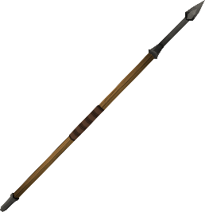
But Doeg the Edomite, who was standing with Saul's officials, said,
"I saw the son of Jesse come to Ahimelek son of Ahitub at Nob. Ahimelek inquired of the LORD for him; he also gave him provisions and the sword of Goliath the Philistine."
D

Slide 23
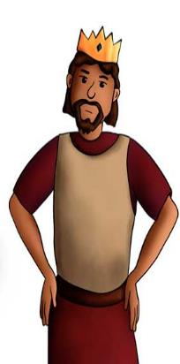
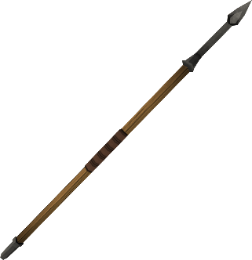
Then the king sent for the priest Ahimelek,
son of Ahitub, and ALL the men of his family,
who were the priests at Nob,
and they all came to the king.
Saul said, "Listen now, son of Ahitub."
"Yes, my lord," he answered.

Slide 24


Saul said to him, "Why have you conspired against me, you and the son of Jesse, giving him bread and a sword and inquiring of God for him, so that he has rebelled against me and lies in wait for me, as he does today?"

Slide 25

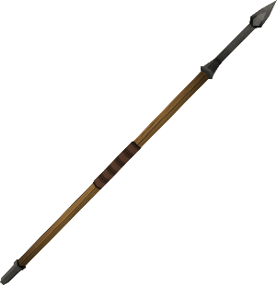
Ahimelek answered the king,
"Who of all your servants is as loyal as David, the king's son-in-law, captain of your bodyguard and highly respected in your household?

Slide 26

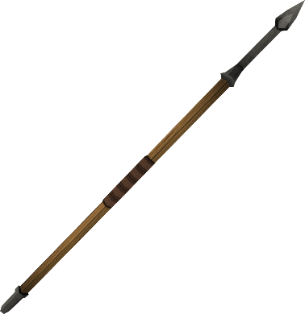
Was that day the first time I inquired of God for him? Of course not!

Slide 27

Let not the king accuse your servant or any of his father's family, for your servant knows nothing at all about this whole affair."

Slide 28

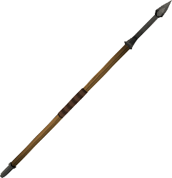
But the king said, "You will surely die, Ahimelek, you and your whole family."
Then the king ordered the guards at his side:
"Turn and kill the priests of the LORD, because they too have sided with David.

Slide 29
They knew he was fleeing, yet they did not tell me."

Slide 30
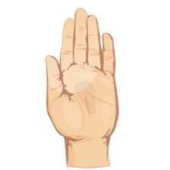
But the king's officials were unwilling to raise a hand to strike the priests of the LORD.

Slide 31


The king then ordered Doeg,
"You turn and strike down the priests."
D

Slide 32
So Doeg the Edomite turned
and struck them down.
That day he killed 85 men
who wore the linen ephod.

Slide 33
He also put to the sword Nob,
the town of the priests,
with its men and women,
its children and infants, and its cattle,
donkeys and sheep.

Slide 34
But one son of Ahimelek son of Ahitub, named Abiathar, escaped and fled to join David. He told David that Saul had killed the priests of the LORD.

Slide 35
Then David said to Abiathar: "That day,
when Doeg the Edomite was there,
I knew he would be sure to tell Saul.
I am responsible for the death of your whole family

Slide 36
Stay with me; don't be afraid; the man who wants to kill you is trying to kill me too*.
You will be safe with me."

Slide 37

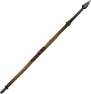
David stayed in the wilderness strongholds and in the hills of the Desert of Ziph.
Day after day Saul searched for him,
but God did not give David
into his hands.
Desert of
Z I P H

Slide 38
While David was at *Horesh
in the Desert of Ziph,
he learned that Saul had come out
to take his life.
Desert of
Z I P H
Horesh

Slide 39
And Saul's son Jonathan went to David
at Horesh and helped him
find strength in God.
Desert of
Z I P H
Horesh

Slide 40
"Don't be afraid," he said. "My father Saul will not lay a hand on you.
Desert of
Z I P H
Horesh

Slide 41
You will be king over Israel,
and I will be second to you.
Even my father Saul knows this."
Horesh
Desert of
Z I P H

Slide 42
Desert of
Z I P H
Horesh
The two of them made a covenant
before the LORD.

Slide 43
Desert of
Z I P H
Horesh
Then Jonathan went home,
but David remained at Horesh.

