Slide 1

1 Timothy 4:12
Don’t let anyone look down
on you because you are young,
but set an example for the believers
in speech, in conduct, in love,
in faith and in purity.
Hide it in your
DigSite #11
Notes:
5

Slide 2
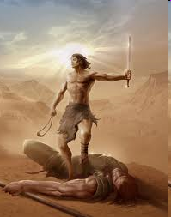
A Sling, a Stone and a Sword
1 Samuel 17:1-51
God uses His faithful people
to accomplish impossible tasks.
Dig Site # 11

Slide 3
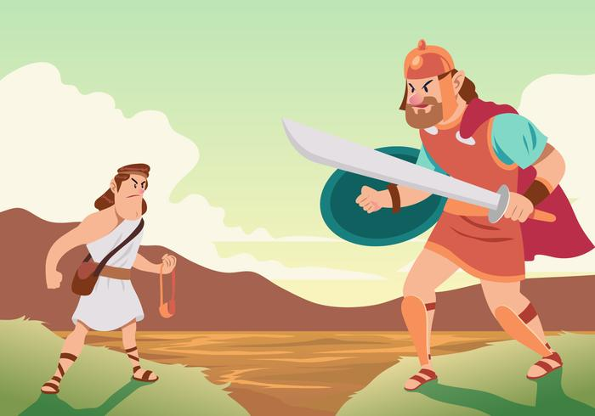
The Story of
David and Goliath
1 Samuel 17:1-51

Slide 4
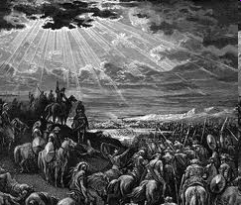
Now the Philistines gathered their forces for war and assembled at Sokoh in Judah.
Sokoh in Judah

Slide 5
They (the Philistines)pitched camp at Ephes Dammim,
between Sokoh and Azekah.
Sokoh
Azekah
Ephes Dammim

Slide 6
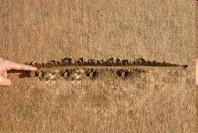
Saul and the Israelites assembled
and camped in the Valley of Elah
and drew up their battle line
to meet the Philistines.
Valley of Elah

Slide 7
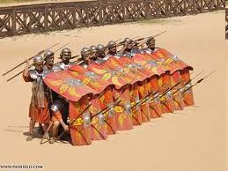
The Philistines occupied
one hill
and the Israelites another,
with the valley between them.

Slide 8
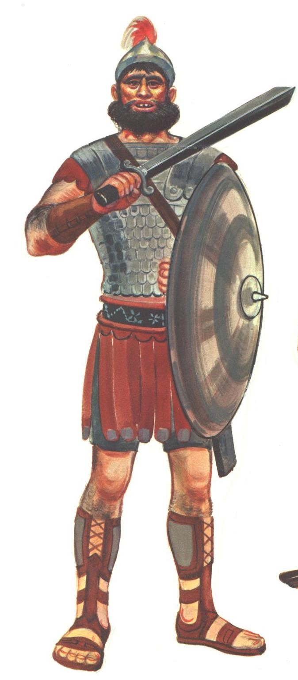
A champion named Goliath,
who was from Gath,
came out of the
Philistine camp.

Slide 9
His height was
six cubits and a span
(about 9 feet, 9 inches).
He had a bronze helmet
on his head
and
wore a coat of scale armor
of bronze weighing 5000 shekels (about 125 pounds);

Slide 10
on his legs he wore bronze greaves, and a bronze javelin was slung on his back.
His spear shaft was like a weaver’s rod, and its iron point weighed 600 shekels (about 15 pounds).

Slide 11
His shield bearer went ahead of him.

Slide 12

Goliath stood and shouted to the ranks of Israel,
“Why do you come out and line up for battle?
Am I not a Philistine, and are you not the servants of Saul?

Slide 13
Choose a man and have him come down to me.
If he is able to fight and kill me, we will become your subjects;
but if I overcome him and kill him, you will become our subjects and serve us.”

Slide 14
Then the Philistine said,
“This day I defy the armies of Israel!
Give me a man and let us fight each other.”

Slide 15
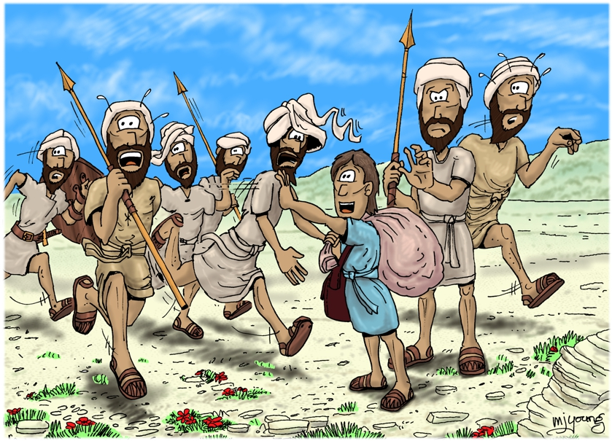
On hearing the Philistine’s words, Saul and all the Israelites were dismayed and terrified.

Slide 16
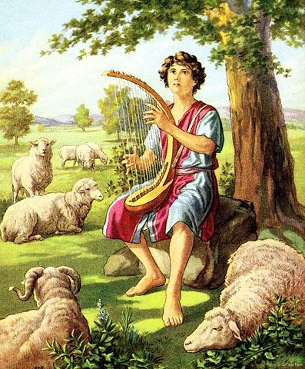
Now David was the son of an Ephrathite named Jesse, who was from Bethlehem in Judah.

Slide 17
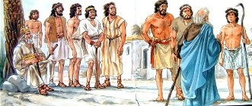
Jesse had eight sons, and in Saul’s time he was very old.

Slide 18
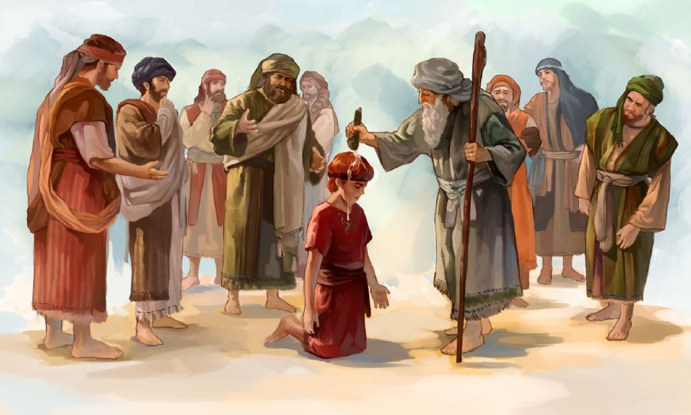
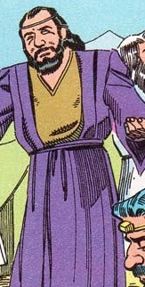
Jesse’s three oldest sons had followed Saul to the war:
The firstborn was Eliab; the second, Abinadab; and the third,
Shammah.

Slide 19
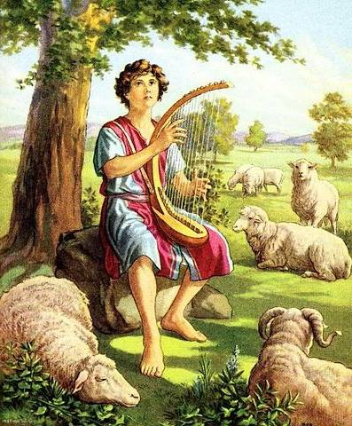
David was the youngest. The three oldest followed Saul, but David went back and forth from Saul to tend his father’s sheep at Bethlehem.

Slide 20
For forty days the Philistine came forward every morning and evening and took his stand.

Slide 21
Now Jesse said to his son David,
“Take this ephah (about 36 pounds) of roasted grain and these ten loaves of bread for your brothers and hurry to their camp.

Slide 22
Take along these ten cheeses to the commander of their unit.
See how your brothers are and bring back some assurance from them.

Slide 23
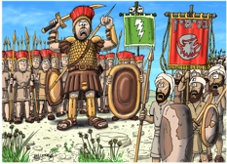
They are with Saul and all the men of Israel in the Valley of Elah, fighting against the Philistines.”

Slide 24
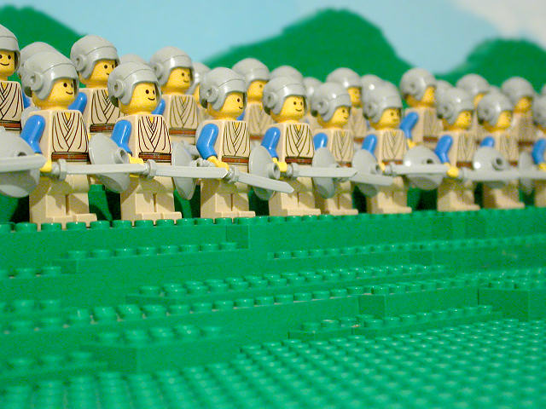
Early in the morning David left the flock in the care of a shepherd, loaded up and set out, as Jesse had directed. He reached the camp as the army was going out to its battle positions, shouting the war cry.

Slide 25

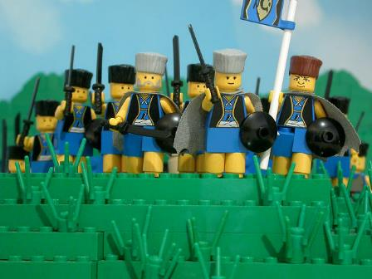
Israel and the Philistines were drawing up their lines facing each other.

Slide 26
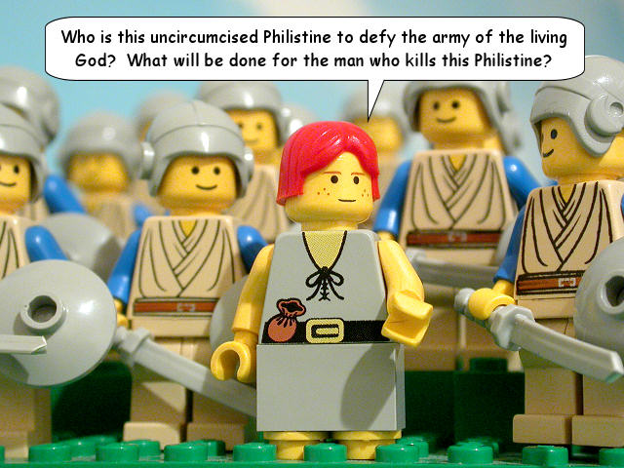
David left his things with the keeper of supplies, ran to the battle lines and asked his brothers how they were.

Slide 27
Hey, bros! How are you?

Slide 28
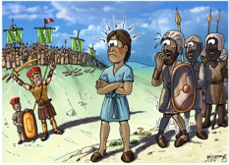
As he was talking with them,
Goliath, the Philistine champion from Gath, stepped out from his lines and shouted his usual defiance, and David heard it.

Slide 29
Whenever the Israelites saw the man, they all fled from him in great fear.
Now the Israelites had been saying,
“Do you see how this man keeps coming out?
He comes out to defy Israel.

Slide 30
The king will give great wealth to the man who kills him.
He will also give him his daughter in marriage and will exempt his family from taxes in Israel.”

Slide 31
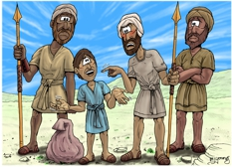
David asked the men standing near him,
What will be done for the man who kills this Philistine and removes this disgrace from Israel?
Who is this uncircumcised Philistine that he should defy the armies of the living God?

Slide 32


They repeated to him what they had been saying and told him,
This is what will be done for the man who kills him.

Slide 33
When Eliab, David’s oldest brother, heard him speaking with the men, he burned with anger at him and asked,

Slide 34
Why have you come down here?
And with whom did you leave those few sheep in the wilderness?

Slide 35
I know how conceited you
are and how wicked
your heart is;
you came down only
to watch the battle.

Slide 36
Now
what have I done?
said David

Slide 37
Can’t I even speak?

Slide 38
He then turned away to someone else and brought up the same matter,
and the men answered him as before.

Slide 39
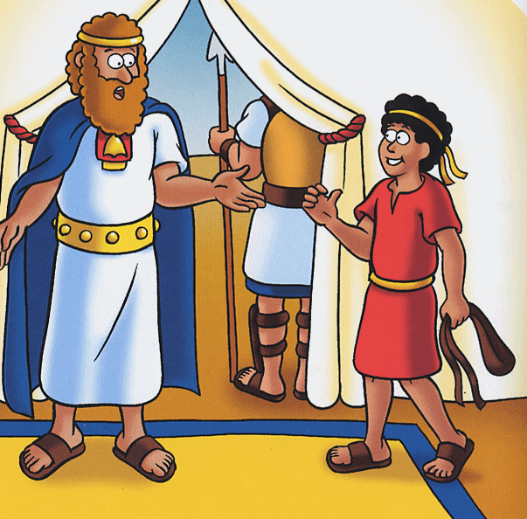
What David said was overheard and reported to Saul, and Saul sent for him.

Slide 40
David said to Saul, “Let no one lose heart on account of this Philistine; your servant will go and fight him.”

Slide 41
Saul replied, “You are not able to go out against this Philistine and fight him; you are only a young man, and he has been a warrior from his youth.”

Slide 42
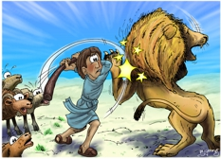
But David said to Saul,
“Your servant has been keeping his father’s sheep. When a lion or a bear came and carried off a sheep from the flock,

Slide 43
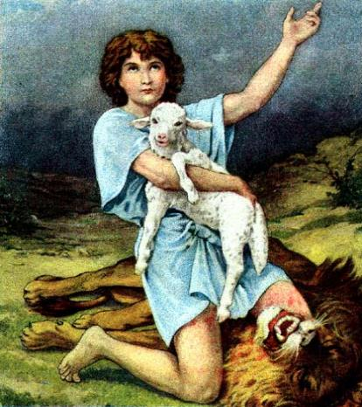
I went after it, struck it and rescued the sheep from its mouth.
When it turned on me,
I seized it by its hair, struck it and killed it.

Slide 44
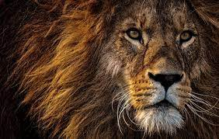
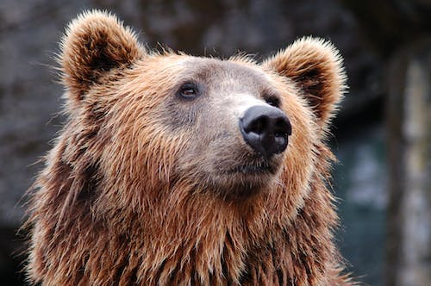
Your servant has killed both the lion and the bear; this uncircumcised Philistine will be like one of them, because he has defied the armies of the living God.

Slide 45
The Lord who rescued me from the paw of the lion and the paw of the bear will rescue me from the hand of this Philistine.”

Slide 46
Saul said to David,
“Go,
and the Lord be
with you.”

Slide 47
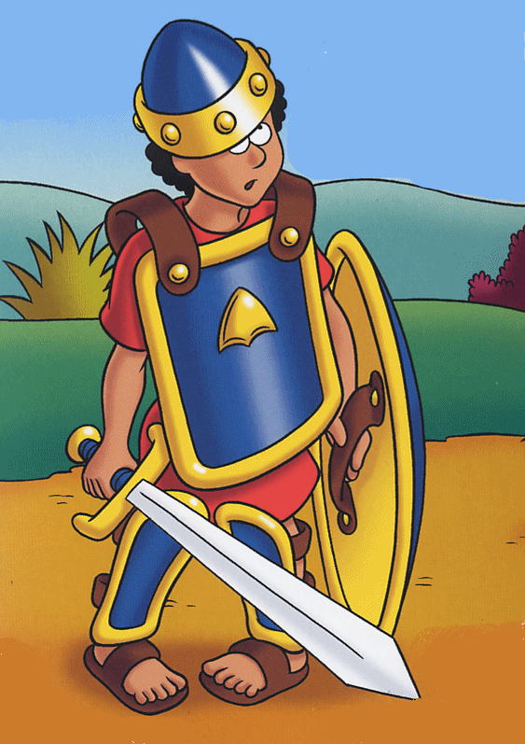
Then Saul dressed David in his own tunic. He put a coat of armor on him and a bronze helmet on his head.

Slide 48
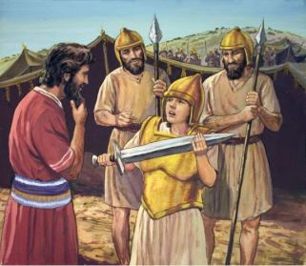
David fastened on his sword over the tunic and tried walking around, because he was not used to them.

Slide 49
“I cannot go in these,” he said to Saul, “because I am not used to them.”
So he took them off.

Slide 50
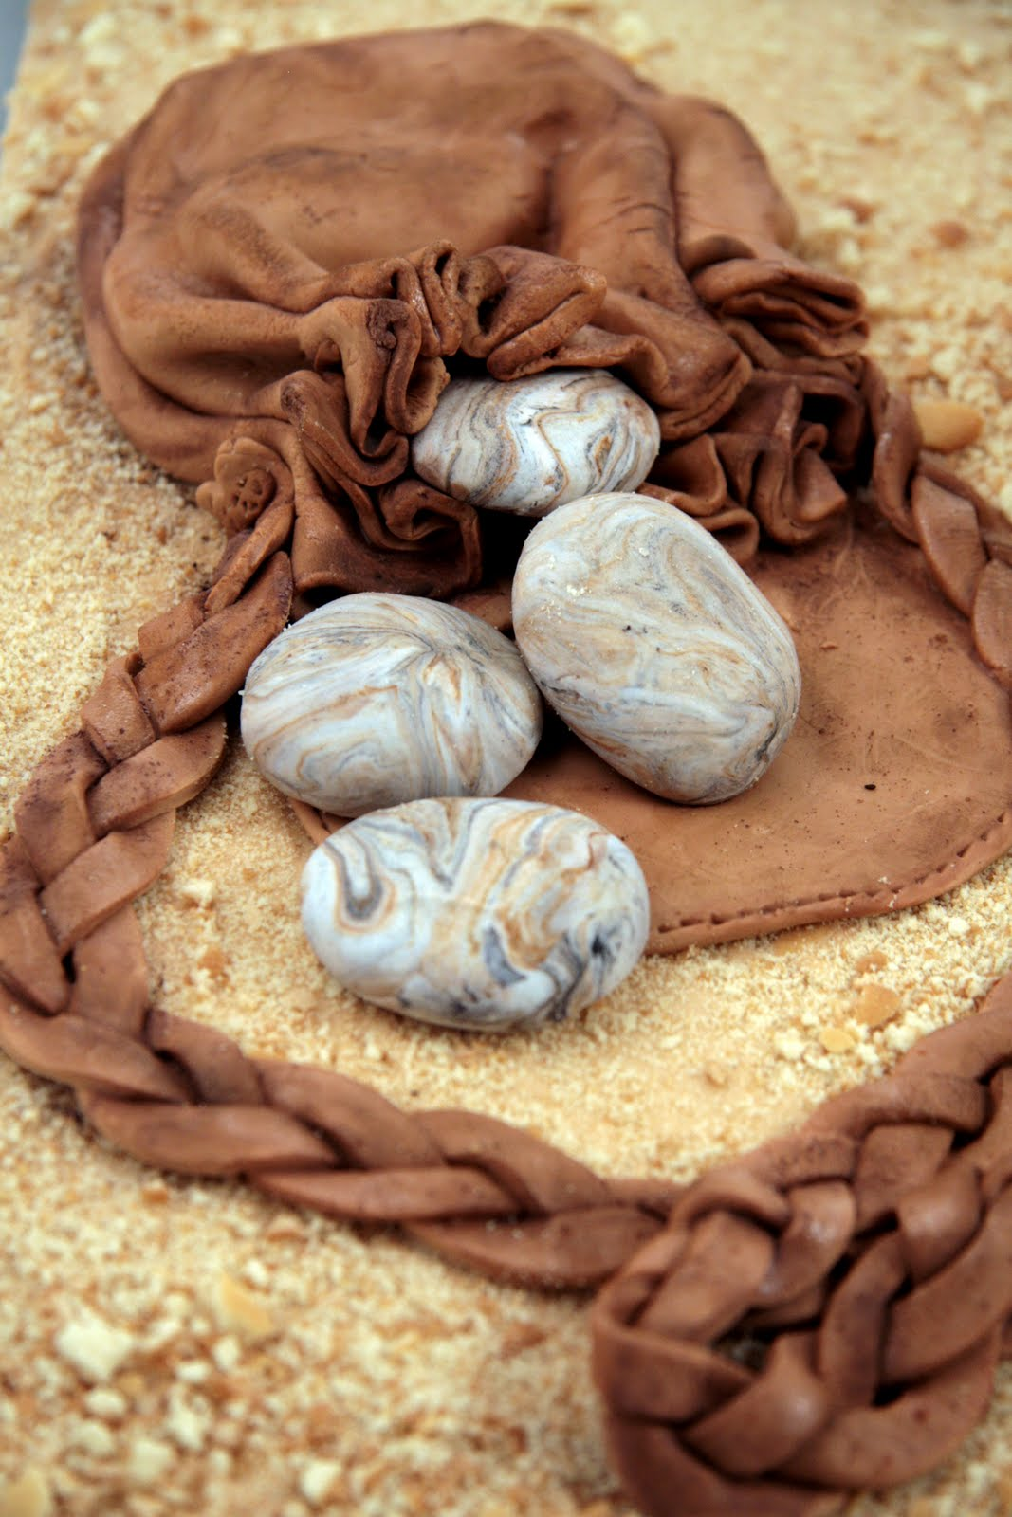
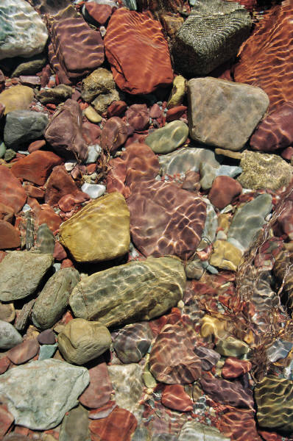
Then he took his staff in his hand, chose five smooth stones from the stream, put them in the pouch of his shepherd’s bag and, with his sling in his hand, approached the Philistine.

Slide 51
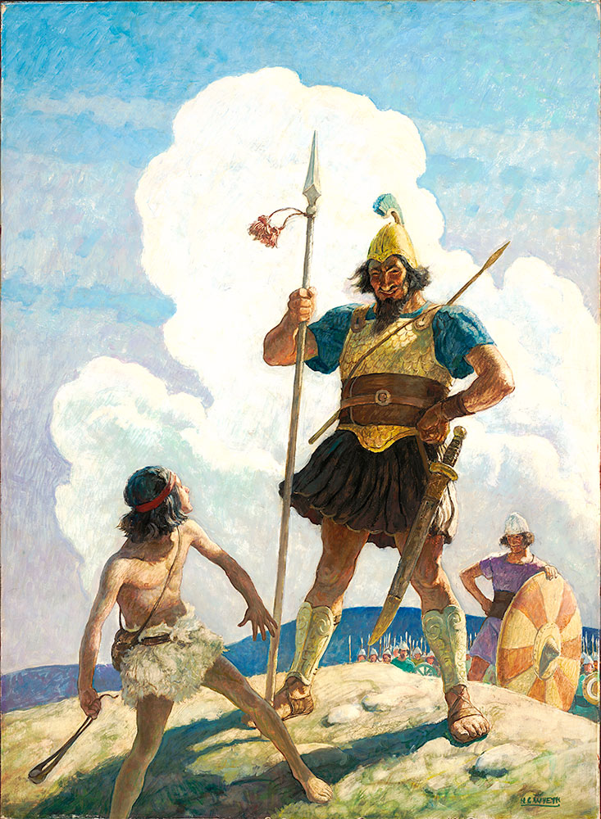
Meanwhile, the Philistine, with his shield bearer in front of him, kept coming closer to David.

Slide 52
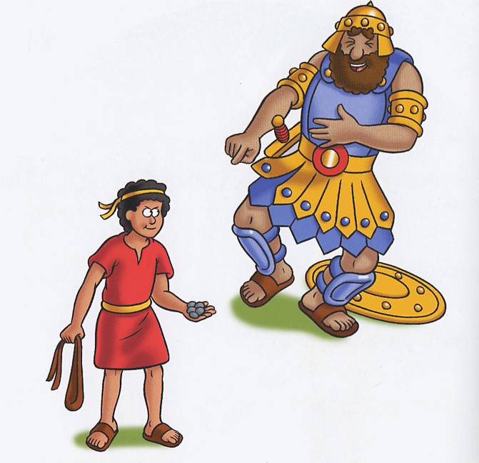
He looked David over and saw that he was little more than a boy, glowing with health and handsome, and he despised him.

Slide 53
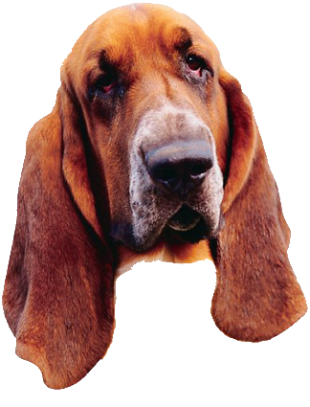
He said to David,
“Am I a dog, that you come at me with sticks?”
And the Philistine cursed David by his gods.

Slide 54
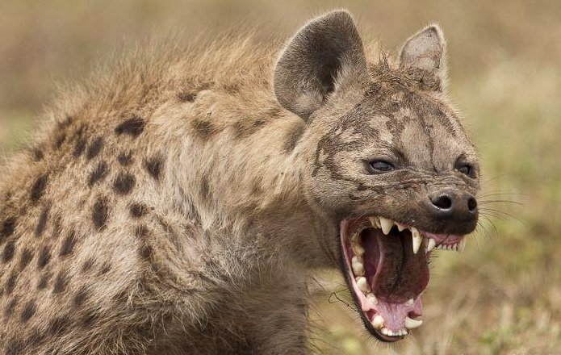
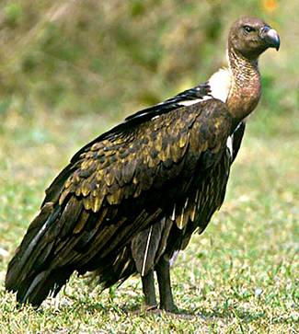
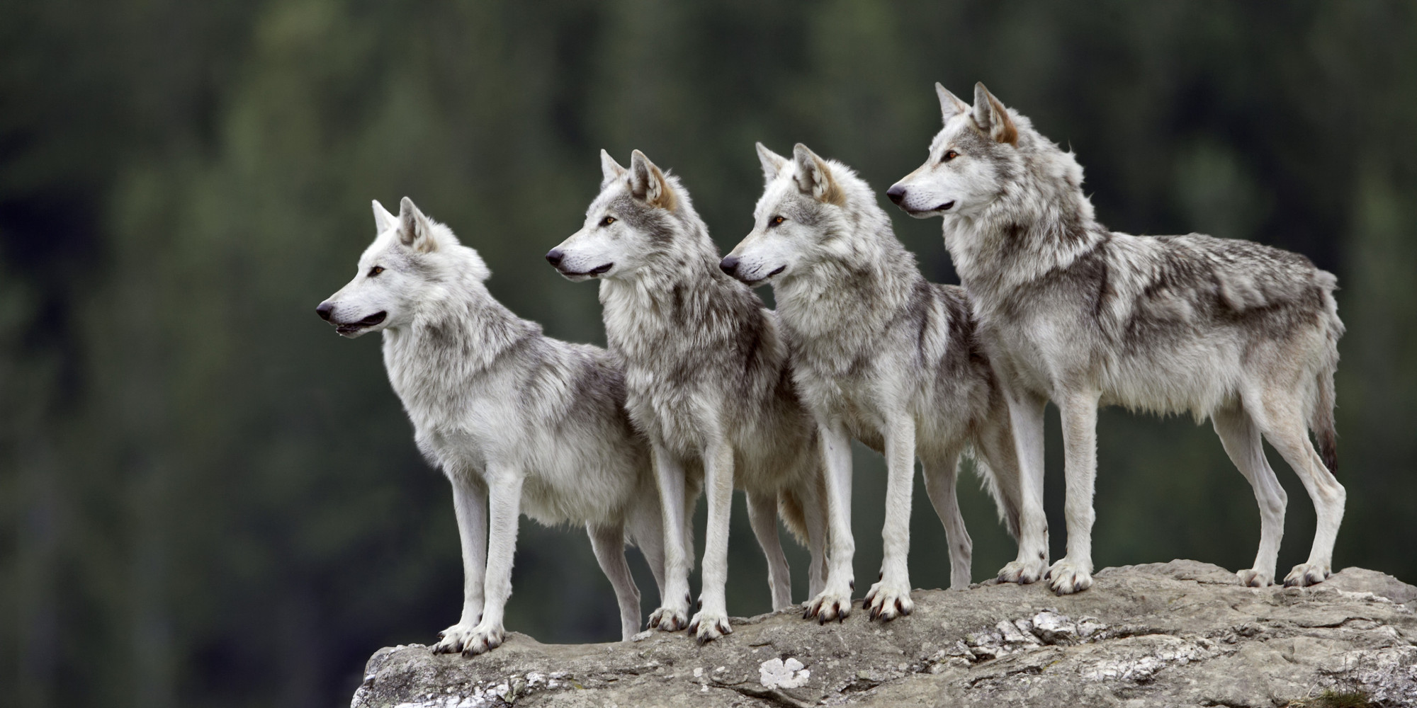
“Come here,” he said, “and I’ll give your flesh to the birds and the wild animals!”

Slide 55
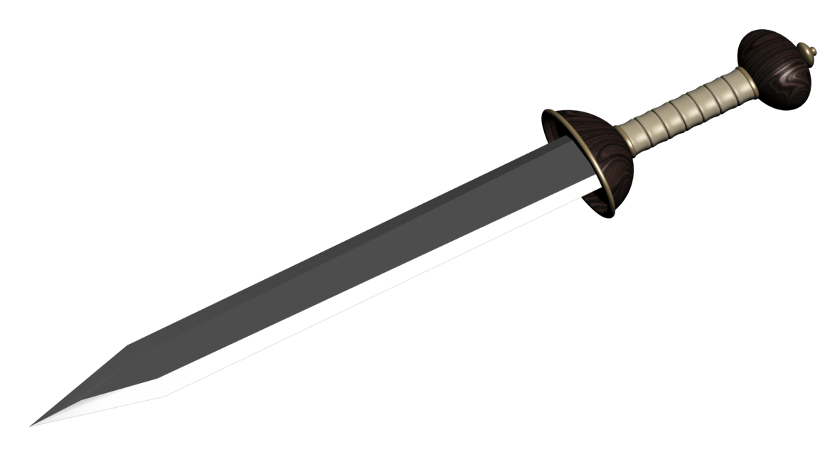
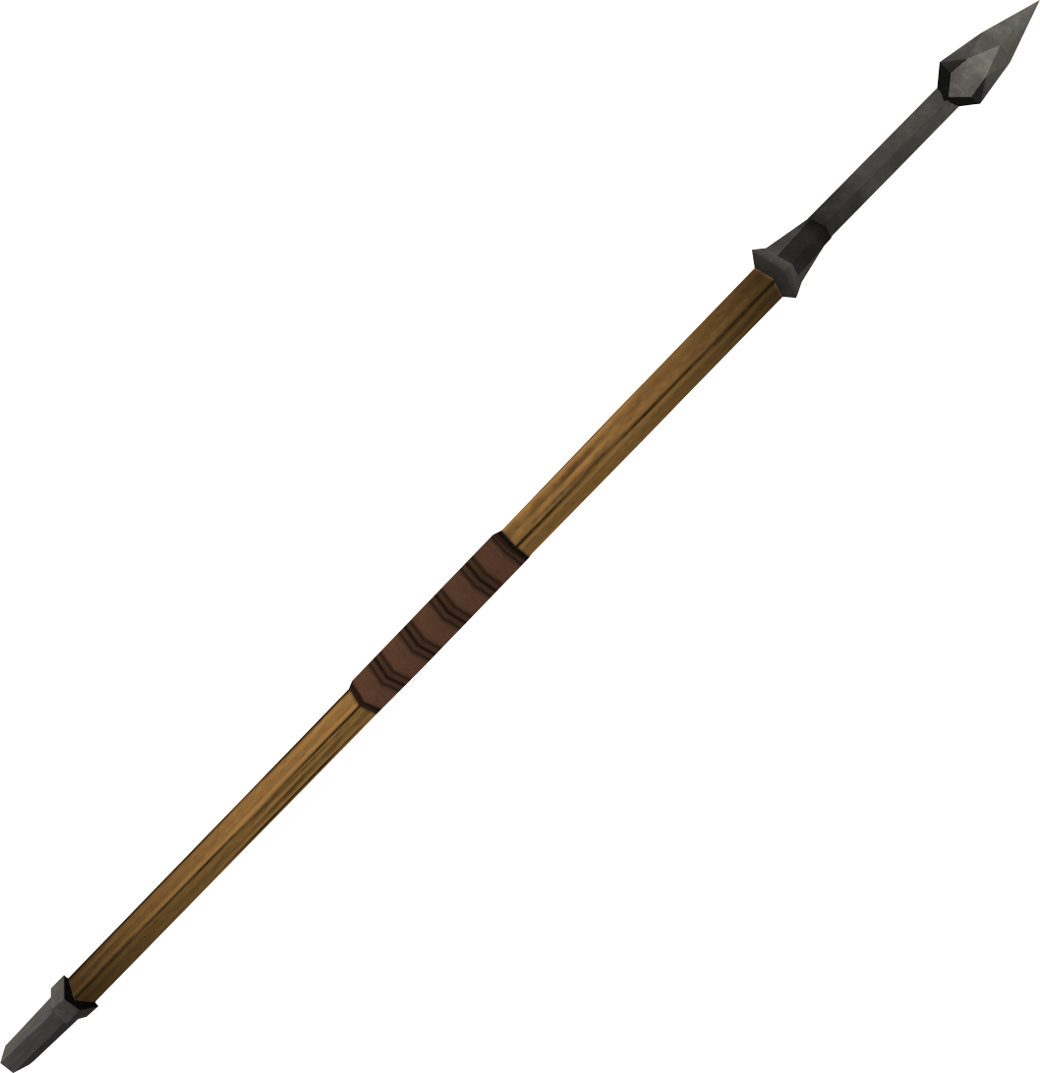
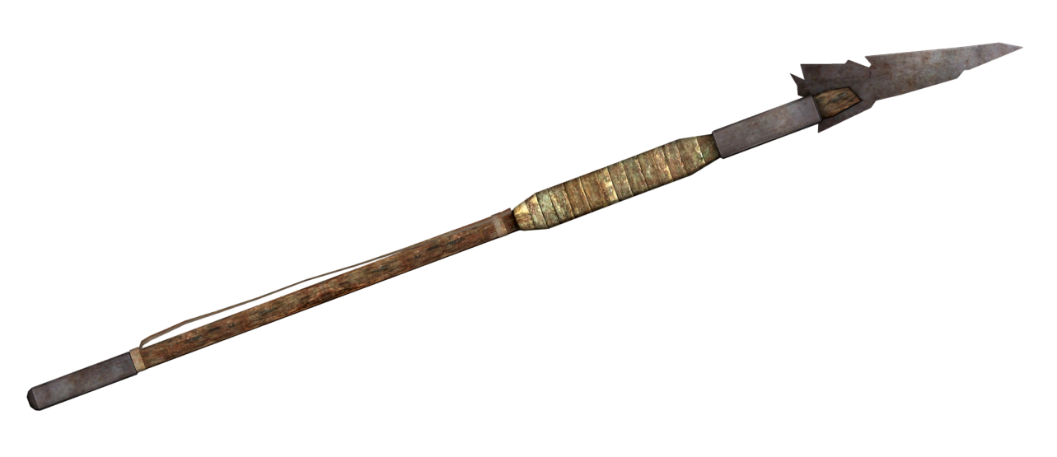
David said to the Philistine,
“You come against me with sword and spear and javelin, but I come against you in the name of the Lord Almighty, the God of the armies of Israel, whom you have defied.

Slide 56
This day the Lord will deliver you into my hands, and I’ll strike you down and cut off your head.

Slide 57
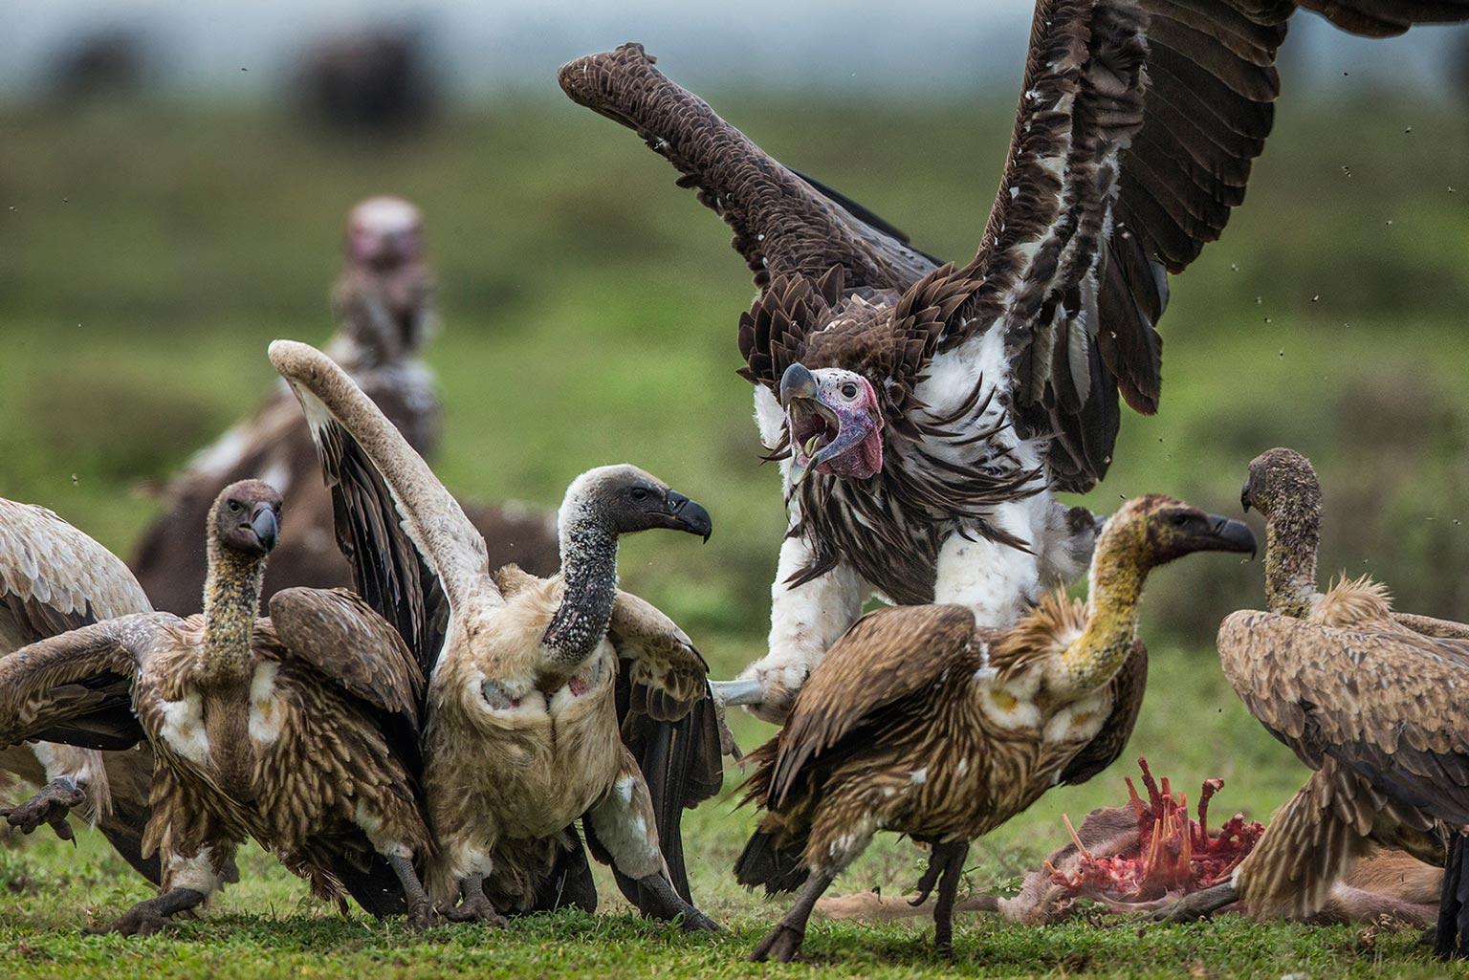
This very day I will give the carcasses of the Philistine army to the birds and the wild animals, and the whole world will know that there is a God in Israel.

Slide 58
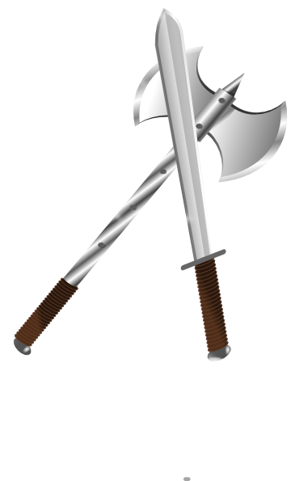
All those gathered here will know that it is not by sword or spear that the Lord saves;
X

Slide 59
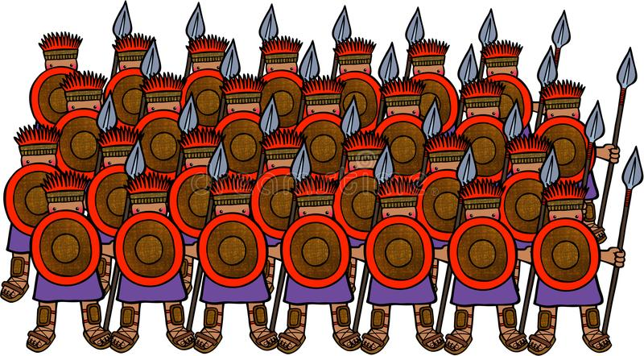
for the battle is the Lord’s, and he will give all of you

Slide 60

for the battle is the Lord’s, and he will give all of you into our hands.”

Slide 61
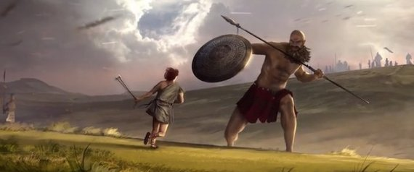
As the Philistine moved closer to attack him,
David ran quickly toward the battle line to meet him.

Slide 62
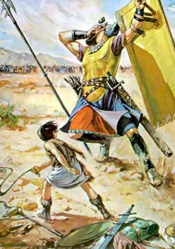
Reaching into his bag and taking out a stone, he slung it and struck the Philistine on the forehead.

Slide 63
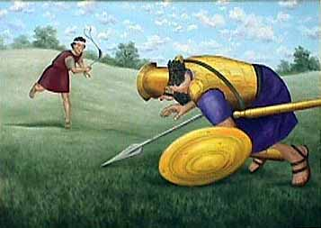
The stone sank into his forehead, and he fell facedown on the ground.

Slide 64
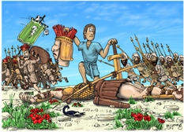
So David triumphed over the Philistine with a sling and a stone; without a sword in his hand he struck down the Philistine and killed him.

Slide 65
David ran and stood over him.
He took hold of the Philistine’s sword and drew it from the sheath.
After he killed him, he cut off his head with the sword.

Slide 66
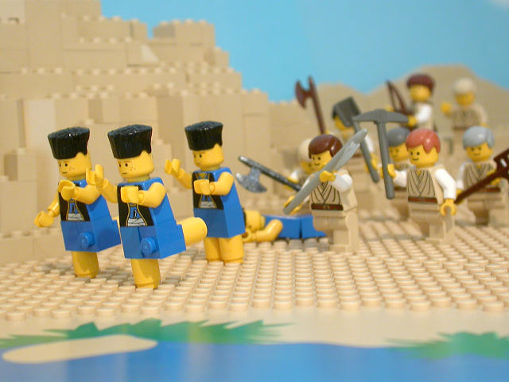
When the Philistines saw that their hero was dead, they turned and ran.

